Slide 1
人教精通版三年级上册
Unit3 Look at my nose.
WWW.PPT818.COM

Slide 2
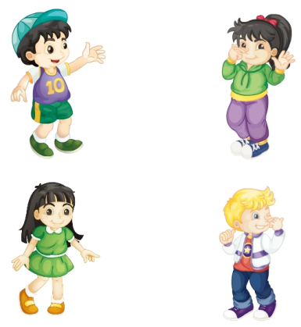
Review
Let’s chant and do
Nose, nose.
Touch your nose.
Nose, nose.
Touch my nose.
Eye, eye.
Touch your eye.
Eye, eye.
Touch my eye.

Slide 3
Lead-in
Let’s sing

Slide 4
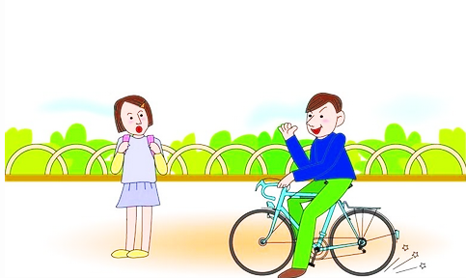
Presentation
Look and guess
Hello! How are you?
Fine, thank you.

Slide 5
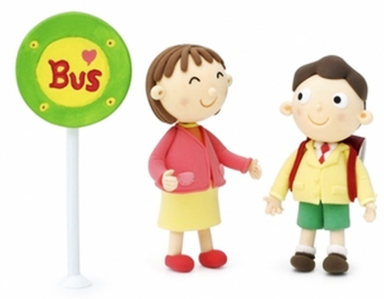
Presentation
Look and guess
Hello! How are you?
I’m fine. Thank you.

Slide 6
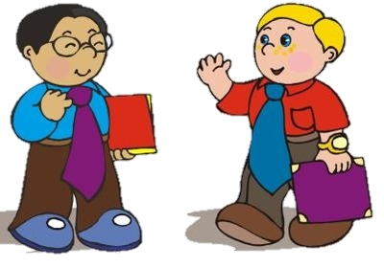
Presentation
Look and guess
Hi! How are you?
I am fine. Thank you.

Slide 7
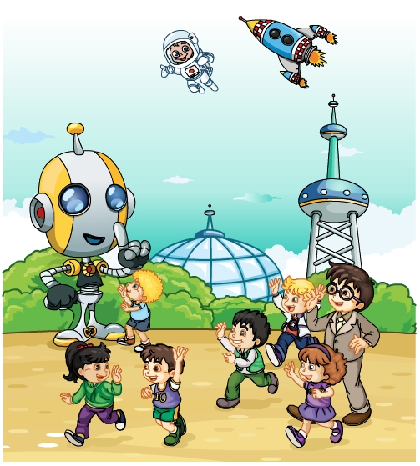
Presentation
Look and say
猜一猜他们都说了什么呢？

Slide 8
Presentation
Listen and imitate
Hello! How are you?
Look at my face!
Fine, thank you.
Oh, he has a big face.

Slide 9
Show time
三人一组，练习对话并表演，其他同学评价。
 | 模仿录音中的语音语调，有感情地朗读。
 | 可以脱离课本，适当改动其中部分，语音地道。
 | 适当添加内容，意思完整，有创新，表演生动。
Good
Great
Excellent

Slide 10
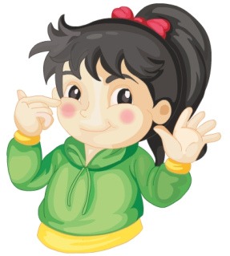
Presentation
Just learn
face
Li Yan has a ____ face.
small

Slide 11
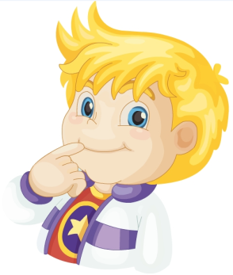
Presentation
Just learn
mouth
Peter has a ___ mouth.
big

Slide 12
Practice
Game1
What’s missing?

Slide 13
Practice
Game2
I say you do
Face, face, touch your face…

Slide 14
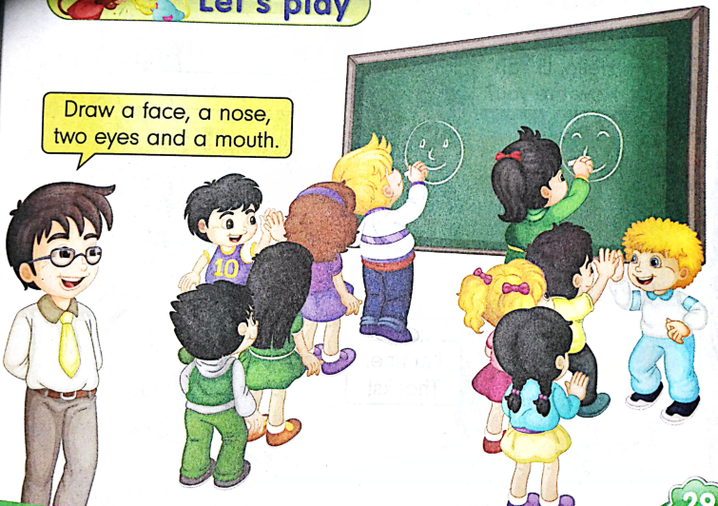
Practice
活动
Let’s play
Draw a face, a nose, two eyes and a mouth.

Slide 15
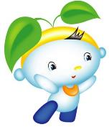
Summary
本课学习的身体部位类的单词有:
face
mouth

Slide 16
Summary
如何问候别人并做相关回答呢？
—Hello! How are you?
—Fine, thank you.

Slide 17
Homework
1. 跟读Just talk部分的课文录音，并注意语音、语调。
2.画一个你喜欢的动物头像，并用英文标出它的各个身体部位。
3. 预习Lesson15。
Close

