Slide 1
Unit 4 Did You Have a Nice Trip?
Lesson 19 Li Ming Comes Home
WWW.PPT818.COM

Slide 2
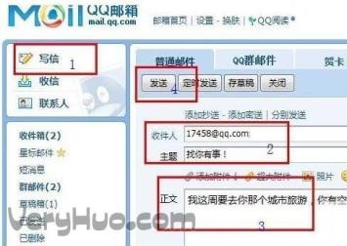
Warming up
Game 根据图片，猜单词。
email
write

Slide 3
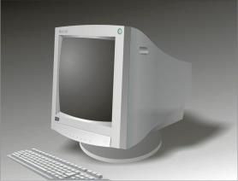
Game 根据图片，猜单词。
computer
wrong

Slide 4
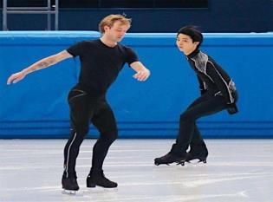
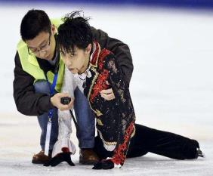
Leading in
Describe
注意用一般过去时哦！

Slide 5
Presentation
观察本课图片，回答问题。
01
Did Li Ming have a nice trip?
02
How did Li Ming go to Wangfujing?

Slide 6
观察本课图片，回答问题。
03
What did Li Ming do in Wangfujing？
04
How many shops did Li Ming look in?

Slide 7
观察本课图片，回答问题。
05
What did Li Ming buy for his father?
How did Li Ming go to the park yesterday?
06

Slide 8
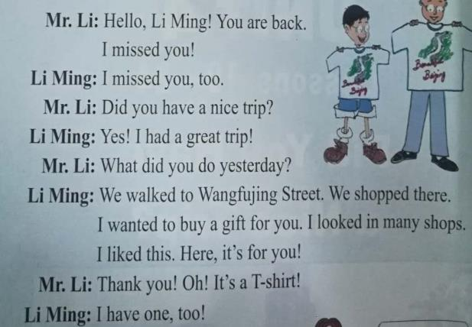
Follow the tape

Slide 9
Consolidation and extension
Show the pictures of yourselves last week.
I went to the zoo with my mum.

Slide 10
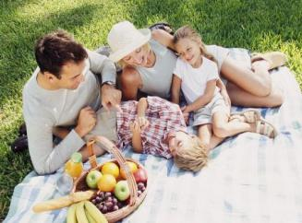
I went to the supermarket with my parents.
We had a picnic last weekend.

Slide 11
Summing up
重点句型：
I missed you!
Did you have a nice trip?
What did you do yesterday?

Slide 12
重点句型：
We walked to Wangfujing Street.
I wanted to buy a gift for you.
I looked in many shops.
I walked to the park yesterday.

Slide 13
过去式的构成和用法：
“主语＋动词过去式＋其他”或者“主语＋was/were＋其他”。一般过去时表示过去某个时间发生的动作或存在的状态，也可表示过去经常或反复发生的动作。

Slide 14
Evaluation
内容 | 学生A | 学生B | 学生C | 学生D
积极发言
乐于合作
完成情况

Slide 15
Homework
完成Let’s do it!中的练习。
用英语讲述今天所见的事情（使用课本句式）。

Slide 16
答案：
1.
Li Ming had fun in Beijing. He missed his father very much. He wanted to buy a gift for his father. He walked to Wangfujing Street and looked in many shops. He liked a T-shirt and bought it for his father.

Slide 17
答案：
2.
I called my friend.
What did you do yesterday? I helped my parents.
What did you do yesterday? I watched TV.
What did you do yesterday? I washed the clothes.

Slide 18
Thanks !

