Slide 1
Unit 8
Have you read Treasure Island yet?
Section A 1a—2d
WWW.PPT818.COM

Slide 2
Survey
Do a survey
What kind of books do you like best?

Slide 3
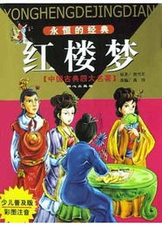
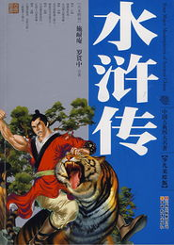
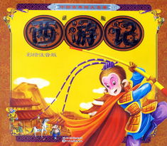
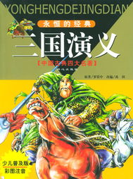
Dream of the Red Chamber
Journey to the West.
The Story by the Water Margin
I have already read Journey to the West.
The Romance of the Three Kingdoms

Slide 4
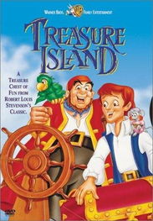
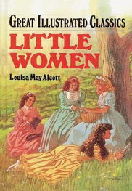
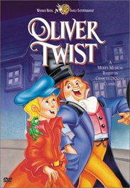
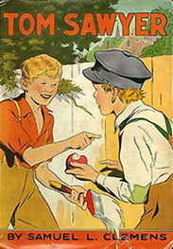
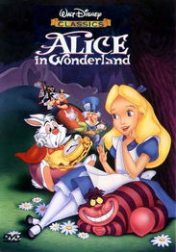
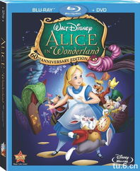
Have you heard of these books?

Slide 5
语法点拨
含义
标志词
现在完成时
结构
过去分词变化

Slide 6
现在完成时的含义
表示过去发生的动作或事情对现在的影响或者是结果
过去发生的动作一直延续到现在，而且有可能继续延续下去

Slide 7
结构
have / has + 动词的过去分词

Slide 8
过去分词
规则变化同过去式的规则
1. 一般动词在结尾加“ed”。work—worked—worked
2. 以“e”结尾的动词，在词尾加“d”。live—lived—lived
3. 以“辅音字母+y”结尾的动词， 将“y”变i，再加“ed”。study—studied—studied
4. 重读闭音节结尾，末尾只有一个辅音字母，先双写这一辅音字母，再加“ed”。stop—stopped—stopped
不规则变化需要熟读记忆

Slide 9
标志词
现在完成时常与以下副词搭配使用：already, yet, just, ever, never…

Slide 10
Listening
Title | Name | Have they read it? | What do they think of it?
Book 1: | Nick
 | Judy
Book 2: | Sandy
 | Alan
Book 3: | Kate
 | Harry

Slide 11
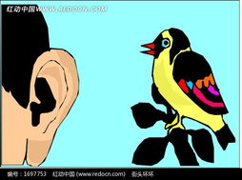
Game Time
A: Have you read … yet?
B: Yes, I have. /No, I haven’t.

Slide 12
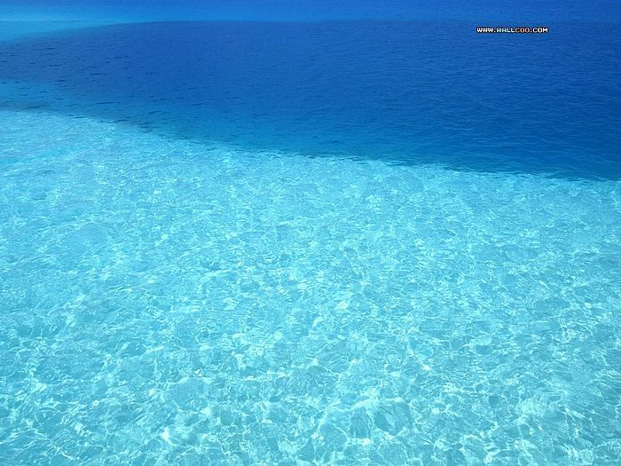
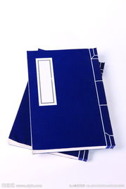
Make conversation
Have you read...yet?
Yes, I have. / No, I haven’t.
What’s it like?
It’s…

Slide 13
Summary
Have you read Little Women yet?
I have already read Little Women .
I haven’t read Little Women yet.
请总结出already, yet 用于的句子类型
already 用在肯定句中
yet 用在疑问句和否定句中

Slide 14
Listen and circle
Treasure Island Mark / Tina
Oliver Twist Mark /Tina
Robinson Crusoe Mark /Tina
Tom Sawyer Mark /Tina

Slide 15
Listen and Write Tor F
Oliver Twist is about a boy who went out to sea and found an island full of treasure.
Robinson Crusoe is a classic.
Tina thinks that Treasure Island is a fantastic book.
Tom Sawyer is about a boy who lives in the United Kingdom.

Slide 16
Role-play

Slide 17
句子接龙

Slide 18
Summary
Have you （读）Little Women yet？
Yes, I .
No, I .
Tina heard of these books?
No, she .
I have （已经）finished reading it.

Slide 19
Homework
我校本月是“热爱读书月”，请你调查你的三位好朋友曾经读过什么好书，然后写一份报告做为本月的调查结果。
Friend’s name
Book

