Slide 1
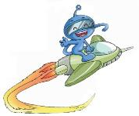
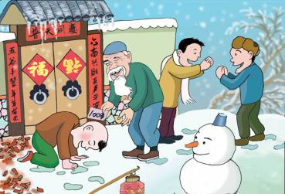
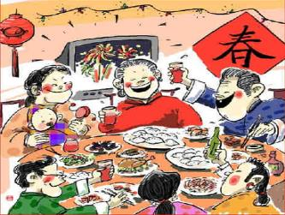
Unit 11
I like the Spring Festival best
WWW.PPT818.COM

Slide 2
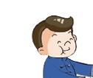
Let’s guess .
Jiamin had a wondeful Spring Festival last year. Guess what he did during the last Spring Festival?
Maybe he ...

Slide 3
Let’s talk .
A: What did Jiamin do during the last Spring Festival?
B: He ...
clean(cleaned)the house
have(had) a big dinner with his family
get (got)some lucky money from his parents

Slide 4
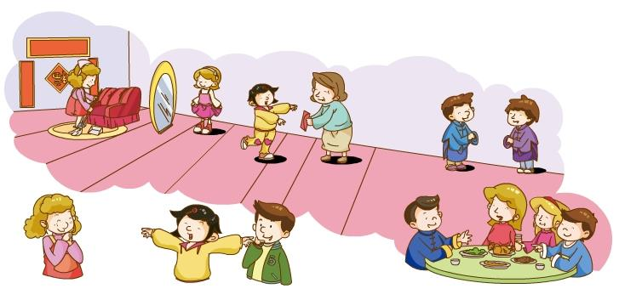
Let’s read .
Xiaoling likes the Spring Festival best. And she had a good time during the last Spring Festival. What did she do?

Slide 5
Last year, I had a very good time during the Spring Festival.
Before the festival, we bought some new clothes and cleaned our house to make everything new and fresh. My Dad’s friend gave us a small orange tree. We put it in the living room and the room looked wonderful.
On the New Year’s Eve, in the morning, we went to a flower fair. There were many people there. Everyone looked happy. We bought some flowers and took a lot of photos. In the afternoon, we had a big dinner together. There was chicken, pork, goose, fish, vegetables and soup. We enjoyed the food so much. After the dinner, Dad and Mum gave me some lucky money. I was excited because there was 100 yuan.
During the Spring Festival, we visited our family and wished each other a happy New Year.
I like the Spring Festival best because it is so much fun.

Slide 6
Let’s read .
Read and fill in the blanks after the model.
What did I do at the last Spring Festival?
( bought some new clothes...)
Things I did before the festival | bought some new clothes, ______________, _________________
Things I did on New Year's Eve | Morning | went to a flower fair,________,_______
 | Afternoon
 | Evening
Things I did during the festival

Slide 7
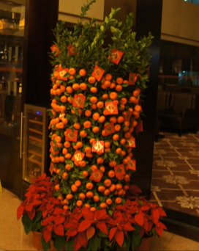
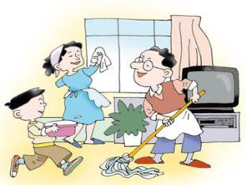
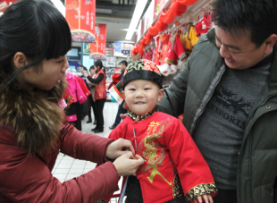
Look and Say
Things I did before the festival | We________some new clothes, We________our house. We______ the ______ tree in the living room.
bought
cleaned
put
orange

Slide 8
Look and Say
Before the festival, we ________________ and ____________to make everything new and fresh. We put ____________ in the living room.
bought some new clothes
cleaned our house
a small orange tree

Slide 9
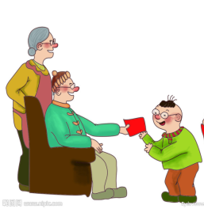
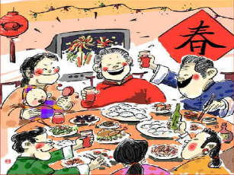
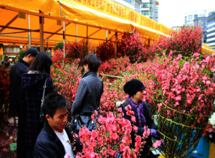
Look and Say
went
Things I did on New Year's Eve | Morning | We _______ to a flower fair. We _______ some flowers and_____ a lot of photos.
 | Afternoon | We ______ a big dinner together
 | Evening | Dad and Mum _____ me some lucky money.
bought
took
had
gave

Slide 10
Look and Say
On the New Year’s Eve, in the morning, we _______________. We _______________________. In the afternoon, we _______________________. After the dinner, Dad and Mum __________________.
went to a flower fair
bought some flowers and took a lot of photos
we had a big dinner together
gave me some lucky money

Slide 11
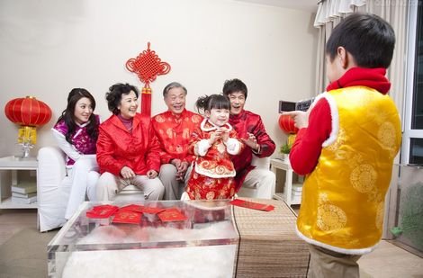
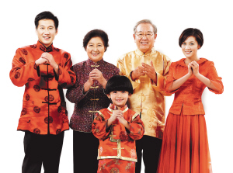
Look and Say
Things I did during the festival | We ____________________________.
visited our family and
wished each other a happy New Year

Slide 12
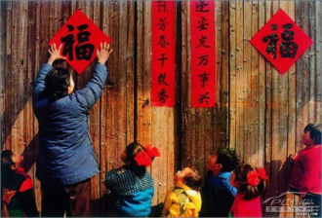
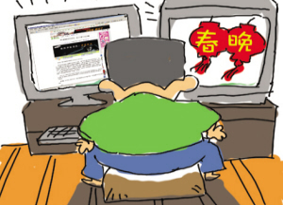
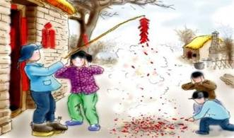
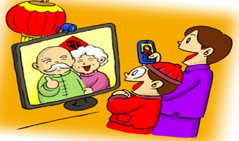
Let's talk
What did you do before the last Spring Festival?
What did you do during the last Spring Festival?
Where did you go during the Last Spring Festival?
Did you have a good time the last Spring Festival? Why?

Slide 13
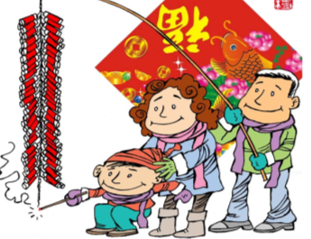
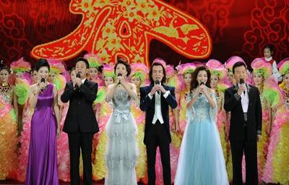
Let's know more.
During the Spring Festival, we also ...
decorate (decorated) the house
set (set)off firecrackers
watch (watched) the CCTV Spring Festival Gala

Slide 14
Let’s talk in groups.
Before the festival
What ... do?
Where ... go?
During the festival
What...do?
Where ... go?
What ... eat?
MY Last Spring Festival
Did you get lucky money/gifts?
How much lucky money did you get?
How did you use the money?
Feelings
Do you like the festival ?
Why or why not?

Slide 15
Let's write.
I had a very good time during the last Spring Festival.
__________________________________________________________________________________________________________________________________________________________________________________________________________________________________________________________________________________________________________________________________________________________________________________________________________________________________________________
写完以后请读一读：
文章通顺吗？
动词形式正确吗？

Slide 16
Let's share.
读一读你同伴的文章，你会给他/她几颗星？
文章通顺
动词形式（过去式）错误不超过3处
其他单词拼写错误不超过3处
Tips: 给出评价标准让学生同桌互评，
同时也是同伴互学的机会。

Slide 17
Homework
根据同伴的评价修改自己的写作。

