Slide 1
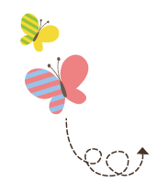
Module 8
WY 六年级下册
Unit 1 Why do you have cups on your heads?
WWW.PPT818.COM

Slide 2
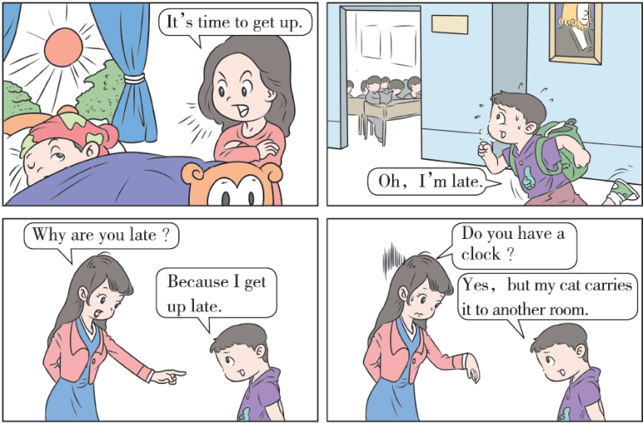

Slide 3
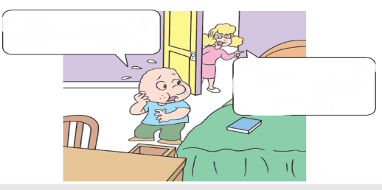
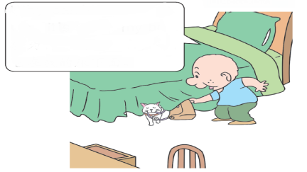
1. Look，listen and say.
Where’s my bag?
Why can’t I see it?
Oh, it’s under my bed.
I put it on your
bed.

Slide 4
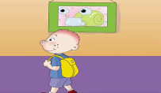
2. Listen and read.
Sam came into the classroom and saw some friends there. They had cups on their heads.“ Why do you have cups on your heads? Why are you laughing?” he asked.
Daming told him the story. They planned to play a baseball game. Amy asked Lingling to bring some caps for the game. But Lingling brought some cups. They all laughed. Then they put the cups on their heads and laughed more.
Sam smiled. “It’s easy to make mistakes with English words,” he said. “I make lots of mistakes with Chinese words too. Now look what’s in my bag!” Sam opened his bag. There were baseball caps! “Hooray!” everyone shouted. They put the caps on. Then they went to the playground and played baseball together.

Slide 5
Why do you have cups on your heads?
你们为什么把杯子戴在头上？
知识点 1
这是用于询问对方做某事的原因的句型。句中的Why是特殊疑问词，意为“为什么”，用来询问原因、理由。Have...on 意为“戴着……”。
用法：
Why do/does + 主语+ 动词原形+ 其他？
句型结构：
例句：
Why does he sing this song?他为什么唱这首歌 ？

Slide 6
cup / kʌp / n. （名词）杯子
These cups are his. 这些杯子是他的。
例句：
a cup of... 一杯……
短语：
cap 帽子
形近词：
把意思相近的单词放在一起记忆的方法。
如：cup （杯子） glass（玻璃杯）
形近词记忆法：

Slide 7
知识点 2
planned / plænd / v.（动词） （plan 的过去式） 计划
I planned to visit my aunt. 我计划去拜访我的阿姨。
例句：
短语：
plan to do... 计划做……
形近词记忆法：
plane 飞机

Slide 8
知识点 3
It’s easy to make mistakes with English
words... 英语单词很容易出错……
这个句型用来描述“做……是容易的”。
用法：
It’s easy to + 动词原形+ 其他.
句型结构：
It’s easy to make the bed. 整理床铺是容易的。
例句：

Slide 9
拓展
“It’s +形容词+ to +动词原形+其他.”是一个固定句型，表示“做……是……的。”如果要表达“做……对某人来说是……的。”要用句型“It’ s +形容词+ for +人+ to +动词原形+其他.”

Slide 10
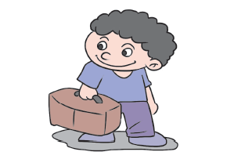
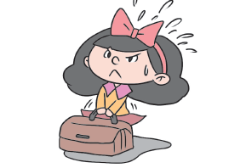
图像对比记忆法：
Its’ easy for him to
carry the bag.
Its’ hard for her to
carry the bag.

Slide 11
mistake / mɪ΄steɪk/ n. （名词）错误
Don’ t be afraid to make mistakes. 不要害怕犯错误。
例句：
make mistakes 犯错误
短语：
形近词记忆法：
mis+take（拿走）= mistake（错误）
魔法记忆：
错“拿了”（take）就犯了个“错误（mistake）。

Slide 12
with / wɪð/ prep. （介词）与……有关
The girl reads a book with Chinese.这个女孩读有关中文的书。
例句：
形近词：
wish 希望

Slide 13
拓展
多功能的with 还有很多意思，一起来总结一下：
单词 | 意义 | 例句
with | 和……在一起 | I’m walking with my mum.我正在和我的妈妈一起散步。
 | 带有；具有 | The girl with big eyes is my sister.那个长着大眼睛的女孩是我的妹妹。

Slide 14
知识点 4
said /sed/ v. ( 动词) （say 的过去式）说
The boy said “sorry” to the girl. 那个男孩对那个女孩说了声“对不起”。It’s easier said than done. 说起来容易做起来难。
例句：

Slide 15
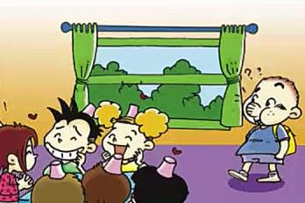
3. Listen and say.
Why do you have cups on your heads?
Why are you laughing?

Slide 16
4. Practise.
Read and write. Then ask and answer.
A: Why are you laughing？
B: Because I’m happy.
laugh
happy
A: Why are you ？
B: Because .
crying
cry
I'm sad
sad
A: ？
B: .
shout
Why are you shouting
angry
Because I'm angry
A: ？
B: .
Why are you eating
eat
Because I'm hungry
hungry

Slide 17
趣味活动：开火车。
六人一组，先准备好表示动作的图片，小组成员轮流摸卡片，用句型Why are you... ？和Because... 进行问答练习。

Slide 18
一、单项选择。
1. — ______ do you cry?
—Because my cat is lost.
A. How B. What C. Why
2. Please give her ______ tea.
A. a cup B. a cup of C. a cup with
C
B

Slide 19
3. ______ is easy for me to cook noodles.
A. It B. This C. They
4. I ______ lots of mistakes yesterday.
A. make B. take C. made
A
C
点拨：
make mistakes“犯错误”；因时间状语是yesterday，故make要用过去式。

Slide 20
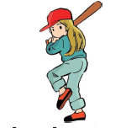
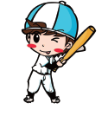
二、根据图片完成句子。
Nancy is going to on the playground..
2. My brother is a b p .
3. The boy is reading a book English.
play
aseball layer
with

Slide 21
本节课我们学习了以下知识，请同学们一定加强巩固，以便能和同学们进行灵活交流哦！
重点词汇：cup, planned, more, baseball, smile
重点短语：make mistakes, plan to do sth.
重点句式：Why do you have cups on your heads?
They planned to play a baseball game.
It’s easy to make mistakes with English words...

Slide 22
1 熟记本节课所学的句型、短语和单词，必须会听、说、读、写。
2 将Listen and read的内容朗读流利。
3 完成配套的课后作业。

Slide 23
Thank you!

