Slide 1
NSE 8B
Module 1 Feelings and impressions
Unit 2 I feel nervous when I speak Chinese.(B)
Chinese
nervous
WWW.PPT818.COM

Slide 2
Learning Goals
Knowledge
1. Identify the topic vocabulary in this lesson.
2. To say some sentences like these:
a. It was great to hear from you, and I can't wait to
meet you.
b.I'm quite tall, with short fair hair, and I wear glasses.
c.I feel nervous when I speak Chinese.
d.But I can't tell you how excited I am about going
to China!

Slide 3
Learning Goals
Ability
We students are able to understand the passage by
using reading skills and describe what others look like.

Slide 4
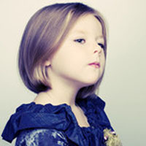
Cooperating and Exploring
Chinese
proud
nervous
C&E
C&E
E&E

Slide 5
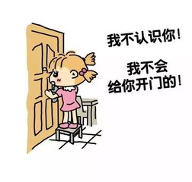
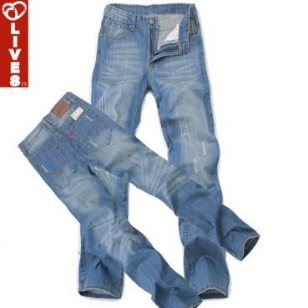
Cooperating and Exploring
stranger
two pairs of jeans
C&E
C&E
E&E

Slide 6
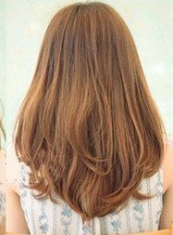
Cooperating and Exploring
high mark/good mark
full marks(100 scores)
long fair hair
C&E
C&E
E&E

Slide 7
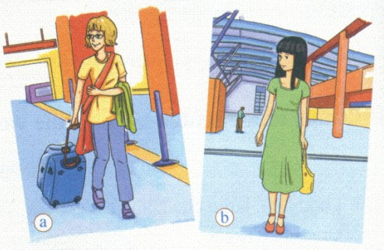
Cooperating and Exploring
Describe the girls in A1, P4
glasses jeans long nervous fair
pretty proud short stranger tall young
C&E
C&E
E&E

Slide 8
Cooperating and Exploring
how to describe one's look
① Height
Size
Age
short, medium, tall…
thin, fat…
young, middle-aged, old…
② Hair
Face
Clothes
short, long, straight, curly
black, brown, fair…
big/small eyes/mouth, flat nose…
yellow T-shirt, blue jeans/dress
jacket…
C&E
C&E
E&E

Slide 9
Cooperating and Exploring
1. Scan for which is Sally's picture.
Picture A
2. Scan and match
a—para 3
b—para 4
c—para 2
C&E
C&E
E&E

Slide 10
Cooperating and Exploring
Skimming, A5
She feels sad…
She often feels a bit sad at first….
She is quite shy…
She feels nervous…
She feels sorry…
She is afraid of flying…
C&E
C&E
E&E

Slide 11
Cooperating and Exploring
Intensive reading, Para 1,2
Describe the girl in Picture A/B in A 1.
Describe your classmates.
Height Size Age Hair Face Clothes
C&E
C&E
E&E

Slide 12
Expanding and Extending
1. Read the passage U2 A2(Para 3)
2. 细解巧练 随堂练习（三、四、五）P5
U3 讲 1---讲 3 P6
3. Handwriting copybook for calligraphy
4. Dictation
words(stranger-love)+sentences(3,4)

Slide 13
Intensive reading, Para 3,4
Cooperating and Exploring
1. What are Sally's hobbies?
2. Why is Sally proud of her brother?
3. Does Sally often get bad marks at school?
4. How does Sally feel about going to China?
Playing classical music, dancing,
doing sports, especially tennis
Because he is good at everything.
No, she doesn't.
She feels very excited.
C&E
C&E
E&E

