Slide 1
Unit 4 Topic 3 China is the third nation that sent a person into space.
Section A
WWW.PPT818.COM

Slide 2
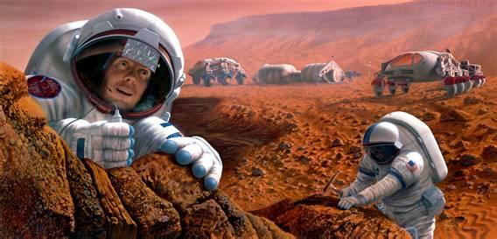
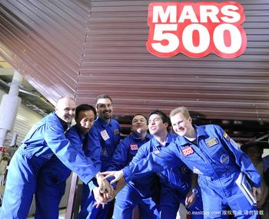
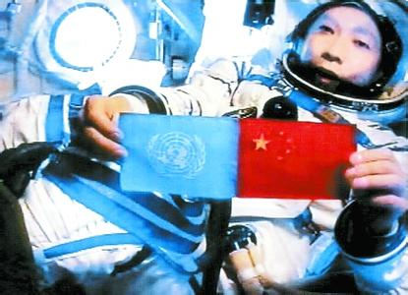

Slide 3
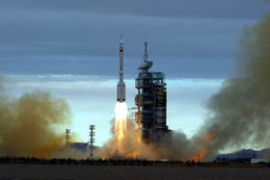
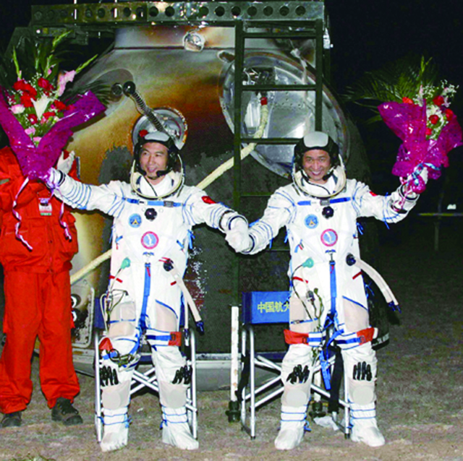
2005.10.12
Fei Junlong and
Nie Haisheng
Shenzhou VI
2005.10.17 4:33 a.m.
about 5 days

Slide 4
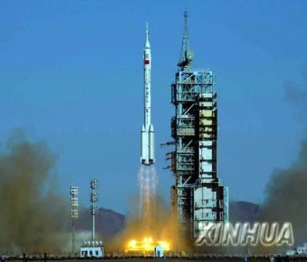
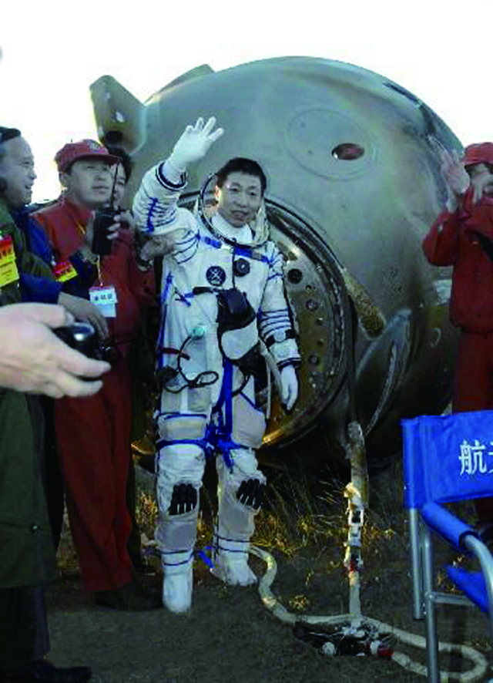
2003.10.15
Yang Liwei
Shenzhou V
21 hours
2003.10.16 6:23 a.m.

Slide 5
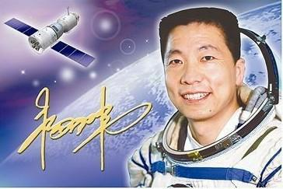
Yang Liwei is our national hero who traveled around the earth in Shenzhou V for 21 hours in 2003.
定语从句

Slide 6
定 语 从 句（1）
Grammar
定语从句在句中做定语，用于修饰句中的某一名词（或代词）。 被定语从句修饰的词叫做“先行词”， 定语从句必须放在先行词之后。 定语从句由关系代词who, whom, whose, which, that 和关系副词when, where, why 等引导。
定语从句结构：先行词+关系词+定语从句

Slide 7
定语从句（2）
Grammar
关系词 | 先行词 | 在从句中成分
who | 人 | 主语，宾语
whom | 人 | 宾语
whose | 人 | 定语
which | 物 | 主语，宾语
that | 物，人 | 主语，宾语
when | 时间 | 状语
where | 地点 | 状语
why | 原因 | 状语

Slide 8
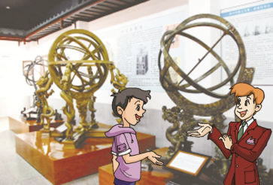
Where is Kangkang ?
2
1
4
3

Slide 9
1b Listen to 1a and tick the expressions you hear.
√
_____ travel into space
_____ make great progress
_____ aliens
_____ lunar probe
_____ Shenzhou V
_____ travel to the moon
_____ launched
_____ space walk
√
√
√
√
√

Slide 10
1c Read 1a and answer the questions.
1. Who is Yang Liwei?
2. How long did ShenzhouⅤ travel around the
earth?
3. How many spaceships has China sent into
space?
4. What’s Chang’e Ⅰ？
5. Do you know the legend of Chang’e?
Please tell it to your partner.
He is the first Chinese to travel into space.
ShenzhouⅤ travel around the earth for 21 hours.
Five.
It is a spaceship which was launched as
China’s first lunar probe.

Slide 11
Key Sentences
1. All of you must be very proud.你们一定都为此而感到骄傲。
be proud of 为……而骄傲
be the pride of 是……的骄傲
e.g. We are proud of Yang Liwei.
Yang Liwei is the pride of us.
2. We have launched another four spaceships in the past few years.在过去几年我国又向太空发射了四艘宇宙飞船。
another four = four more 意为 “又有四个”之意。
3.It proves that China has made great progress in its space industry.这证明中国在航空业已经取得了巨大的进步。
prove v.证明，证实 +从句

Slide 12
Attributive Clause
1.He is our national hero who traveled
around the earth in Shenzhou V for 21
hours in 2003.
2.China is the third nation that sent a
person into space.
3.It’s a spaceship which was launched as
China’s first lunar probe.

Slide 13
Yang Liwei is the first Chinese to travel into space. He is our national hero who traveled around the earth in Shenzhou V for 21 hours in 2003. China is the third nation that sent a person into space. All of us are very proud of it. What’s more, we have launched another four spaceships in the past few years. It proves that China has made great progress in its space industry. We are sure China will send more spaceships into space.
Retell it like this :

Slide 14
2 Study the change of the following sentences. Then try to find the rules and fill in the blanks.
1. Yang Liwei is our national hero.
He traveled around the earth in Shenzhou V for 21 hours in 2003.
Yang Liwei is our national hero who/that traveled around the earth in Shenzhou V for 21 hours in 2003.
2. Wang Yaping is a woman astronaut.
She gave us a lesson in Shenzhou X spaceship.
Wang Yaping is a woman astronaut ____________________________________________.
3. Shenzhou X is a spaceship.
It was launched with three astronauts in 2013.
_________________________________________ __________________________________________.
who/that gave us a lesson in Shenzhou X spaceship
Shenzhou X is a spaceship that /which was launched with three astronauts in 2013

Slide 15
3 Listen to the passage and fill in the blanks.
China’s First Man-made Satellite Dongfanghong Ⅰ
Launch time:____________
Launch place: ____________ Satellite Launch Center
Development team: many scientists under ____________________________
Significance: · becoming the _______ country to independently launch a satellite · stepping into _____________ · being a landmark of China’s _______________________
April 24, 1970
Jiuquan
the direction of Qian Xuesen
fifth
the Space Age
space industry

Slide 16
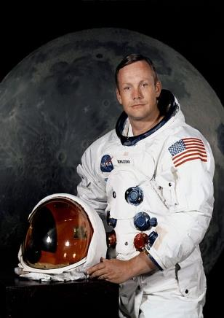
Neil Alden Armstrong
born on August 5, 1930
the U.S.A
the first man
On July 20, 1969
Apollo 11
2.5 hours

Slide 17
4 Choose the correct forms of the given words to complete the passage.
Neil Alden Armstrong was born on August 5, 1930. He was an American astronaut ________(which/who) was the first man to set foot on the moon. During his life, he took part in two space flights. On July 20, 1969, his second and last space flight was in a famous spaceship _________(which/ who) was named Apollo 11. Along with his partner, Buzz Aldrin, Armstrong had a spacewalk and then ______(lands/landed) on the lunar surface. They spent 2.5 hours ________ (exploring/ to explore) and collecting soil and rocks to take back to earth. On July 24th, they returned to the earth ________(safe/ safely).
who
which
landed
exploring
safely

Slide 18
Summary
We learn：1.Some words: prove, spacewalk
2.Some phrases: another four, make progress
3.Attributive clause:
(1) China is the third nation that sent a
person into space.
(2) He is our national hero who/that travelled
around the earth in Shenzhou Ⅴ for 21
hours in 2003.
We can: Talk about something about popular science.
(1) China is the third nation to send a
person into space.
(2) …we have launched another four
spaceships in the past few year.

Slide 19
Assignment
Read 1a.
Memorize the useful expressions and key sentences which we learned today.
Finish Section A in your workbook.
Preview Section B.

