Slide 1
Crafts
第一课时
WWW.PPT818.COM

Slide 2
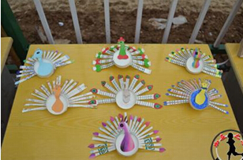
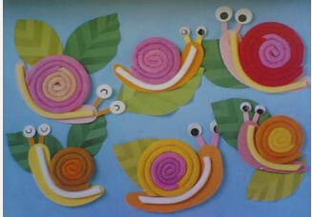
Warming
Do you want to make presents for your families and friends? What do you want to make? What do you need?

Slide 3
Presentation
What’re these?
They are crafts.

Slide 4
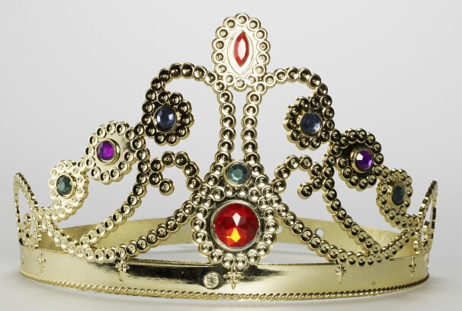
Presentation
What is this?
It’s a crown.

Slide 5
Discussion
We want to make a crown, what do we need?

Slide 6
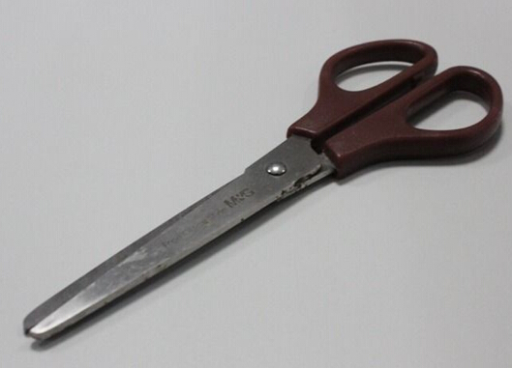
Presentation
We need a pair of scissors.

Slide 7
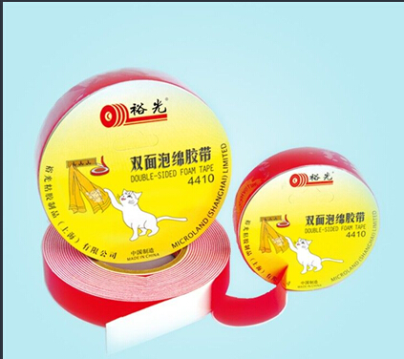
Presentation
We need some tape.

Slide 8
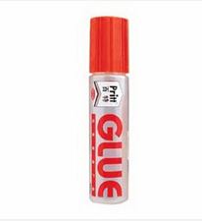
Presentation
We need some glue.

Slide 9
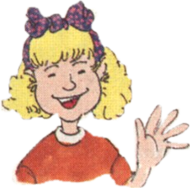
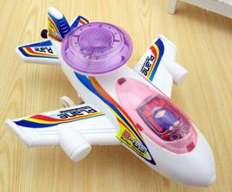
Listen and say
I’m making a toy plane for my brother. He likes playing with toy planes.
What are you making, Peter?

Slide 10
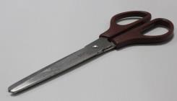
Listen and say
I want to make a crown. I need a pair of scissors.
Who is it for?
It’s for my little cousin. She wants to be a princess.

Slide 11
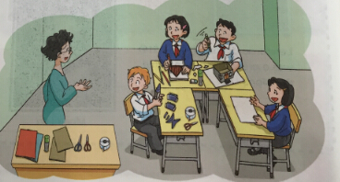
Listen and say
Ms Guo: What are you making, Joe and Alice?
Joe﹠ Alice : We are making a model house. It’s for Kitty. Her birthday is coming. We don’t have any tape. Can you give us some, please?
Ms Guo: Sure!

Slide 12
Exercise
What do the children want to make? What do they need? Complete the notes.
Jill wants to make a crown for her ________. She needs ____________________.
Peter wants to make a __________ for his _________.
Joe and Alice want to make a ____________ for _______.
They need __________.
cousin
a pair of scissors.
toy plane
brother
model house
Kitty
some tape

Slide 13
Work in pairs
What do you want to make? What do you need?

Slide 14
Summary
本课重点句型：
What do you want to make?
I want to make a crown.
What do you need?
I need a pair of scissors.

Slide 15
Homework.
用英语询问同学、朋友、家长等，完成这个survey。填写表格。
name | craft | for whom | need
…

