Slide 1
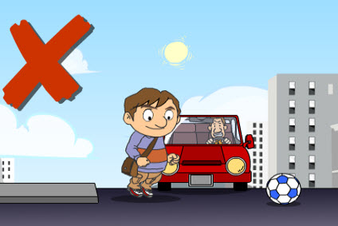
Unit 4
Road safety
第一课时
WWW.PPT818.COM

Slide 2
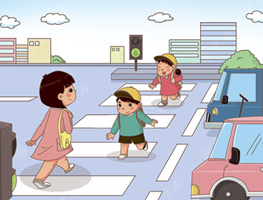
Introduce
T: How can you cross the road safety?
S：We must look for a zebra crossing.
We must look at the traffic lights and
wait for the green man. See the red
man, we mustn’t cross the road. You
can wait on the pavement. You
mustn’t play on the road.
T: Well done. Now let’s play a game.

Slide 3
Words
look [lʊk]
动词，和at构成固定词组：look at,意为“看...”
eg：He is looking at the boys over there.他正在看那边的男孩。
小练习：填上合适的介词：
To keep safe, you can look ______for cars and blkes.
out

Slide 4
Words
can [kæn]
情态动词 ，表示：“会、能.后跟动词原形
eg：I can swim.我会游泳。
小练习：单项选择：
（ ） He can______ basketball well.
A. plays B. play
B
拓展：其否定形式can not=can’t有时还表示请求、允许，或推测
eg：Can I help you?我能帮助你吗？

Slide 5
Expressions
Red man ,stop.
stop to do停下来去做某事； stop doing停下某事。
eg：（1）Let's stop to have a rest. 我们停下来歇会儿吧
（2）Stop talking, please. Let‘s sing an English song.
不要说话了，让我们唱支英文歌曲吧。
小练习：英译汉：
Now, stop talking. Class begins．____________
不要讲话了，开始上课。

Slide 6
Words
clean [kli:n]
动词，解释为打扫；形容词，解释为干净的；
eg：1.This is my clean room.这是我干净的房间。
2.Let’s clean our classroom.让我们打扫一下我们的教室。
小练习：Be careful to keep yourself clean.
What’s meaning of clean?
清洁的

Slide 7
Expressions
You mustn’t run quickly on the road.
你不能在路上快速跑。
quick是形容词,后修饰名词；quickly是副词后修饰动词。
eg：The bus is coming，and you must be quick.
车子过来了，你必须快点。
Quickly，the bus is coming.
快点，公交车来了。
小练习：用所给词的适当形式填空：Be _____(quick)!快点！
quickly

Slide 8
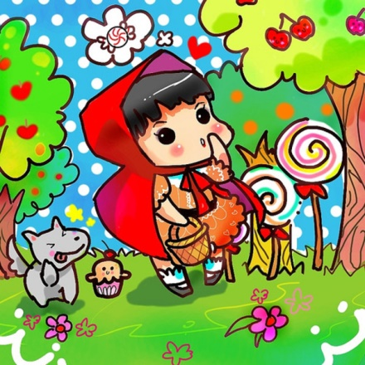
Dialogue
Red man, stop. Green man go!
红灯停，绿灯走！
What must you do on the road?
在公路上你必须做什么？
I must look out for cars.
我必须小心汽车。
Right!
对了！

Slide 9
Summary
look
can
clean
Red man ,stop.
What must you do on the road?

Slide 10
Exercise
词性转换
1.cannot(缩写形式)_______
2.must not(缩写形式) ______
3.quick(副词) ______
4.loud(副词) ______
can’t
mustn’t
quickly
loudly

Slide 11
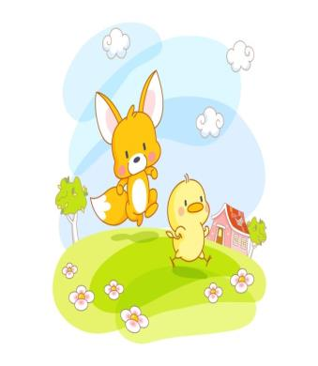
Exercise
词组互译
1.踢足球_______________
2.在路上跑_____________
3.绿灯_________________
4.快速跑_______________
5.大声说话_____________
6.在课上_______________
play football
run on the road
green man
run quickly
talk loudly
in class

Slide 12
Exercise
连词成句
1.mustn’t , play games you, ball the road, on(.)
__________________________________
2.must , you, listen, teachers, to ,class, in(.)
__________________________________
3.what , you ,must, do the. on ,roads(.)
__________________________________
You mustn’t play ball games on the road.
You must listen to teachers in class.
What must you do on the roads?

Slide 13
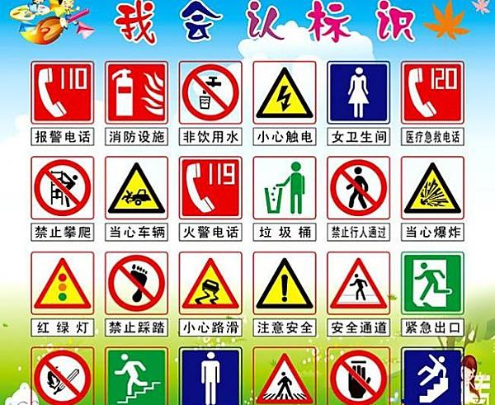
Homework
Know the traffic signs.

