Slide 1
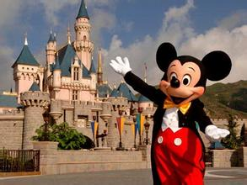
Unit 8 A trip to HongKong
---Disneyland
WWW.PPT818.COM

Slide 2
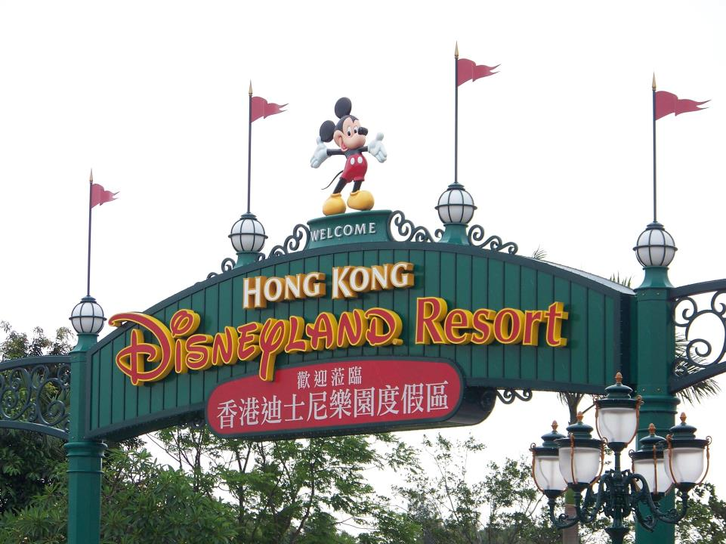

Slide 3
Answer the questions :
1.Who went to HongKong last weekend ?
2.How did they go to hongKong ?
3.Where did they stay in HongKong ?
4.What did they do at Disneyland?
5.Who did jiamin and Ben meet in HongKong ?
Jiamin's mother、 Ben and Jiamin
By train
Disneyland
They took many photos and played lots of games.
Xiaoling and her mother

Slide 4
Find out the past tense words:
went travelled stayed said was took played
ate felt had sat were met didn't came talked

Slide 5
Key phrases & sentences:
1.last weekend 上个周末
2.go on trip 去旅行
3.his first visit to
4.take us to
5.lots of different games 许多不同的游戏
6.on our first day 在我们旅行的第一天
7.talk about 谈论
8.on the street 在大街上
9.eat a little too much 吃的有点太多
10. go shopping 去购物

Slide 6
11.Ben said he was very excited because it was his first visit to the island .
12.On our first day my cousin took us to Disneyland .
13.We had hamburgers and chips for lunch .

Slide 7
Discuss:
What did you think of your lastest trip?
(Write a short passage about "What did you do in your holiday ?")

Slide 8
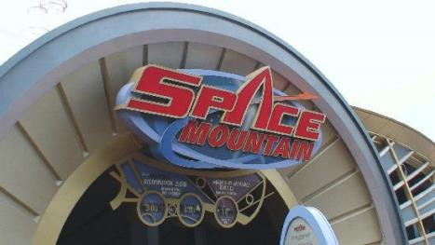
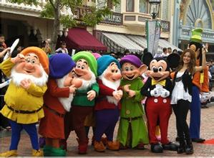
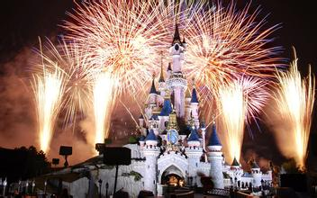
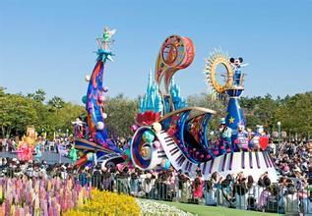
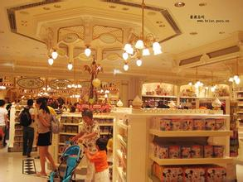
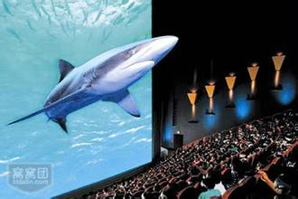
Which one do you like best ?

Slide 9
1.Space Mounatin
飞越太空山（Space Mountain），它其实就是一座室内过山车，但因为里面的氛围被高科技和超劲的音响系统营造得非常神秘，你乘坐的过山车一经开动就有如太空舱般让你喘不过气！全过程都在封闭空间内进行，在让人眼花缭乱的轨道周围是闪烁的灯光和投影，你仿佛置身于无尽太空之间，尤其是当过山车急剧转弯或翻滚旋转时，你仿佛被丢入茫茫银河内，于是你就只有尖叫了！
What is Kitty's feeling about the Space Mountain?

Slide 10
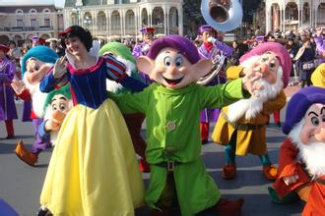
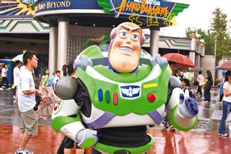
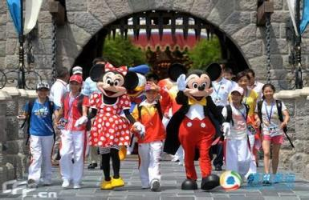
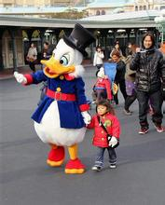
2.Cartoon characters
Buzz Lightyear
Snow White and Seven Dwarfs
Donald Duck
Mickey and Minnie

Slide 11
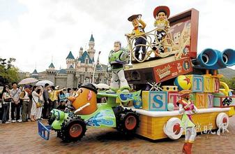
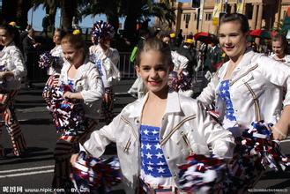
3.a parade

Slide 12
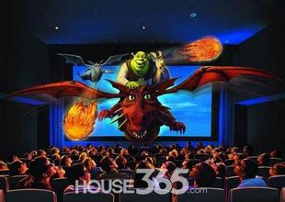
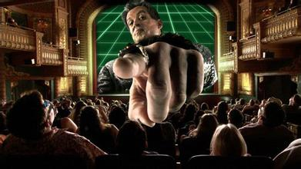
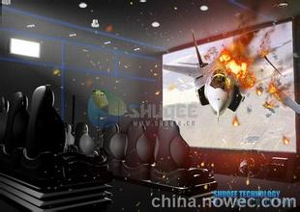
4.A 4-D film
4D电影立体电影和特技影院结合产物除了立体视觉画面外放映现场还能模拟闪电、烟雾、雪花、气味等自现象观众座椅还能产生下坠、震动、喷风、喷水、扫腿等动作些现场特技效和立体画面与剧情紧密结合视觉和身体体验上给观众带来全新娱乐效犹身临其境紧张刺激
magic！

Slide 13
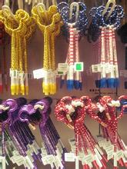
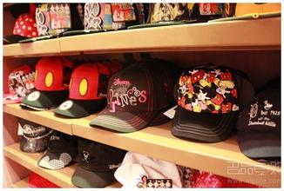
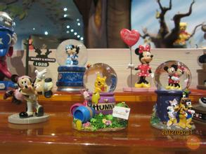
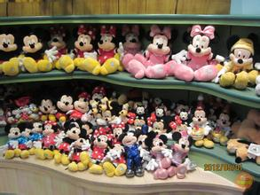
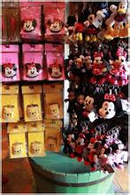
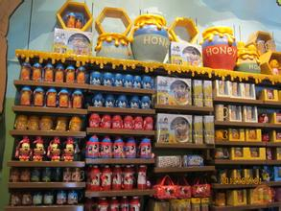
5.Did some shopping
What will you buy for your friends?

Slide 14
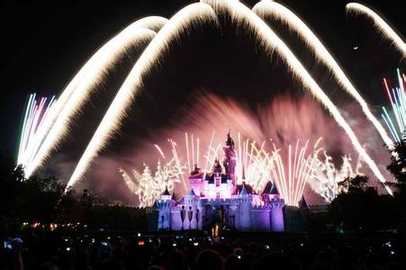
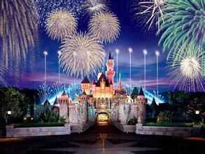
6.watch fireworks
Watch a video about a fireworks show.
Can you describe the fireworks show in one word?
What about the castle under the fireworks show?

Slide 15
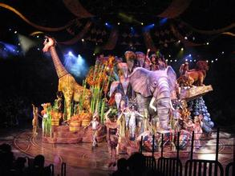
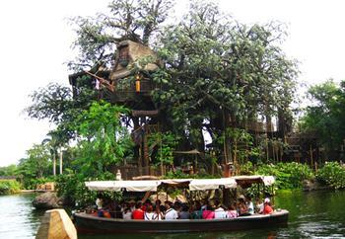
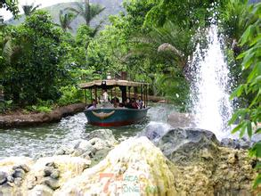
Task: Design your trip to Disneyland
Adventureland(探险世界)：
Festival of the lion king
(狮子王庆典)
Tarzan's treehouse
(泰山树屋)
Jungle river cruise
(森林河流之旅)

Slide 16
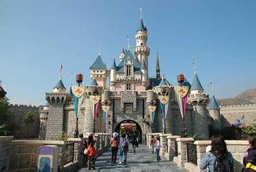
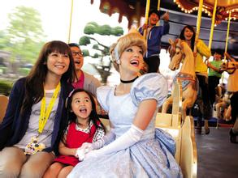
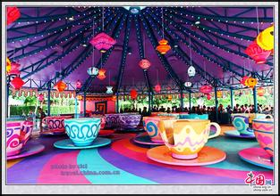
Fantasyland(幻想世界)：
Sleeping beauty castle
(睡美人城堡)
Cinderalla's carousel
(灰姑娘的旋转木马)
Mad hatter tea cups
(疯帽子旋转杯)

Slide 17
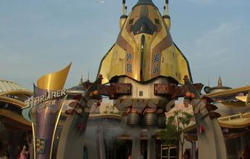
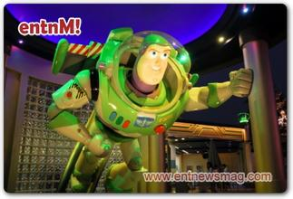
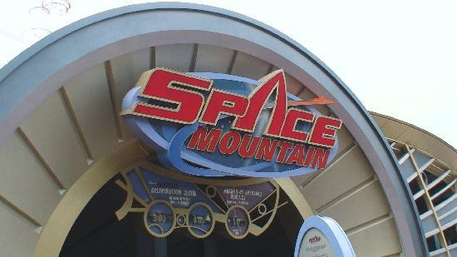
Tomorrowland(明日世界):
Orbitrain(太空飞碟)
Buzz Lightyear Astro Blasters
(巴斯光年星际历险)
Space Mountain
(飞越太空山)

Slide 18
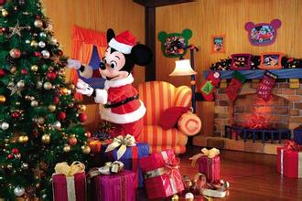
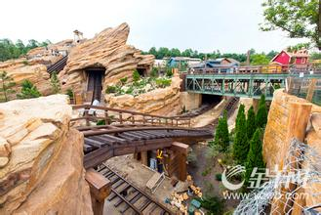
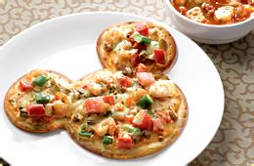
Mickey's House
(米奇圣诞屋)
Big Grizzly Mountain Runaway Mine Cars
(灰熊山急速矿车)
shops
Restaurant

Slide 19
Homework
1.Copy the past tense words.
2.Write a short passag about your lastest holiday .
3.Read the passage three times.

