Slide 1
Unit 6 Travel
I'm going to Mount Taishan
WWW.PPT818.COM

Slide 2
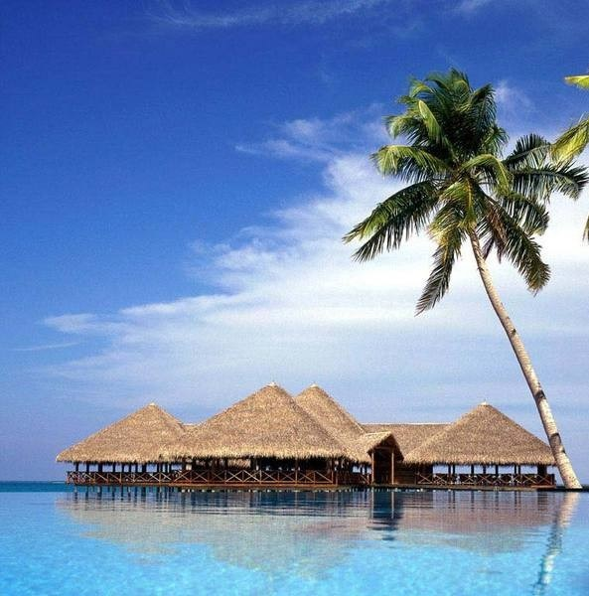
Do you like travel?

Slide 3
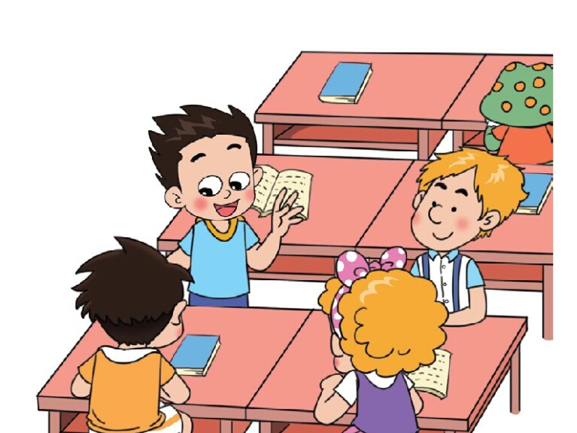
What are they talking about?
（读课文思考，他们在谈论什么？）

Slide 4
It’s June now. The summer vacation is coming.
Are you going to travel?
Yes. I’m going to _____________.
Mount Taishan

Slide 5
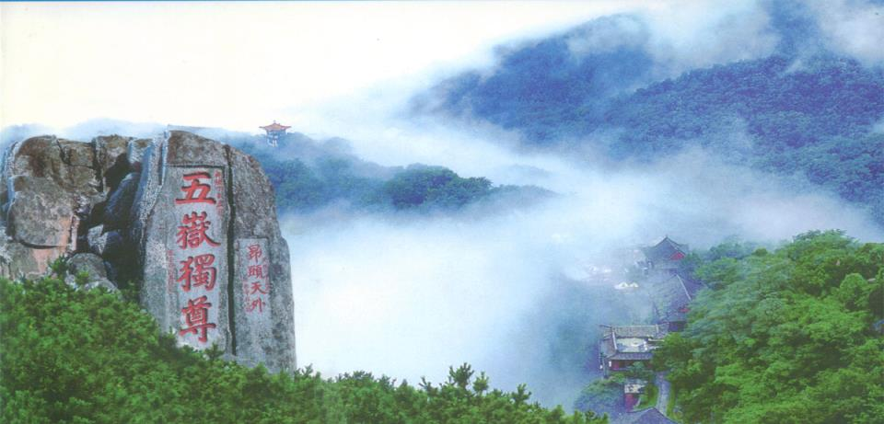
I’m going to_____________.
Mount Taishan

Slide 6
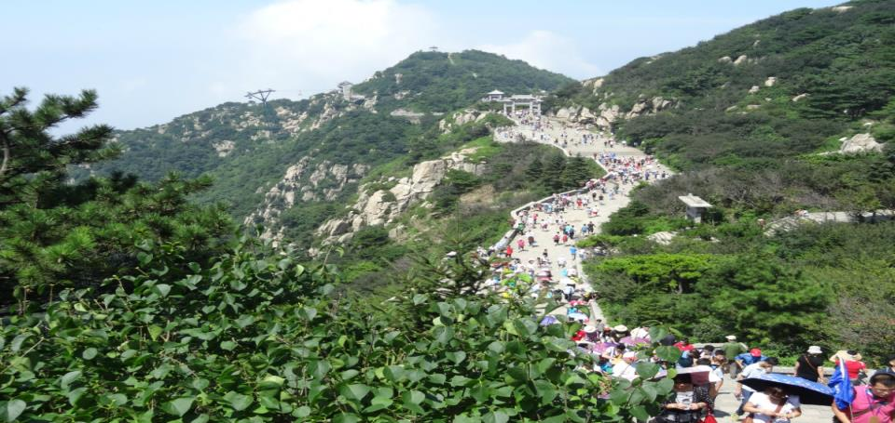
I’m going to_____________.
Mount Taishan

Slide 7
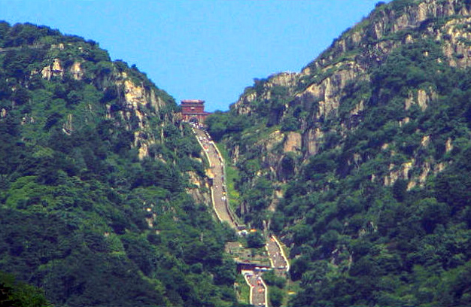
I’m going to_____________.
Mount Taishan

Slide 8
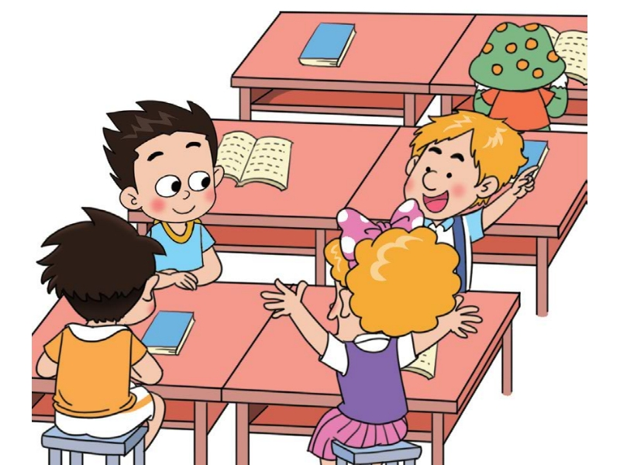
I’m going to _______.
Dalian
I’m going back to Canada in July.

Slide 9
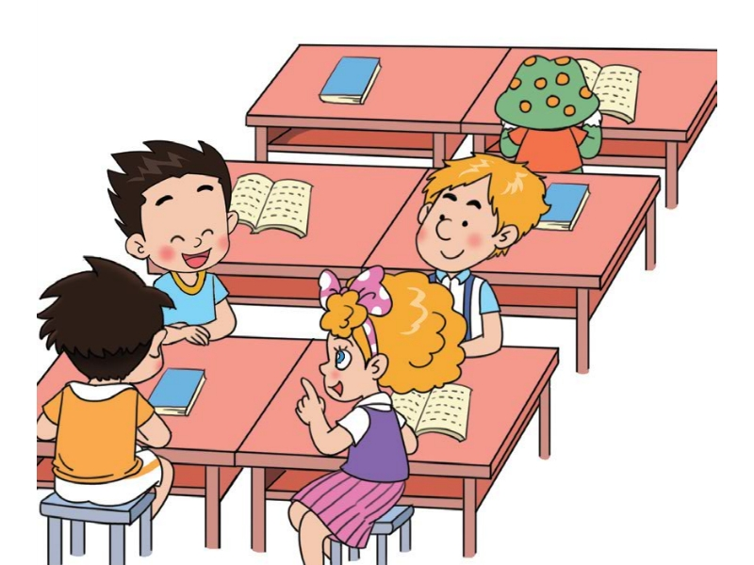
How do they ask Li Ming?
（他们是如何询问李明的？）

Slide 10
Where are you going this summer, Li Ming?
I’m going to __________________.
the Shaolin Temple

Slide 11
I’m going to__________________.
the Shaolin Temple

Slide 12
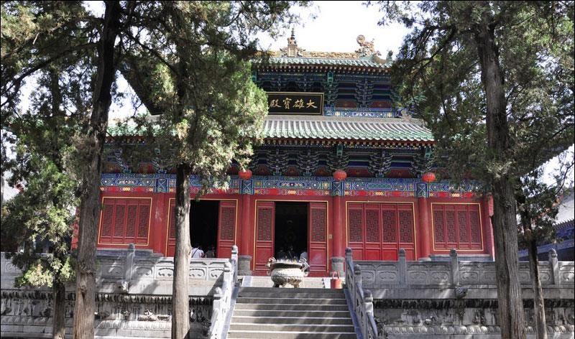
the Shaolin Temple
I’m going to_________________.

Slide 13
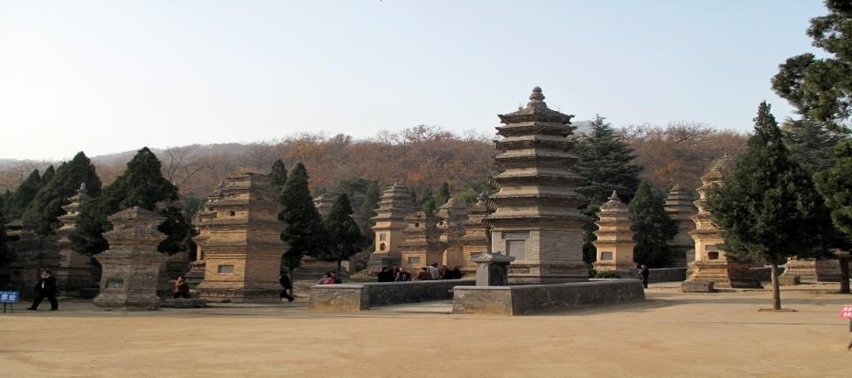
I’m going to__________________.
the Shaolin Temple

Slide 14
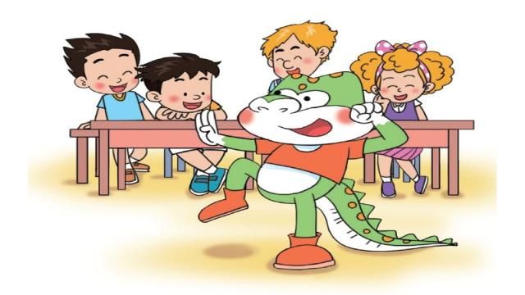
Me, too! I love kung fu!

Slide 15
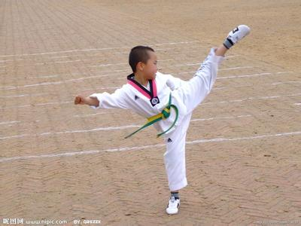
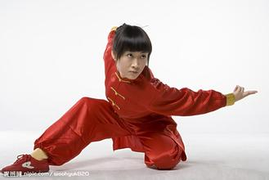
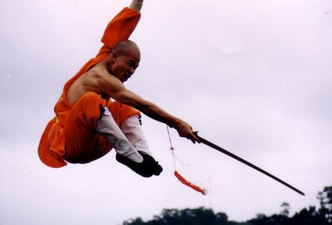
kung fu 功夫

Slide 16
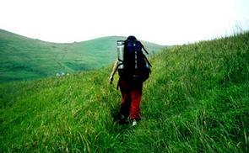
travel 旅行

Slide 17
summer vacation 暑假

Slide 18
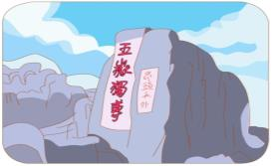
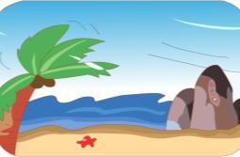
Where are you going this summer?
I’m going to…

Slide 19
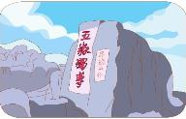
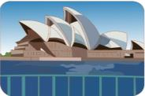
Let’s talk
Mount Taishan
Hainan
London
Australia
A: Where are you going?
B: I’m going to_____.

Slide 20
Test
连一连
travel 假期
back 泰山
June 旅行
July 回
vacation 六月
Mount Taishan 七月
temple 庙宇

Slide 21
Thank You.

