Slide 1
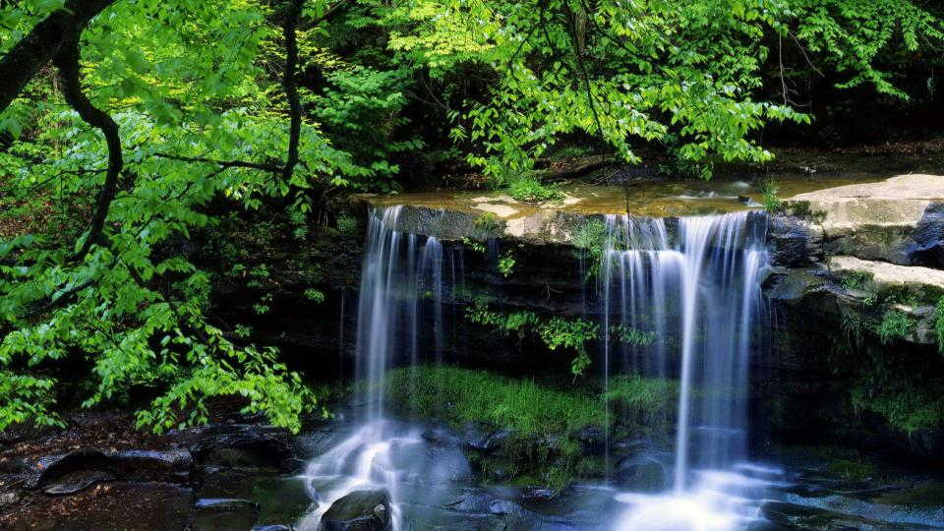
Unit 1 Food for thought
Period Three Using language & Developing ideas
WWW.PPT818.COM

Slide 2
PART 1
语篇理解
PART 2
基础自测
PART 3
互动探究
PART 4
达标检测

Slide 3
PART
1
语篇理解
精读精练 萃取文本精华

Slide 4
Ⅰ.Read the passage and judge whether the following statements are true(T) or false(F).
1.All of these five people are too busy to do cooking by themselves.( )
2.Mike is a chef with five children and he likes doing much cooking at home.
( )
3.As a teacher，Jenny likes cooking at home to get a chance to relax.( )
F
F
T

Slide 5
Ⅱ.Read the passage carefully and choose the best answer.
1.What’s the main idea of the passage?
A.The suggestions about what you eat.
B.The suggestions about how to keep a healthy diet.
C.The suggestions about improving eating habits.
D.The test about “You are what you eat”.
√

Slide 6
2.What is the truth behind the saying “You are what you eat”？
A.Keep a good eating habit.
B.Eat fresh，seasonal fruit and vegetables.
C.Diet can reflect a person’s personality and living environment.
D.A good diet is important for good health.
√

Slide 7
3.Which of the following is TRUE according to the passage?
A.Ellie is a doctor and she has a good eating habit.
B.Ted likes to eat a big meat dinner because of tiredness.
C.Max has three healthy meals every day.
D.Jenny’s husband doesn’t like cooking at home.
√

Slide 8
PART
2
基础自测
自主学习 落实基础知识

Slide 9
Ⅰ.重点单词
1. v. 下载(信息或程序)
2. n. 日常饮食
3. n. 指点，建议
4. n. 风俗，习惯，传统
5. n. 礼貌，礼仪
6. n. 诀窍，技巧，技法
7. prep. 在……里
download
diet
tip
custom
manners
trick
within

Slide 10
8. v. (使)(前后)摆动，(使)摇摆
9. n. 蜂蜜
10. n. 厨师
11. v. 确定，发现
12. v. (使)适应，(使)适合
13. n. 功能；作用
→ adj. 实用的；功能的
14. adj. 有关系的，相关的
→ v. 与……有联系，相关联
→ n. 亲戚
→ n. 关系
swing
honey
chef
identify
adapt
function
functional
related
relate
relative
relation

Slide 11
15. n. 对……着迷的人
→ adj. 入迷的，上瘾的
→ n. 上瘾，沉溺
16. v. 不同，有区别
→ adj. 不同的
17. adv. 略微，稍微
→ adj. 轻微的，少量的
18. v. 推荐
→ n. 推荐信
addict
addicted
addiction
differ
different
slightly
slight
recommend
recommendation

Slide 12
19. v. 侵袭，攻击
→ n. 攻击者
20. adj. 令人高兴的，令人满意的
→ v. 使满意，使满足
→ adj. 感到满意的
→ n. 满意
21. adj. 方便的，便利的
→ adv. 便利地
→ n. 便利
22. adv. 原先，最初
→ adj. 原先的，最初的
attack
attacker
satisfying
satisfy
satisfied
satisfaction
convenient
conveniently
convenience
originally
original

Slide 13
掌握规律 巧记单词
attack (v.攻击)＋er(后缀，表示人，动作者)→attacker(n.攻击者)
fight(v.战斗)＋er→fighter(n.战士)
work(v.工作)＋er→worker(n.工人)
write (v.写)＋er→writer(n.作家)
think(v.思考)＋er→thinker(n.思想家)

Slide 14
Ⅱ.核心短语
1. 解决，算出；实现
2. 以防万一
3. 拿起；捡起，学会；买，购买
4. 属于
5. 最终处于，到头来
6. 打听，别后叙谈
7. 教育；养育；提出
8. 或多或少
work out
in case
pick up
belong to
end up
catch up
bring up
more or less

Slide 15
9. 忙于做某事
10. 例如
11. 同……分享……
12. 试用，试验
be busy doing sth.
such as
share...with...
try out

Slide 16
Ⅲ.经典句式
1. too...to太……以至于不能
My fridge is usually half empty and I’m often anyway.
我的冰箱通常是半空的，而且我经常都是太累了以至于不想吃太多。
2.the way后跟定语从句
As a doctor，I know I had better change ，but I just don’t have the time or the energy right now.
作为一名医生，我知道我最好改变我的饮食方式，但我现在没有时间和精力。
too tired to eat much
the way I eat

Slide 17
3. 动名词作主语；a chance＋to do表示“做……的机会”
gives us and catch up on each other’s days.
一起做饭给了我们一个放松的机会，聊聊彼此白天发生的事情。
4.where引导定语从句
Sometimes I bring home food from the restaurant .
有时我从我工作的餐馆带食物回家。
Cooking together
a chance to relax
where I work

Slide 18
PART
3
互动探究
探究重点 互动撞击思维

Slide 19
重点词汇
1
Can you guess which fridge belongs to which person？你能猜出哪台冰箱属于哪个人吗？
belong to属于
※belong to属于，没有被动形式，也不用于完成时和进行时。后面要接宾格代词或名词作宾语。
※belongings n.所有物；财产

Slide 20
(1)Think of the people who belong to book groups.
想想那些属于图书小组的人。
(2)The house (belong) to my grandfather was sold yesterday.
属于我爷爷的那套房子昨天被卖掉了。
(3)Later，he took all his (belong) to France.
后来，他带着全部财产去了法国。
belonging
belongings

Slide 21
2
If we have children，I want to bring them up just like us，but my husband says that everyone should be able to make their own lifestyle choices.如果我们有孩子，我想教育他们就像我们一样，但是我丈夫说每个人都应该能够选择自己的生活方式。
bring up抚养；培养；教育；提出；呕吐
[一词多义] 写出下列句子中bring up的汉语意思
(1)The old woman brought up five children. _____
(2)David was brought up to value the sense of sharing. _____
(3)The greedy child brought up all he had eaten. _____
养育
教导
呕吐

Slide 22
bring in引进；获利；赚钱
bring out出版；使显现
bring about引起；导致
bring down使倒下；减少；降低
(4)He in Hannibal，Missouri，along the Mississippi River.
他在密西西比河畔密苏里州的汉尼拔长大。
(5)We need to bring some new blood.
我们需要输入一些新鲜血液。
was brought up
in

Slide 23
(6)His carelessness brought his failure in the exam.
他的粗心导致了考试的失败。
(7)Could you please bring the price a little?
你把价格降一点好吗？
about
down

Slide 24
3
I know we should eat more fresh fruit and vegetables，but ready meals are so convenient.我知道我们应该多吃新鲜的水果和蔬菜，但是即时餐确实很方便。
convenient adj.方便的，便利的
※convenience n.便利；方便
for convenience为方便起见
at sb. ’s convenience在某人方便时
※It is convenient for sb. to do sth. 某人方便做某事。

Slide 25
(1)It is convenient for people to do some shopping online now.
现在人们网上购物很方便。
(2)Please come to see me .
＝Please come to see me if .
请在你方便时来看我。
注意：convenient作表语时，不可用人作主语，而要用物作主语或用it作形式主语。“当你方便的时候”应用when it is convenient for you表示，而不是when you are convenient。
(3)If convenient，I’ll go to see him this weekend.
如果方便，我这个周末去看他。
at your convenience
it is convenient for/to you
it is

Slide 26
4
Visual information，such as photos and illustrations，can support reading and help you identify the theme and content of a text.视觉信息，如照片和插图，可以支持阅读，并帮助您识别文本的主题和内容。
such as例如，比如
for example例如
that is即……
(1)English is also spoken in Singapore and Malaysia and countries in Africa such as South Africa.
在新加坡、马来西亚和非洲一些国家，例如南非，人们也说英语。

Slide 27
[易混辨析] such as，for example
※ such as用来罗列同类人或物中的几个例子，可置于被列举的事物与前面的名词之间，但其后不能用逗号。
※for example强调举例说明，而且一般只举同类人或物中的一个作为插入语，
且用逗号隔开，可置于句首、句中或句末。

Slide 28
(2)The farm grows many kinds of crops， wheat，corn，cotton and rice.
这个农场种植很多种庄稼，例如小麦、玉米、棉花和水稻。
(3)A lot of people here， ，Mr John，would rather have coffee.
这儿的许多人，例如约翰先生，宁愿喝咖啡。
(4)I have two friends. ，Tom and Lucy.
我有两个朋友，即汤姆和露西。
such as
for example
That is

Slide 29
5
What’s more，it is easy to make and can be adapted to individual tastes. 更重要的是，它很容易制作并能迎合个人口味。
adapt v.使适应，使适合；改写，改编
※adapt oneself to适应
adapt A for B 将A改编为B
adapt A from B 根据B改编A
※adaptable adj.有适应能力的，能适应的
※adaptation n.适应；改编本，改写本

Slide 30
(1)It took him a while to adapt himself to the new surroundings.
他过了好一阵子才适应新环境。
(2)It is said that the TV play a novel.
据说这部电视剧改编自一部小说。
(3)Successful businesses are highly (adapt) to economic change.
成功的企业高度适应经济变化。
(4)Here I will stress some smarter and more creative examples of ___________
.这里我要强调一些在气候适应方面更聪明、更具创造性的例子。
(5)Three of her novels have been by a famous director.
她的三部小说已被一位著名导演改编成电视剧。
is adapted from
adaptable
climate
adaptation
adapted for television

Slide 31
6
So，don’t forget to pick up some chicken on your way home and try this recipe out！所以，别忘了在回家的路上买些鸡肉，试试这个食谱！
pick up v.捡起；收集；接人；偶然结识；站起，扶起；振作精神；(不费力地)学会；获得

Slide 32
[一词多义] 写出下列句子中pick up的汉语意思
(1)He picked up the child and put her on his shoulders. _____
(2)But we have to survive，so I have to pick myself up，and then continue my work. _________
(3) The next morning，my mum came to pick me up. _______
(4)She’s talking with the man she picked up on holiday. ________
(5)She soon picked up French when she went to live in France. ____
抱起
振作精神
开车接
偶然结识
学会

Slide 33
pick and choose挑三拣四，仔细挑选
pick on故意挑剔；故意找茬
pick out挑选出
pick sb. to do sth. 挑选某人做某事
(6)It’s not easy the best actor for this play，because they’re all so good.要在这出戏里选出最佳演员可真不容易，因为他们都演得十分出色。
(7)They always her when anything goes wrong.
每当事情出了什么差错，他们总是责怪她。
(8)When I was in the third grade，I was picked (be) the princess in the school play.在三年级时，我被选为校园剧中的公主。
to pick out
pick on
to be

Slide 34
经典句式
1
As a doctor，I know I had better change the way I eat，but I just don’t have the time or energy right now.作为一名医生，我知道我最好改变我的饮食方式，但我现在没有时间和精力。
the way I eat我的饮食方式，这里I eat作the way的定语。way作“方式”解，且其关系词在定语从句中作状语时，定语从句用in which或that引导，也可省略关系词。当the/a way后面的定语从句缺少主语或宾语时，关系词用that或which，作宾语时可省略。

Slide 35
(1)I hate the way (that/in which) you answer back with your mother.
我讨厌你那样和妈妈顶嘴。
(2)The way (that/which) he explained to us was quite simple.
他给我们解释的方法很简单。
(3)I don’t like the way ( ) you talk to your children.
我不喜欢你和孩子们谈话的方式。
that/in which

Slide 36
2
Sometimes I bring home food from the restaurant where I work.有时我从我工作的餐馆带食物回家。
这是一个复合句。where在句中引导定语从句，修饰先行词restaurant，在从句中作状语，这里的where可用“in which”替换。
※当先行词是表示地点的名词，如place，room，mountain，airport等，同
时关系词在从句作地点状语时，定语从句需用关系副词where来引导。
※除了具体的地点名词外，当先行词为system，case，point，position，
situation，stage，condition，industry，activity，job，race，scene，
circumstance等抽象的地点名词，且关系词在从句中作地点状语时，也常
用where引导定语从句。

Slide 37
(1)Then we moved to Paris，where we lived for six years.
然后我们搬到了巴黎，我们在那里住了六年。
(2)Students should take part in some activities they can gain experience.
学生们应该参加一些他们能获得经验的活动。
(3)Can you think of a case the word is properly used?
你能想出一个恰当使用这个词的情境吗？
where
where

Slide 38
PART
4
达标检测
当堂检测 基础达标演练

Slide 39
Ⅰ.单句语法填空
1.The house (belong) to the old man is on show at the moment.
2.It was said that she was brought by her aunt.
3.The Internet makes surveying and voting easy and (convenience).
4.I know many of them，such John，Peter and Tom.
5.Can you imagine such conditions you have nothing to live on for a week?
6.She packed her few (belong) in a bag and left.
7.It’s not safe to travel by standing at the roadside hoping to (pick) up by passing motorists.
belonging
up
convenient
as
where
belongings
be picked

Slide 40
Ⅱ.完成句子
8.This is the room his elder brother once lived.
这是他哥哥曾住过的房间。
9.If ，I’ll go to see you on Sunday morning.
如果你方便的话，我会在星期天上午去看你。
10.However，on TV and the radio you will hear differences in the way
.
但是，从电视上和收音机上，你会听到不同的人有着不同的说话方式。
11.As time went by，I gradually .
随着时间的推移，我逐渐适应了学校生活。
where/in which
it is convenient for you
(that/in which) people speak
adapted myself to the school life

Slide 41
Ⅲ.课文缩写——概要写作
下面是根据课文内容写的一篇60词左右的内容概要，请根据括号内的汉语提示完成短文。
As we all know,12. (生活方式是很重要的) in daily life.Each person 13._______________________________________________
(有机会选择其喜欢的方式).14. (以饮食习惯为例)，some of us are busy working，studying，and meeting friends so 15.____
(他们太过劳累以至于不经常做饭) at home.Bad eating habits more or less affect our health.16.____________________
(用新鲜的时令水果和蔬菜做饭) is beneficial to us.
lifestyle is of great importance
has a chance to choose the way (that/which) he or she
likes
Take eating habits for example
they
are often too tired to do much cooking
Cooking at home with
fresh，seasonal fruit and vegetables

