Slide 1
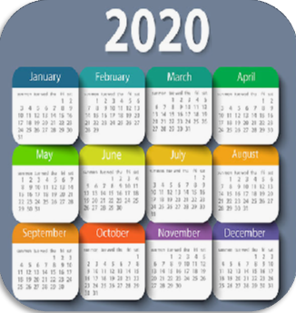
Unit4 January is the first month.
精通英语六年级（上)册
WWW.PPT818.COM

Slide 2
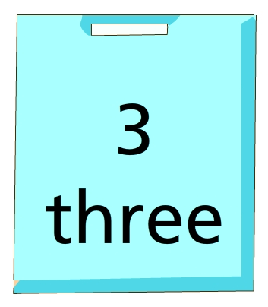
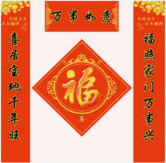
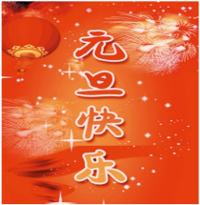
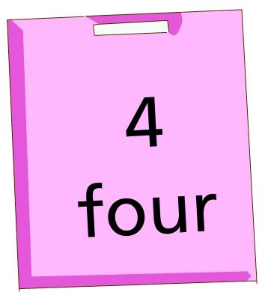
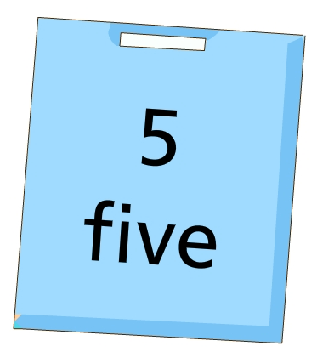
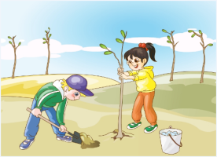
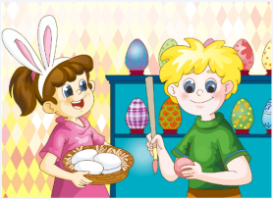
Let’s review
Which month or festival is it?
2
1
Quick
response
3
4

Slide 3
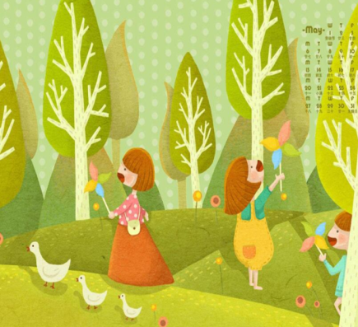
Presentation
Let's learn
May
______ is the fifth month of the year.
May
五月

Slide 4
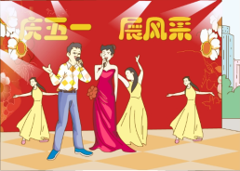
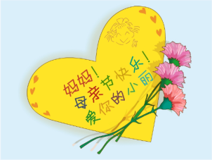
Task1 Listen and answer
1.What festivals are in May?
Labour Day and Mother’s Day.
2.When are the festivals?
Labour Day, or May Day, is on May 1st.
Mother’s Day is also in May.
3.What do people do in the festivals?
People sing and dance to celebrate May Day. Mother’s Day, We give gifts to our mothers to show our love.

Slide 5
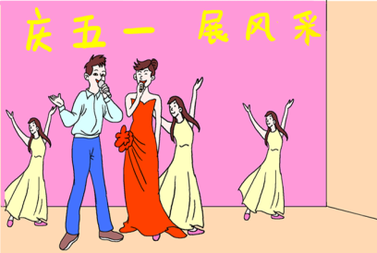
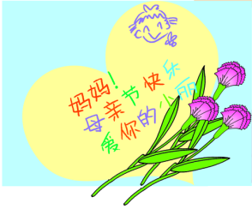
Just read and talk
May is the fifth month of the year. Labour Day, or May Day, is on May 1st.People sing and dance to celebrate May Day. Mother’s Day is also in May. We give gifts to our mothers to show our love.

Slide 6
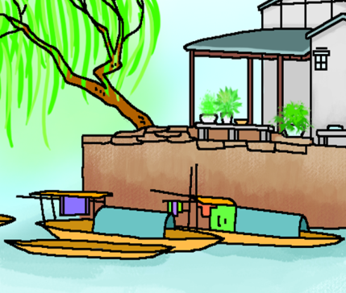
Presentation
Let's learn
June
六月

Slide 7
Practice
Task2
Read and find the key information
about June.（读并找到有关六月的关键信息）
1.What festivals?
2.When?
3.What do people do?

Slide 8
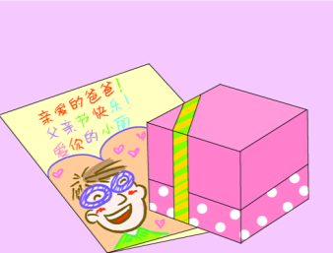
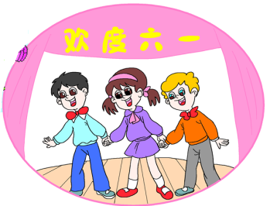
June is the sixth month of the year. The first day of June is Children’s Day in China. Many children perform to celebrate. Father’s Day is in June, too. We also give gifts to our fathers to show our love.

Slide 9
Practice
Task2
Read and find the key information
about June.（读并找到有关六月的关键信息）
1.What festivals?
Children’s Day and Father’s Day.
2.When?
Children’s Day is on the first day of June.
Father’s Day is also in June.
3.What do people do?
Children perform to celebrate.
Father’s Day, We also give gifts to our fathers to show our love.

Slide 10
June is the sixth month of the year. The first day of June is Children’s Day in China. Many children perform to celebrate. Father’s Day is in June, too. We also give gifts to our fathers to show our love.

Slide 11
Just read and talk
May is the fifth month of the year. Labour Day, or May Day, is on May 1st.People sing and dance to celebrate May Day. Mother’s Day is also in May. We give gifts to our mothers to show our love.

Slide 12
June is the sixth month of the year. The first day of June is Children’s Day in China. Many children perform to celebrate. Father’s Day is in June, too. We also give gifts to our fathers to show our love.

Slide 13
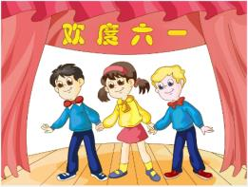
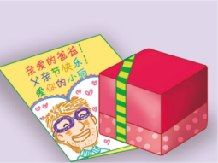
Summary
本课学习主要学习的月份有:
May
June
本课学习主要学习的节日有:
Labour Day
Mother’s Day
Children’s Day
Father’s Day

Slide 14
Thank you!

