Slide 1
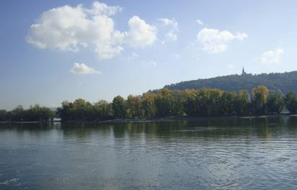
Air
10
WWW.PPT818.COM

Slide 2
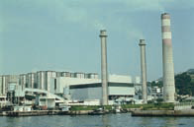
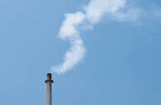
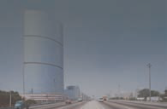
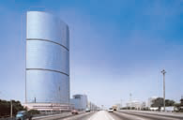
Read and spell
factory
smoke
dirty
clean

Slide 3
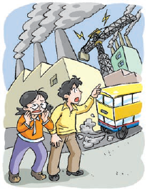
What’s the matter, Kitty? Are you crying?
I’m not crying. My eyes hurt.
It’s the smoke.
Where is the smoke from?
It’s from the cars and buses.
Look at the black smoke from the factory.
It makes the air dirty.
Let’s go to the park, Ben.
The air is clean there.
OK.

Slide 4
The air is so fresh here.
Yes. There are a lot of trees in the park. Trees keep the air clean.
We should plant more trees and keep the air clean.
Yes! We should keep our city clean.

Slide 5
Look and read
The smoke in the street comes from cars, buses and factories.
The air is dirty in the street.
The air is clean and fresh in the park.
There are a lot of trees in it.
Trees keep the air clean.

Slide 6
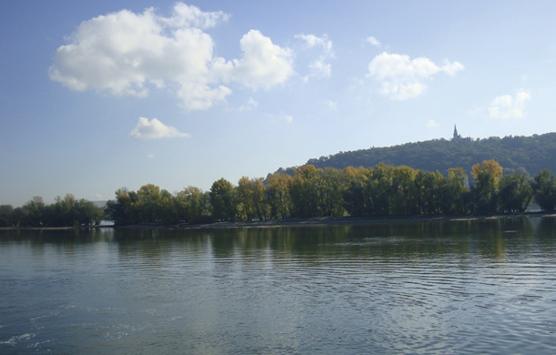
Think and say
Is air important? Why?

Slide 7
Look and say
Air, water and food keep us alive.
We can live without food for five weeks.
We can live without water for five days.
We can live without air for only five minutes.

Slide 8
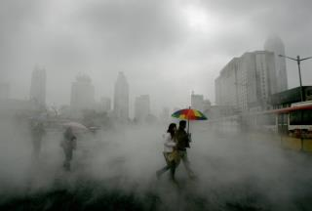
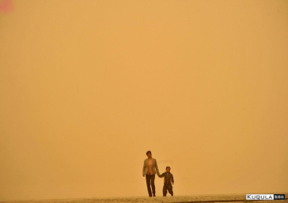
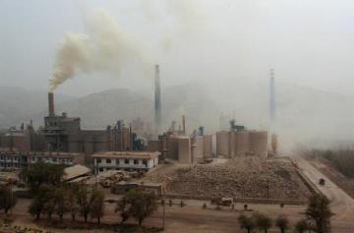
Look and say
The air on Earth is getting dirty.

Slide 9
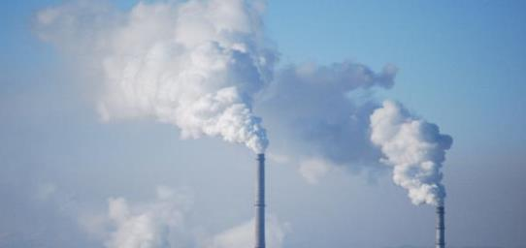
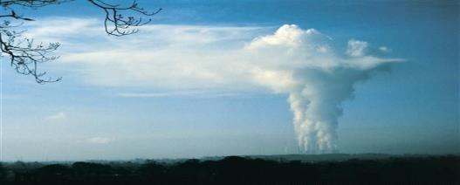
Look and say
Air pollution comes from factories.

Slide 10
Look and read
AIR POLLUTION

Slide 11
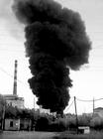
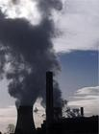
Look and read
We burn coal to make electricity.
Factories give out a lot of smoke.

Slide 12
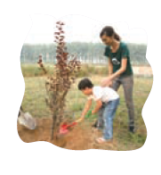
Think and say
Look at the pictures.
Talk about them with your classmates.

Slide 13
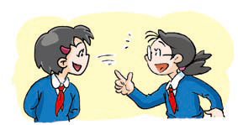
Ask and answer
S1: What makes the air dirty?
S2: The smoke from … makes
the air dirty.
S1: What should we do to keep
the air clean?
S2: We should …

Slide 17
chess
peach
lunch
chase
cherry
church

Slide 18
shine
she
flash
bush
shoe
dish

Slide 19
jeep
jet
joke
jade

Slide 22
Let’s judge！
√
peach
lunch
√
chair
chess

Slide 23
Let’s judge！
she
√
bush
√
she
sheep

Slide 24
Let’s judge！
jam
√
jump
√
job
joke

Slide 25
Let’s judge！
gage
good
×
game
×
age

Slide 26
Let’s judge！
×
snake
pleasure
television
usually
√

Slide 27
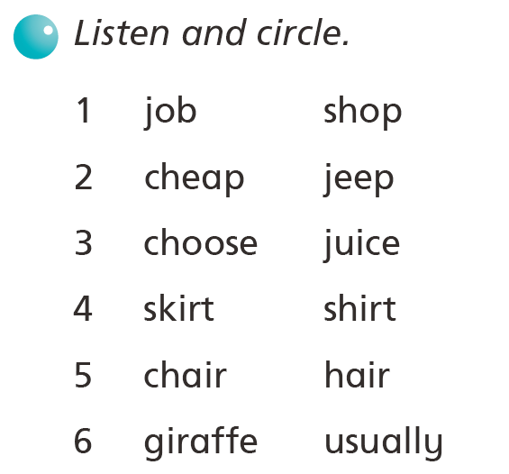

Slide 28
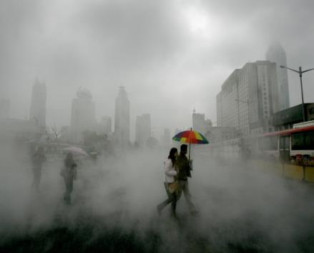
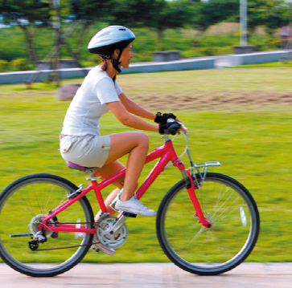
Think and say
Our future
Which do you want?

Slide 29
Make a poster about AIR

Slide 30
We only have one Earth!
We must keep it healthy!

Slide 31
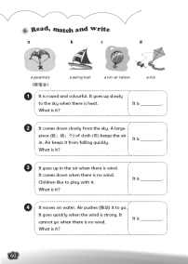
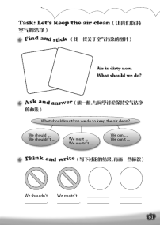
Homework
1. Listen to and read “Listen and say” & “Say and act” on Student’s Book pages 68 and 70.
2. Finish your poster about air.
3. Finish Workbook pages 60 and 61.

