Slide 1
Unit 6 Topic 2
How about exploring Tian'anmen Square?
Section A
WWW.PPT818.COM

Slide 2
Dialog Competition
Suppose you are enjoying your trip to Mount Tai. Call your parents or your friends to tell them something about your trip.
Act out your conversations.

Slide 3
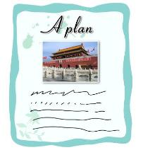
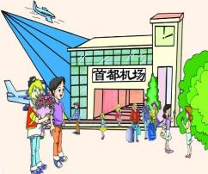
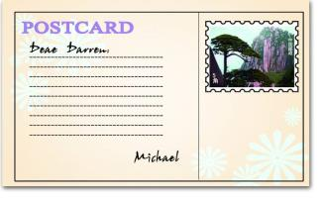
Listen to 1a and tick the pictures according to what you hear.
1b
√
√
3
1
2
make an exploring plan
enjoy his trip
visit the Great Wall
1
√
4
√
5
v. to get or accept sth. from sb. 收到
meet their friend
receive a postcard

Slide 4
Listen to 1a and answer the following questions.
Who is Darren?
What was Darren doing while Michael was enjoying his trip?
What did Michael invite Darren to do?
What did Michael want Kangkang to do?
He is Michael’s friend from San Francisco.
He was preparing for his exams.
n. holiday
He invited him to come to China for his vacation.
He wanted him to meet his friend and make a plan to explore Beijing.

Slide 5
1c
Read 1a and number the following sentences. Then try to retell it.
( ) Michael invites Darren to visit China.
( ) Darren is on vacation.
( ) Kangkang helps Michael make a plan for Darren’s visit.
(1) Darren receives a postcard from Michael.
( ) Michael and Kangkang will meet Darren.
3
2
4
5

Slide 6
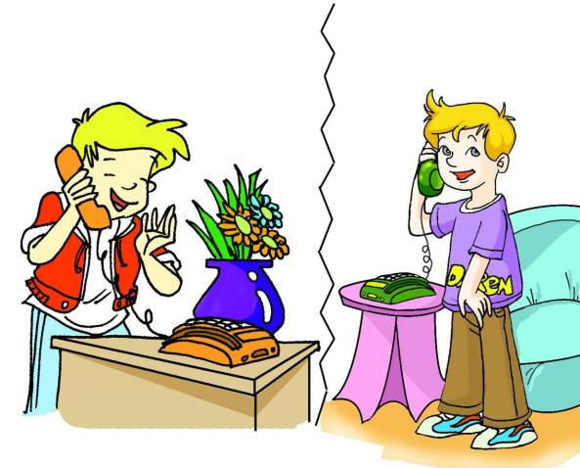
Act the dialog out with your partners.
Key words:
speak to, receive, postcard, trip, exams, vacation, would you like…,
from, meet, look forward to, plan, explore, Tian’anmen Square

Slide 7
Read and match the sentences. Then find more similar expressions from 1a and practice with your partner.
2
Would / Will you help me plan a trip?
Could / Can you come along with us?
Shall we take him there?
All right.
No, let’s not.
Sorry, I’m afraid I have no time.
Yes, I can.
Yes, I’d love to.
I’m sorry I can’t.
Make conversations with the above expressions.

Slide 8
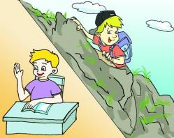
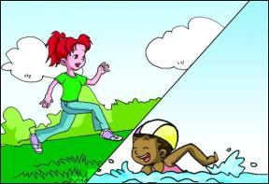
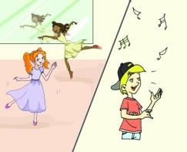
Look at the pictures and make sentences with while or when.
3
Example:
Darren was having a class while Michael was climbing a mountain.
have a class / climb
run / swim
dance / sing
Maria was swimming while Jane was running.
Michael was singing while Jane was dancing.

Slide 9
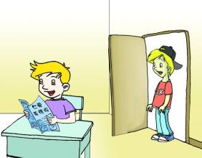
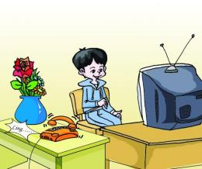
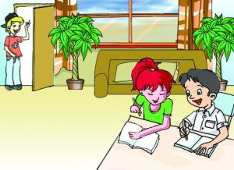
Look at the pictures and make sentences with while or when.
3
Example:
Darren was reading when Michael came in.
read / come in
watch / ring
write / knock at
Kangkang was watching TV when the telephone rang.
Kangkang and Jane were writing when Michael knocked at the door.

Slide 10
The use of “while” and “when”.
“While” means “during the time that something is happening” or “at the same time as sth. is happening” . 只用于指一个时间段（只能与延续性动词连用）， 表示主句与从句动作同时发生。“while”也可以作为名词来使用，表示“一段时间， 一会儿”，如：for a while, after a while
“When” means “at or during the time that…”.它既可指一个时间点，又可指一个时间段；可与延续性动词连用，也可与非延续性动词连用。

Slide 11
Listen to the conversation and choose the correct answers.
4
Diana’s perfect holiday activity is ______.
Diana and Lily should ______ for the holiday.
Where do they decide to go finally?
☀
A. riding B. camping C. fishing
算出，解决to find out the answer or to solve sth.
learn to swim in the sea. B. know more about camping
C. work out the cost carefully
☀
Go to the seaside. B. Camp in the forest.
C. We don’t know.
☀

Slide 12
Exercise
Choose the words and use the proper forms to complete the sentences.
receive camping before postcard vacation
We send each other _________ before the New Year comes.
It’s better to give than to ________.
In China, students usually have a two-month summer ________.
You’d better plan the trip carefully ______ you start.
What about going _______ in the forest next weekend?
postcards
receive
vacation
before
camping

Slide 13
Translation
Exercise
receive one’s postcard
While you were enjoying your trip, I was busy preparing for my exams.
be on vacation
make a plan to explore Beijing
work out the cost of the trip
收到某人的明信片
当你在愉快地游玩的时候，我正忙着准备考试。
在度假
制定考察北京的计划
算出旅行的费用

Slide 14
Translate the following sentences.
Exercise
1. -我能跟Maria通电话吗？ -我就是。
- May I speak to Maria?
- ( This is Maria ) Speaking.
2. -下午去公园好吗？ -好主意！
- Would you like to go to the park this afternoon?
- Great idea!
3. 昨天当我回到家的时候正下着大雨。
It was raining heavily when I got home yesterday.
4. 刚才我在做作业，而我妈妈在炒菜。
I was doing my homework just now while my mother was cooking.

Slide 15
Summary
We learn
New words and phrases:
receive, postcard, vacation, on vacation, work out
Expressions of making phone calls:
- May I speak to…? - This is… speaking.
The use of “while ” and “when”.
While you were enjoying your trip, I was busy preparing for my exams.

Slide 16
Summary
We can
Talk about the holiday travel with my friends :
Make requests or suggestions:
- Would you help me make a plan? - Yes, of course.
- Would you like to come to China for a visit?
- Great idea!
- How about exploring Tian’anmen Square?

Slide 17
Project
Please help Kangkang make the plan to explore Beijing. The following questions may help you.
What are the famous places of interest in Beijing?
What places of interest do you plan to visit?
Which vehicle will you choose?
What should you take with you while exploring?
…

Slide 18
Homework
Review the key points in Section A.
Master the use of “when” and “while”, make more sentences with them.
Search the Internet to find some information about the Tian’anmen Square.
Preview Section B.

Slide 19
The end.
Thanks!

