Slide 1
Module 8
Unit 1
I can hardly believe we’re in the city centre.
WWW.PPT818.COM
1

Slide 2
Know you & know me
hobby
I think that…
school
age
I guess that…
subject
I know that…
I’m sure that…
I can’t believe that…

Slide 3
Guess where the teacher has ever been to.
I think that…
I guess that…
I know that…
I’m sure that…
I can’t believe that…

Slide 4
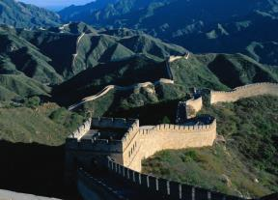
Beijing is the capital of China.
There are many places of interests.
Tian’anmen Square
The Great Wall

Slide 5
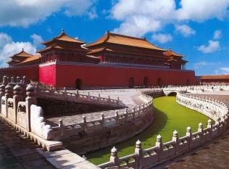
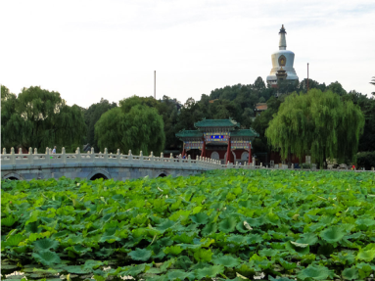
The Forbidden City
Beihai Park

Slide 6
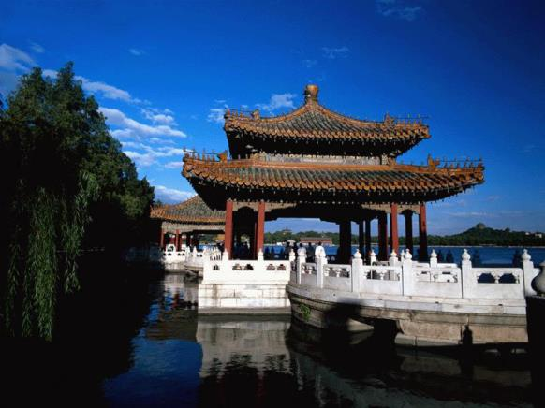
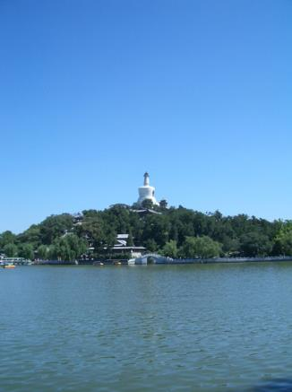
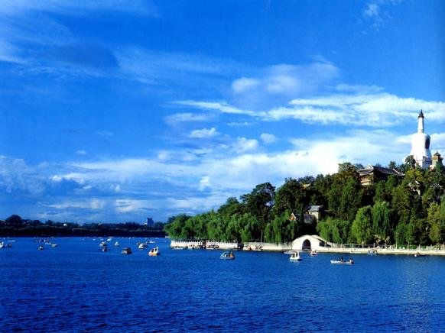
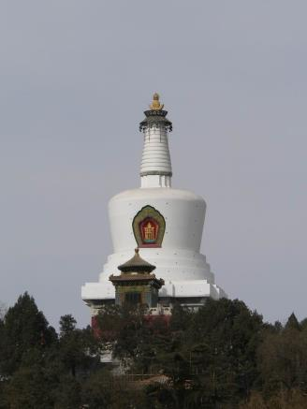
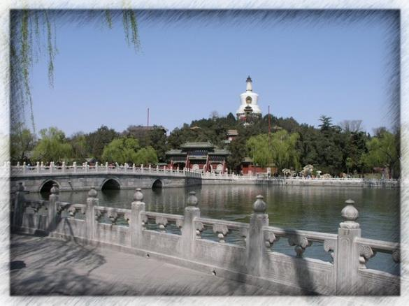
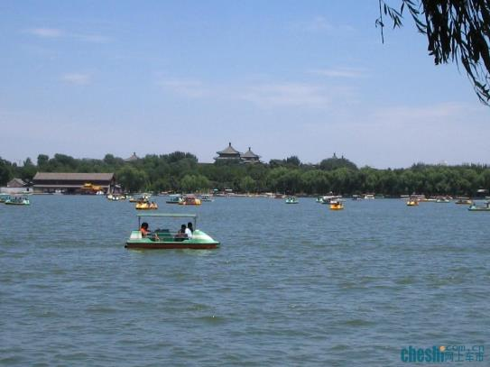
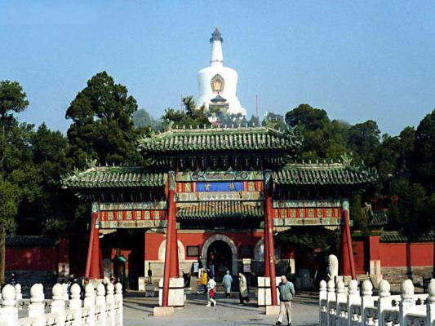
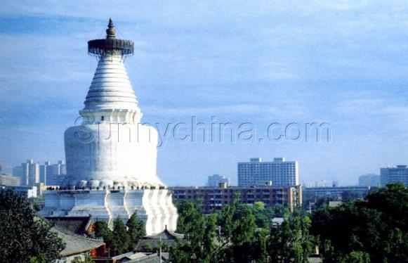
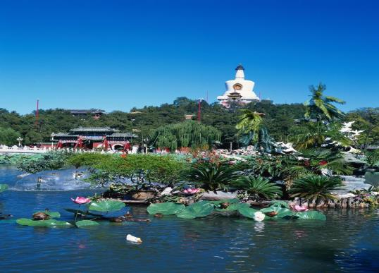
Baita Temple
At the top of the hill
ancient buildings
bridge
large lake
The lake takes up more than half of the park area.
A, 花费 B， 占去

Slide 7
Let’s listen
1. What are they talking about?
They are talking about ___________________ Beihai Park.
A: their ways to B: their plans to visit C: their experience in

Slide 8
Listen again and choose the correct answer.
Tony has / hasn’t heard about Beihai Park.
Tony guesses that the park is very popular / not very popular.
Lingling suggests that they spend the day there / Daming and Betty come to.
Lingling thinks / doesn’t think …

Slide 9
They have talked about their plans. What will they do next?
I think they will…
I guess they will…

Slide 10
Listen and answer the following questions:
Activity 3
1. where are they?
2. What’s the park famous for?
3. How big is the lake?
Beihai Park.
This park is famous for its lake, bridges and ancient building on the hill.
It takes up over half of the park area.

Slide 11
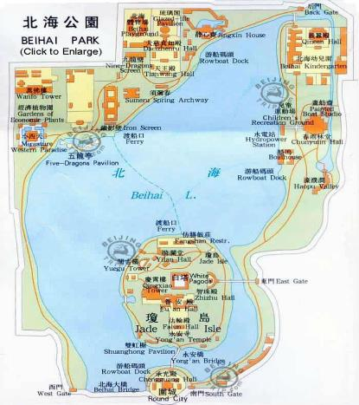

Slide 12
What can you do in the park?
What will they do in the park?
I think they will…
I guess they will…

Slide 13
Let’s read

Slide 14
Listen to the conversation and answer the questions.
1. What is Beihai Park famous for?
This park is famous for its lake, bridges and ancient building on the hill.
2. Where are they have a picnic?
At the top of the hill.

Slide 15
3.Where are Lingling, Tony and Daming?
4.How does Tony feel about the park?
They’re in Beihai Park.
It’s so quiet. He can even hear the birds singing.
5. Why does Daming want to climb the hill?
Because he is so tired and the weather is so hot.

Slide 16
Read and complete the sentences about Beihai Park.
1. Beihai Park is so __________ that you can even hear the birds singing.
2. The park is famous for its ______, bridges and the ancient building on the hill.
3. The lake takes up ________ of the park area.
4. You can point out the _______ of Beijing from the top of the hill.
5. They do not allow people to swim ___________.
quiet
lake
over half
sights
in the lake

Slide 17
Read again and answer the questions.
1. I can hardly believe we’re in the city centre.
Does Tony think they are in the city centre or not?
Tony doesn’t think they are in the city centre.

Slide 18
2. Then I can point out the sights of Beijing for you.
Does Lingling want them to look at something or listen to something?
Lingling wants them to look at something.
3. I’m so hungry and thirsty.
Does Daming want something to drink?
Yes, he does.

Slide 19
4. Let’s not waste any more time.
Does Tony think they are spending their time well or badly?
Tony thinks they are spending their time badly.

Slide 20
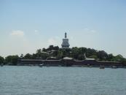
Let's talk
Beihai Park
Location: in the center of the city.
Area: 690000 square meters
History about 1000 years old
Special : the beautiful lake and the hill.
Others: Nine-Dragon Screen / Baita temple

Slide 21
Mount Yandang
Location:…
Area: 450 square kilometres
History: 120 million years
Special: peaks, caves, waterfalls
Others:
Jiangxin Island
Location:…
Area: 700 square kilometres
History: over 1000 years
Special: Jiangxin Temple, waterworld
Others:
Nanxi River
Location:…
Area: 625 square kilometres
Length: 139.8 kilometers
Special: clean water and rocks
Others:

Slide 22
A: where is it?
How big is it?
How old/long is it?
What is it special for?
Do you know any other information?
BCD: I guess that…
I know that..
I ‘m sure that…
I can’t believe that…

Slide 23
Talk about the places of interest in your city
Report:
In my group, _____ knows that …is…
_____ thinks (that) …
_____ has heard that…
_____ guesses (that)…
_____ is sure that…
_____ can’t believe that…

Slide 24
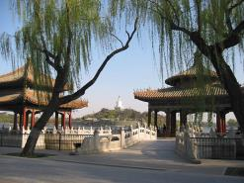
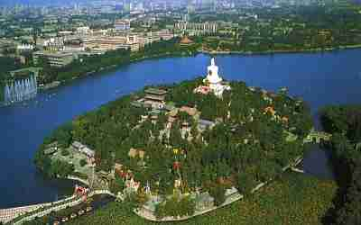
Have you ever been to Beihai Park? When did you go there?

Slide 25
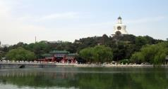
go boating
climb the Baita
go for a walk
go sightseeing
We can
We can see
beautiful flowers
clear water
ferry
different kinds of boats

Slide 26
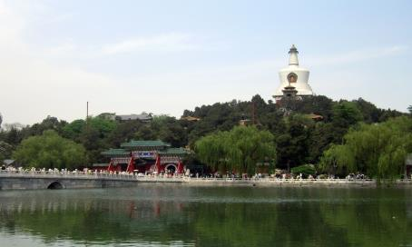
Look at the photo and listen. What is the conversation about?
The conversation is about going to Beihai Park.

Slide 27
Read the conversation and fill in the blanks.
Beihai Park
A: I’ve heard that ___________ is very beautiful.
B: Yes, it is. Shall we _______________ there?
A: That’s a great idea. Maybe Daming and Betty will come, too.
go for a walk

Slide 28
B: Let’s tell them that we’re going to ______ the day there.
A: I guess it’s a very ________ place. Will there be lots of people there?
B: Well, lots of people go there, but it’s a big park, so I don’t think it’ll be very ______.
A: I hope not.
spend
popular
busy

Slide 29
Language points
1. time off
time off 意思是“（ 正式规定的）休假或放假”。如：
If you are feeling tired, you should take some time off.
Will you mind if I have some time off?
He gave up holidays and other time off.

Slide 30
2.Welcome to Beihai Park.
welcome (sb.) to ... 欢迎某人进入…...。如 Welcome to our school.
Welcome home.
welcome也可以作名词, “欢迎”。 如：
give visitors a warm welcome
receive a cold welcome
别人说thank you 或thanks时，可以用You are welcome.来回答。

Slide 31
3. I can hardly believe ...
hardly adv.“几乎不,仅仅”，含有否定的意味,放于be 动词或助动词之后、行为动词之前。如：
It was so dark that I could hardly see anything.
The old people can hardly speak English.
I haven’t seen her for years but she has hardly changed at all.

Slide 32
辨析：hard、hardly
1、hard可用作形容词或副词。用作形容词时意为“困难的，硬的，勤奋的，严厉的，苛刻的”；用作副词时，意为“努力地，猛烈地，剧烈地”。
2、hardly是副词，意为“几乎不”，多和can连用，接近almost not，也可表示“几乎没有”的意思，和any连用时，相当于almost not。

Slide 33
4. The lake takes up over half ...
take up
(1)占，占去（时间；空间）
That big table takes up too much room.
Learning English takes up a lot of my time.
That boy took my time up with his questions.

Slide 34
(2)开始从事
He had studied Japanese for a year and a half before he took up English.
We took up physical chemistry at college.
The scientist has taken up a new subject.

Slide 35
[Practice]
1. When did he take up football?
2. The work took up all his time.
他是什么时候开始踢足球的?
那工作花费了他所有的时间。

Slide 36
After studying in a medical college for five years, Jane ______ her job as a doctor in the countryside.
A. set out B. took over
C. took up D. set up
答案： C

Slide 37
5. point out
point out 指出，说明；使注意到
Did he point out where you were wrong?
No matter who point out our shortcoming, we will correct them.
Point out the mistake in this sentence, please.

Slide 38
[辨析] point at, point to, point out
point to和point at都有“指向”之意，有时可以互换。
①point to多指较远距离的事物，to着重于指方向，主语既可以是人，也可以是物；
②point at多指向较近距离的事物，at着重于指的对象，其主语通常是人；但point … at是“瞄准 ……”之意；
③point out是“指出……”之意，out是副词。

Slide 39
[Practice]
point at
1). Don’t _________ the words while you are reading.
2). As he started the operation, the hour hand of the clock __________ 9.
3). The teacher ___________ many mistakes in my homework.
4). Will you please __________ the man who saved the boy’s life?
5). They ________ their guns ____ her head, but she was not afraid.
pointed to
pointed out
point out
pointed
at

Slide 40
6. Why don’t we go for a swim?
Why don’t … do …? = Why not do…? “为什么不…？” 。如：
Why don’t you come earlier?
Why not come earlier?

Slide 41
[Practice]
1). --- ________ come and join us in the game?
--- Id like to. But I must go to meet Mr. Smith at the airport.
A. Why not B. Why don’t
C. Why not to D. Why
【答案与解析】很显然这是对 why not do …和 why don’t you do sth. 句型的考察，这里用排除法很容易就能排除 B 项，缺少主语 you；排除 C 项，不需要加 to；排除 D 项，缺少 not；所以选 A。

Slide 42
[Practice]
2). ---Why not come and join us in the game?
---________. But I must go to meet Mr. Smith at the airport.
A. I’d like to B. Let’s go
C. Yes, please D. It’s a pleasure
【答案与解析】 本题考察Why not do ...句型的回答。根据句意：---来参加我们的比赛，怎么样？ ---我想去，但是我必须去机场接 Smith 先生。不难看出应该选择 A。其他的选项不符合句意。

Slide 43
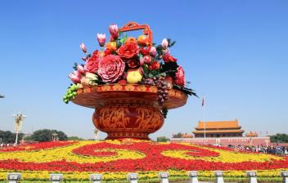
Read and practice the conversation with your partners.
Make a new conversation.

Slide 44
Pronunciation and speaking
Listen and notice how the speaker pronounces the words.
It’s so quiet here that I can even hear the birds singing.
Let’s walk along the lake, cross the bridge and climb up the hill.
I don’t want to climb.

Slide 45
Work in pairs. Take about a place of interest in your home town.
Student A: You’re a visitor from another country.
Student B: You’re introducing a place of interest in your home town to student A. You can talk about:

Slide 46
Where it is
How big it is
How old it is
What is special about it
Any other information you know about it
Use the expressions:
I guess (that) …
I know (that) …
I think (that) …
I’m sure (that) …
I can’t believe (that) …

Slide 47
谢谢
47

