Slide 1
Unit 2 Let’s play sports!
WWW.PPT818.COM

Slide 2
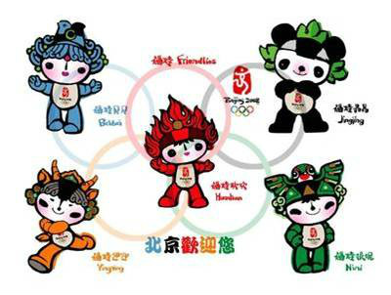
Lead-in
Beijing Olympic Games

Slide 3
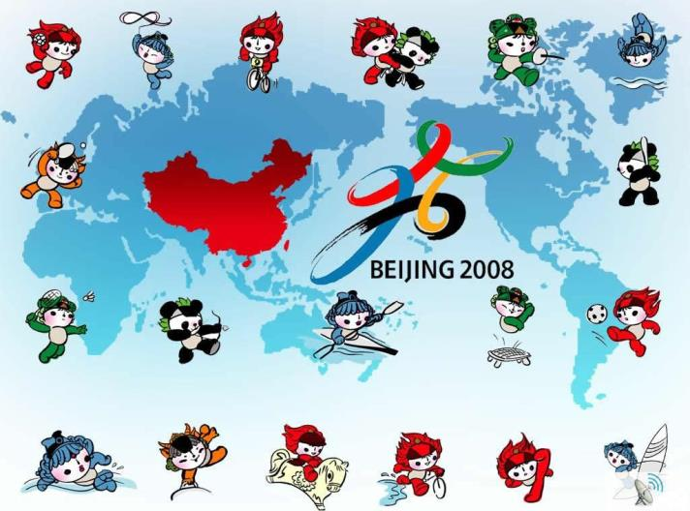
Friendlies (福娃) love sports！

Slide 4
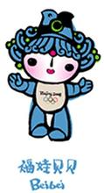
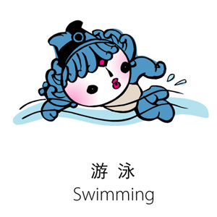
What sport does Beibei like best?
Beibei likes swimming best.
His favourite sport is swimming.

Slide 5
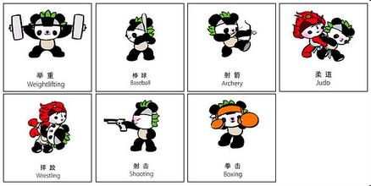
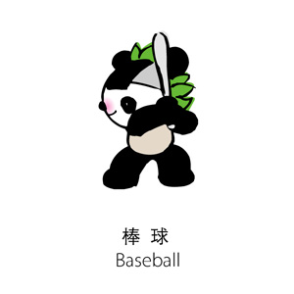
Which sport does Jingjing like best?
Jingjing likes baseball best.
Baseball is his favourite sport.

Slide 6
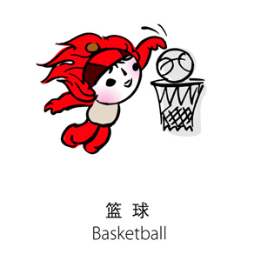
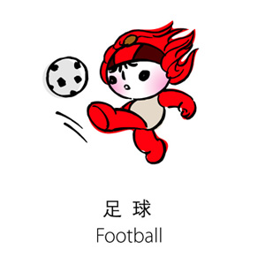
Huanhuan is good at two kinds of sports. What are they?

Slide 7
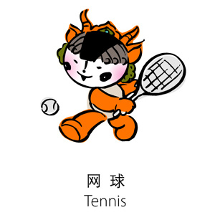
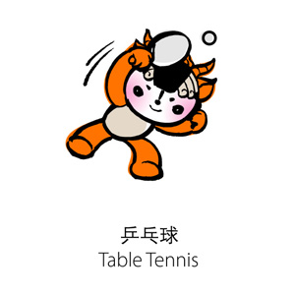
What are Yingying's favourite sports?

Slide 8
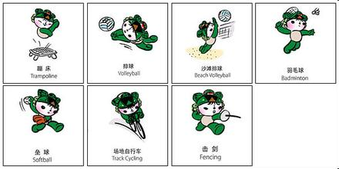
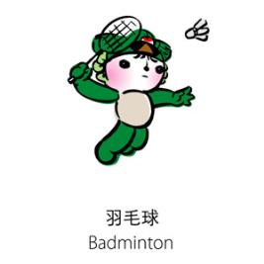
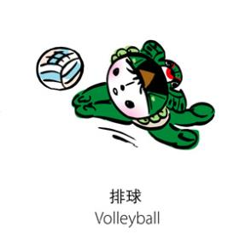
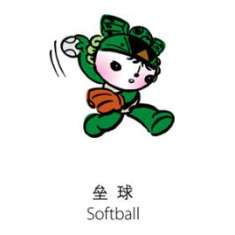
Which of the sports does Nini like best?

Slide 9
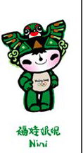
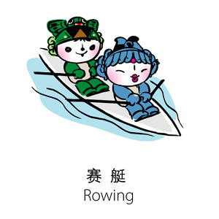
What sport do Beibei and Nini both like ?
They both enjoy rowing.

Slide 10
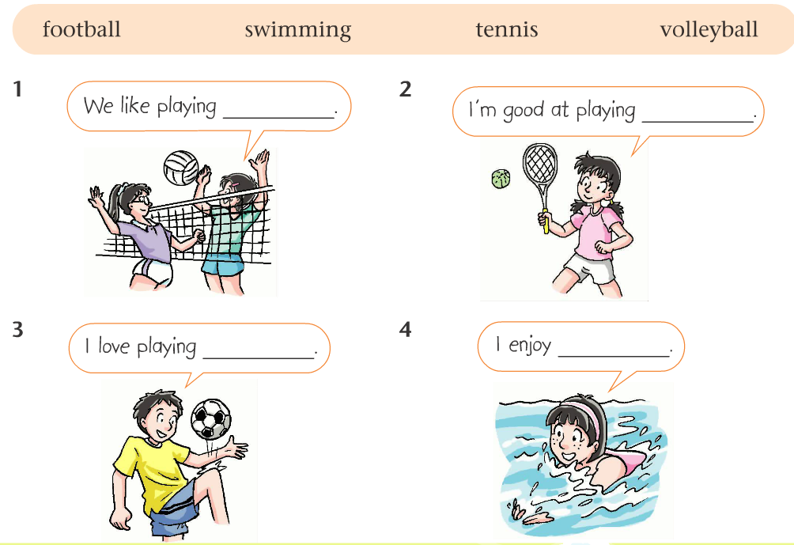
What sports do they like? (Part A1, P19)
volleyball
tennis
football
swimming

Slide 11
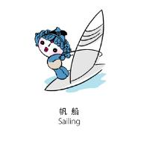
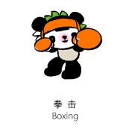
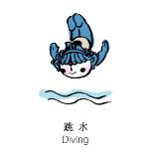
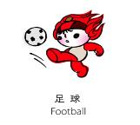
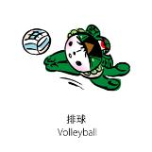
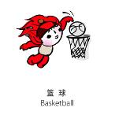
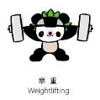
Pairwork
A: What sports do you like?
B: I like ....
What about you?
A: I enjoy/like/love ....

Slide 12
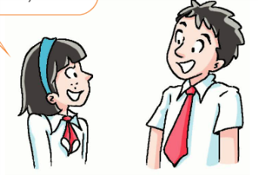
Listen and answer
1. How often does Amy go swimming?
She goes swimming every week.
2. What sport does Simon like best?
He likes football best.

Slide 13
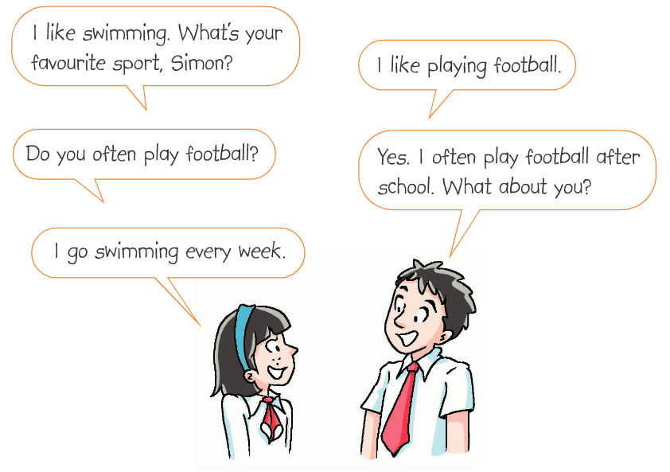
Listen and read
once a week
twice a week
three times a month
many times a day

Slide 14
Group work: a report on your groupmates' favourite sports
Sample:
My groupmates are...
A likes....He/She plays/goes... every week/twice a week.
B’s favourite sport is .... He/She ....
C enjoys .... He/She ....
I love ....
We all love sports.

Slide 15
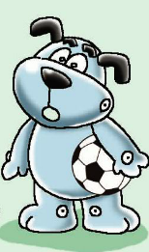
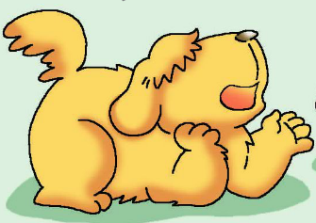
?
Hobo likes football very much.

Slide 16
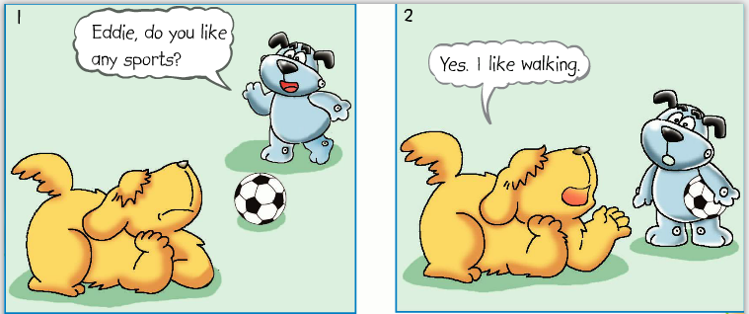
Watch and answer
What is Eddie's favourite sport?
He likes walking.

Slide 17
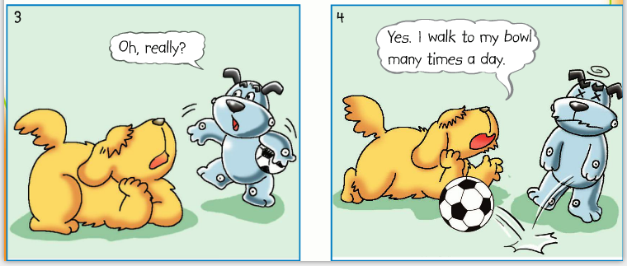
Listen, read and answer
Does Eddie really like walking?
No, he doesn't. He likes eating. So he walks to his bowl many times a day.

Slide 18
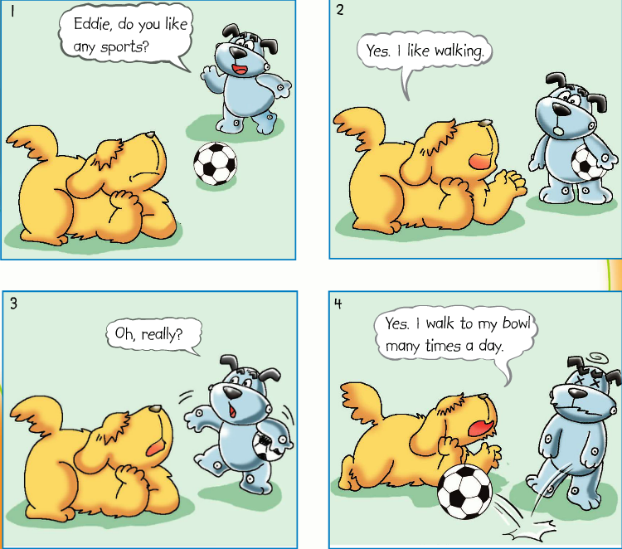
Read in roles

Slide 19
Act it out

Slide 20
Fill in the blanks
Eddie says he l____ sports because he likes w______. He tells Hobo that he walks to his b____ many times a day. In fact, he doesn’t r_____ like sports at all. He just likes e______ food.
ikes
alking
owl
eally
ating

Slide 21
Sports are good for our health. We love sports. We are healthy. We are happy. Enjoy sports and enjoy our life.

Slide 22
Homework
1. Recite Comic strip and Part B
2. Write a report on your favourite sport.

