Slide 1
Unit 4
Then and now
第二课时
WWW.PPT818.COM

Slide 2
Introduce
动词过去式不规则变化总结:
be(是)----was, were become(变成)----became bring (带来)---- brought
build(建筑)---- built buy (买)---- bought can(能) ---- could
come(来)---- came do(做) ---- did fly (飞)----flew
go (去)----- went have ( 有)---- had lose (丢失)----- lost
read (读)-----read run(跑)---- ran say (说)----- said
see (看见)---- saw take (拿到)---- took tell (讲述)---- told

Slide 3
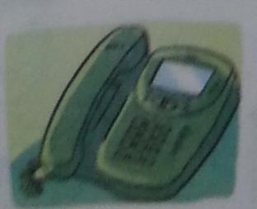
Words
telephone
/'telɪfəʊn/
名词,表示“电话”。
常用短语：use the telephone 使用电话
on the phone 在打电话
eg： Why not just use the telephone ?
为什么不直接使用电话 ？
小练习：（ ）te ___ ___ ph ___ ne
A. el ; i B. le ; o
B

Slide 4
Words
office
/'ɒfɪs/
名词,表示“办公室”。
常用短语：in the office 在办公室
near the office 在办公室旁边
eg ： There is a post office near the supermarket .
在超市附近有个邮局。
小练习： worked, in, he , office, the, yesterday.
______________________________
He worked in the office yesterday.

Slide 5
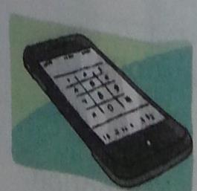
Words
mobile phone
名词,表示“手机、移动电话”。
常用短语：a mobile phone 一部移动电话
eg ： There is something wrong with his mobile phone.
他的手机出了点问题。
小练习：现在几乎每个人都有一部电话。
__________________________
Now almost everyone has a mobile phone.

Slide 6
Expressions
Twenty years ago, she bought things from shops.
20年前,她从商店里买东西。
ago指的是从现在起到过去时间的某一点的一段时间。
eg ：Five years ago， we visited Yunnan.
五年以前,我们参观了云南。
小练习 : He wants ________(bring) some English books to school.
They _______( see) many beautiful birds last week.
brought
saw

Slide 7
Expressions
Twenty years ago.
20年前。
某段时间+ago表示·····前,一般过去时的常见的时间状语。
eg: Little Tom was born five years ago. Now he is five years old.
Little Tom五年前出生,现在他五岁了。
小练习 :Liu Tao could read when he was young .(改为否定句)
___________________________________________
Now Mrs Green has a telephone.(对画线部分提问)
___________________________________________
Liu Tao couldn’t read when he was young.
What does Mrs Green have now ?

Slide 8
Dialogues
Retelling the text!

Slide 9
Expand
一般过去时的构成
(一)规则动词的过去式
1.一般情况下,在动词原形后面加-ed。
look →looked play→played start →started visit→visited
2.以不发音e结尾的动词,在词尾直接加-d。
live →lived use →used

Slide 10
Expand
一般过去时的构成
(一)规则动词的过去式
3.以“辅音字母+ y”结尾的动词,先将 y 改为i ,再加 –ed。
study →studied try →tried fly →flied
4.以重读闭音节（即辅音＋元音＋辅音）或r音节结尾,末尾只有一个辅音字母的动词,要先双写这个辅音字母后,再加 –ed。
stop →stopped plan →planned prefer →preferred

Slide 11
Expand
一般过去时的构成
(二)不规则动词的过去式
1.改变动词中的元音
begin →began drink →drank know →knew
2.变词尾的–d 为–t
build →built lend →lent send →sent

Slide 12
Expand
一般过去时的构成
(二)不规则动词的过去式
3.与动词原形一样
cut →cut put →put cost →cost
4.变-ay 为-aid (少数动词)
say →said pay →paid lay →laid

Slide 13
Expand
一般过去时的构成
(二)不规则动词的过去式
5.采用不同词根:
sell →sold teach →taught buy →bought
6.其他
am/is →was are →were have/has →had

Slide 14
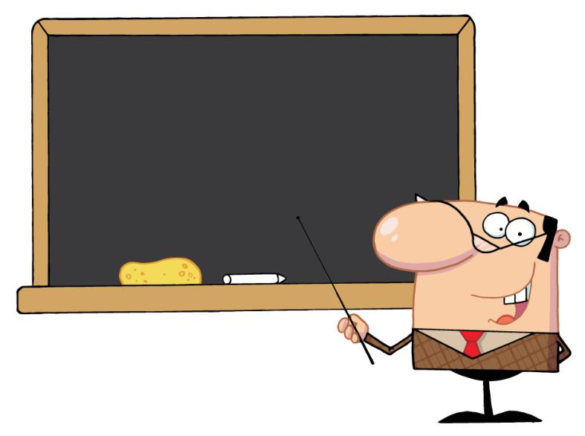
Summary
telephone office
mobile phone
···ago

Slide 15
Exercise
1. --- Did you like the film ? --- ______.
A. Yes, it was interesting. B. Yes, I was. C. No, I don’t.
2. _____ there ______trees on the farm now ?
A. Were, any B. Are, some C. Are , any
A
A

Slide 16
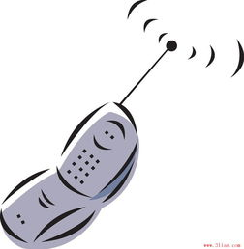
Exercise
3. There _____ a mobile phone on the desk.
A. are B. were C. was
4. Do you like _______piano ?
A. play B. playing C. playing the
C
C

Slide 17
Exercise
5. Yang Ling and his friend __ to music last week.
A.didn’t listened B. didn’t listen C. doesn’t listen
6.I often _____ flowers in the morning.
A. waters B. water C. watered
B
A

Slide 18
Homework
Write a passage titled“··· years ago”.
一般疑问句 | Did you catch any fish ? | Yes, I did .
句型结构 | Did +主语+动词原形+其它 ？ | Yes，主语+did. No, 主语+ didn’t .
特殊疑问句 | What did you do there ? How was your holiday , Mike ? | We went to the Bound . It was fun.
句型结构 | 特殊疑问词+一般疑问句+？ | 主语+动词过去式规则与不规则变化 。

