Slide 1
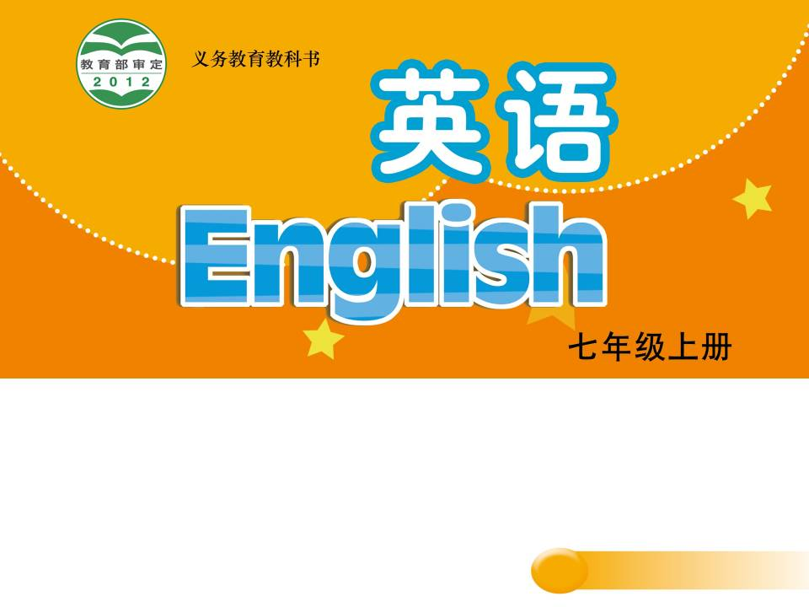
Unit 7 Shopping
Task
WWW.PPT818.COM

Slide 2
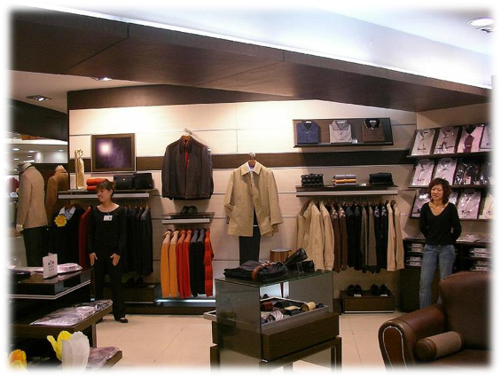
clothes shop
It’s a ____________.
We can buy _____________________ in it.
different kinds of clothes
Notes:
2

Slide 3
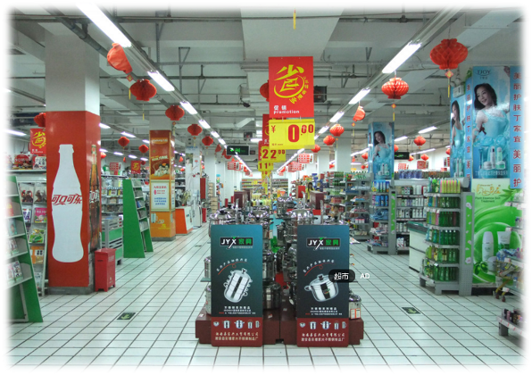
It’s a _____________.
We can buy ___________________ in it.
supermarket
many different things
Notes:
3

Slide 4
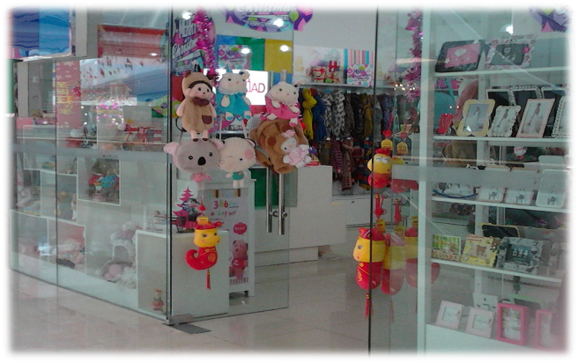
It’s a _____________.
We can buy _____________________ in it.
gift shop
lots of interesting gifts
Notes:
4

Slide 5
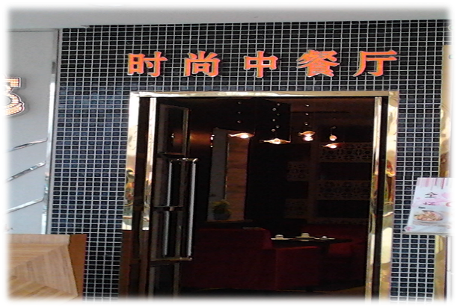
restaurant
It’s a _____________.
We can taste ______________________ in it.
foods from different areas
Notes:
5

Slide 6
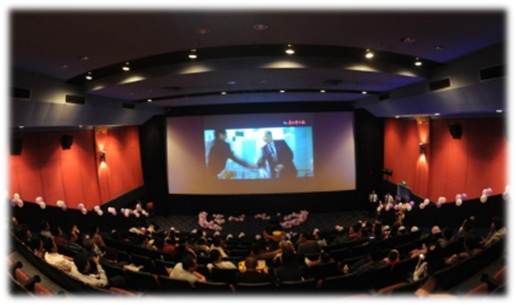
cinema
It’s a _________.
We can ____________ there.
watch films
Notes:
6

Slide 7
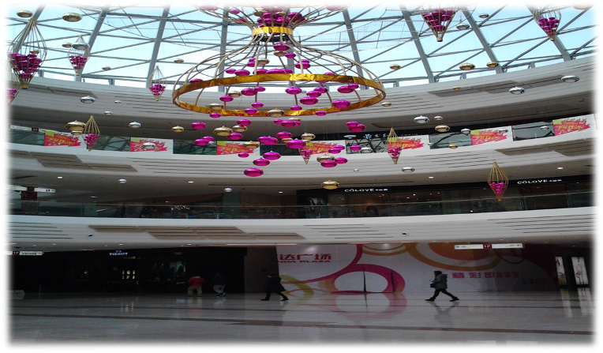
a shopping mall
Notes:
7

Slide 8
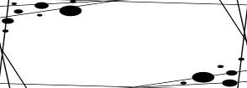

Pair work
Read the notes about Sunshine Shopping Mall
and ask and answer in pairs
1. Where is the shopping mall?
2. How many floors of shops are there?
3. Where are the restaurants?
4. Which place is Millie’s favourite?
5. Can people buy any books in the mall?
6. Can people buy clothes there?
7. What food can people eat there?
Notes:
8

Slide 9
Read and complete
Sunshine Shopping Mall is a new mall. It is near .
The mall is very big. There are floors of shops and each floor is big. There are many . We can get kinds of clothes here. There is also a big . It has lots of interesting books.
All the restaurants are on the . There are foods from different . I like Chongqing Restaurant. The food there is really great.
I like watching films, so the big is my favourite place in the mall.
The mall is a good place to meet friends and have fun.
a bus stop
five
clothes shops
different
bookshop
top floor
areas
cinema

Slide 10
What does Millie tell us about the Sunshine Shopping Mall?
Sunshine Shopping Mall is a new mall. It is near a bus stop.
The mall is very big. There are five floors of shops and each floor is big. There are many clothes shops. We can get many kinds of clothes here. There is also a big bookshop. It has lots of interesting books.
All the restaurants are on the top floor. There are foods from different areas. I like Chongqing Restaurant. The food there is really great.
I like watching films, so the big cinema is my favourite place in the mall.
The mall is a good place to meet friends and have fun.
name and location
the kinds of shops and things in the shops
the reason you like it

Slide 11
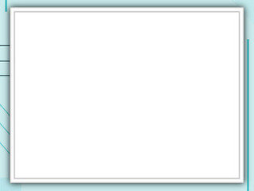
Write about a shopping mall
Para 1:
Name of the shopping mall
Location
(How to get there)
Para 2:
Number of floors
The kinds of shops
Things in the shops
Para 3:
The reason you like it

Slide 12
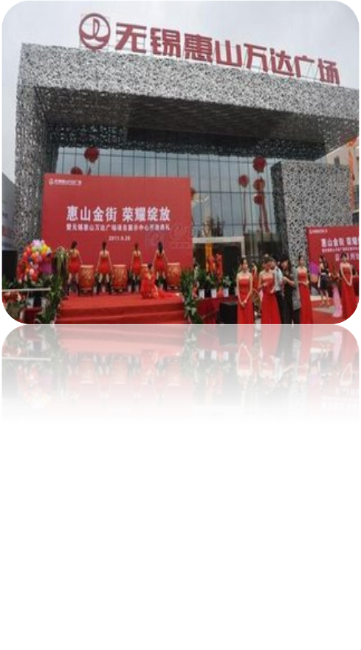
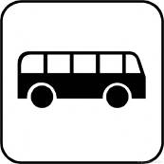
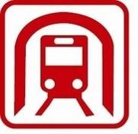
Good location
bus stop
Wanda Shopping Mall
underground station
Notes:
12

Slide 13
Discussion
Wanda Shopping Mall
Fashion Shopping Guide
How many floors are there?
What’s on each floor?
What can we do on each floor?
Notes
特色美食
Food
3F 万达影城
Wanda Cinema
three floors
on the top floor
foods from different areas
a big cinema for watching films
different kinds of clothes and shoes
lots of interesting gifts
buy all kinds of things
have a chat with friends
时尚服饰/ 精品鞋馆/潮流礼品
Beautiful clothes / Shoes
/Nice gifts
2F
超市
Supermarket
1F 咖啡店/肯德基
Coffee shop / KFC

Slide 14
Do you like shopping malls like Wanda?
Why?
have fun/
have a good time
meet friends
A good place to
…
relax oneself
(放松自己)
kill time
(打发时间)

Slide 15
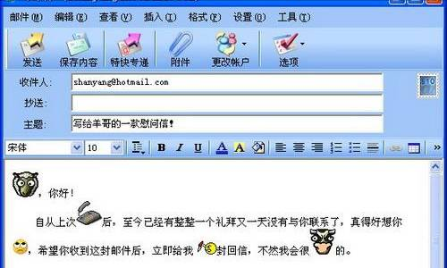
Millie @ qq.com
Wanda Shopping Mall
Dear Millie,
Thanks for telling me a good place to go shopping. I will also tell you a wonderful place for shopping. It is …

Slide 16
Evaluation form
标准内容 | 得分 | 组评 | 师评
内容完整， 语言流畅 | 8
有自己的思想，有创意 | 1
书写工整 | 1
拼写，用词及语法错误每两处0.5分

Slide 17
Homework
Design your dream shopping mall and then write a guide to it.
Notes:
17

