Slide 1
Module 10 Australia
Unit 1
I have some photos that I took in Australia last year.
WWW.PPT818.COM

Slide 2
Warm up

Slide 3
While we’re learning,
Pay full attention
Remember as many as possible
Try your best to answer every question
We’re the best!

Slide 4
Look at the following inventions used in our daily life. What are they in English?

Slide 5
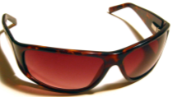
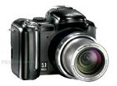
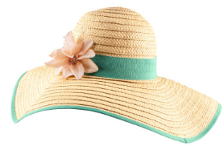
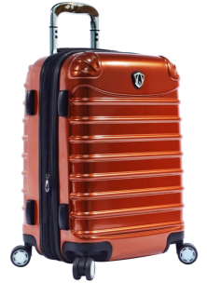
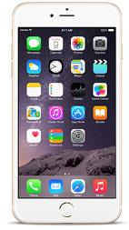
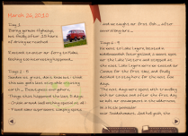
Tony’s mother
Where is she going?

Slide 6
According to what you see, which of the following countries will she visit now?

Slide 7
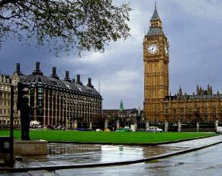
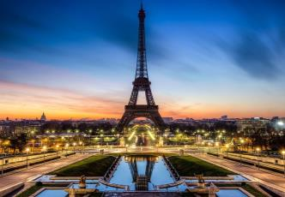
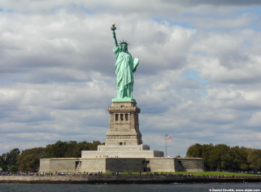
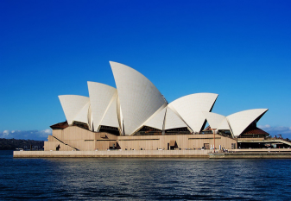
Which country will Tony’s mother visit now?
Britain
France
the USA
Australia

Slide 8
Presentation
Do you know what Australia is famous for?

Slide 9
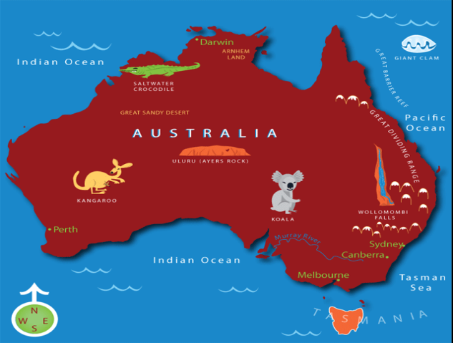
central
off the northeast coast

Slide 10
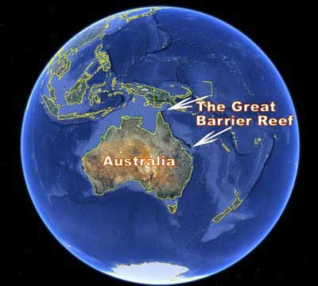
Great: it can be seen from outer space.

Slide 11
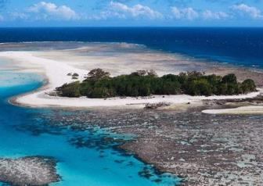
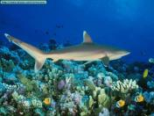
the Great Barrier Reef (大堡礁)
barrier
(屏障)
[bæriə]
[ri:f]
a natural wonder
shark
鲨鱼
It is an island with many ______ animals.
sea
It is the largest coral reef in the world.
['kɒrəl]
珊瑚礁

Slide 12
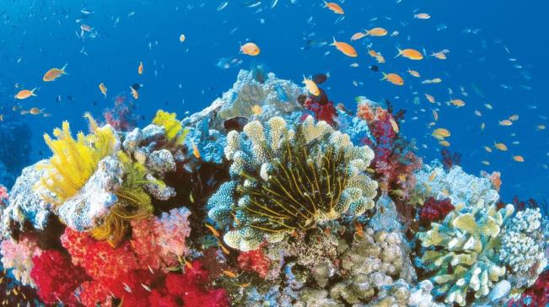
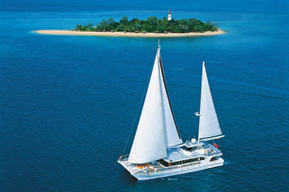
coral reef
sailing boat

Slide 13
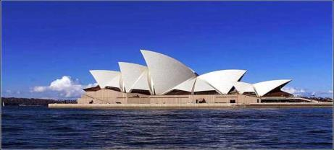
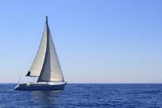
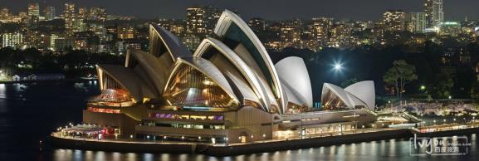
the Sydney Opera House
man-made
The Sydney Opera House is a _____________ wonder.
It looks like a huge _______ boat on the water.
sailing

Slide 14
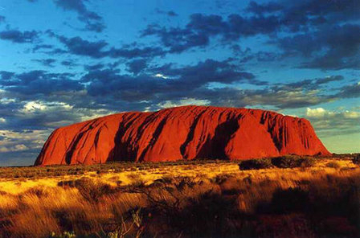
Ayers Rock (also called Uluru)
Height: over 300 meters
magical
3.6 km long

Slide 15
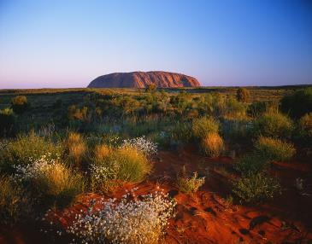
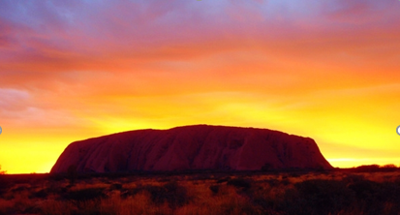
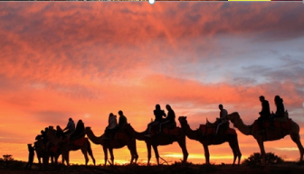
Ayers Rock
The colour of the rock will be changed because of the sunlight.

Slide 16
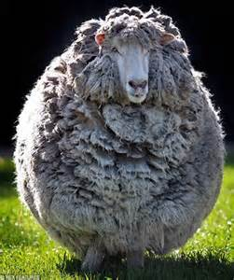
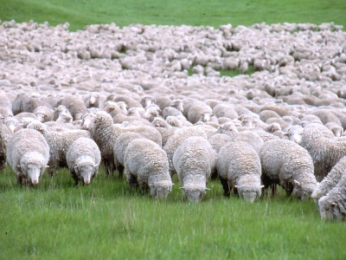
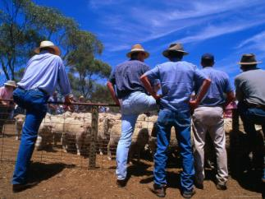
a sheep
lots of sheep
a hat
sheep farmers

Slide 17
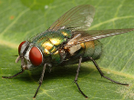
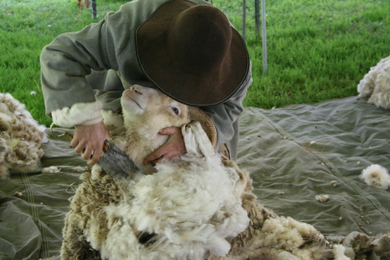
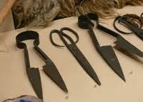
keep the flies away
fly
wool
scissors
cut the wool off the sheep

Slide 18
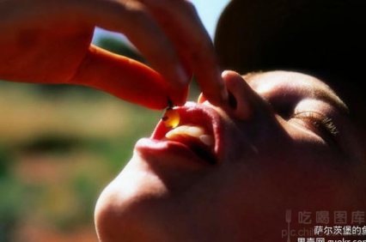
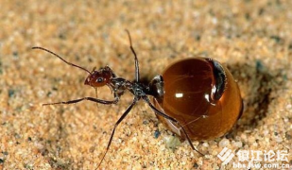
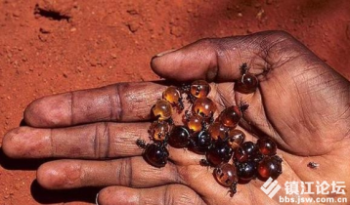
an ant
local people’s sweet food

Slide 19
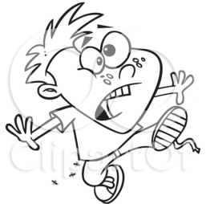
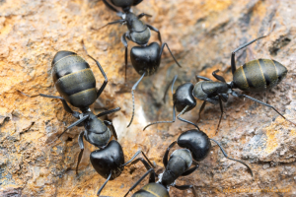
brush them off

Slide 20
Let’s review the new words we’ve learned.
Read aloud
Put it into Chinese
Ask your partner for help when necessary.

Slide 21
scissors
wool
hat
according to
brush
central
magical
sailing boat
diary
fly(ies)
ant
height

Slide 22
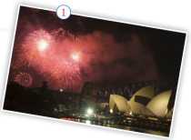
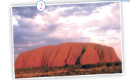
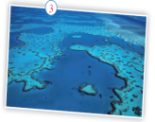
Listening
Listening
1.Answer the questions. Use the pictures to help you.
Where were the Olympic Games held in 2000?
Sydney
2. What is the largest English-speaking
country in the southern part of the world?
Australia
3. What famous things can you see there?
We can see the Opera House, Ayers Rock and the Great Barrier Reef.

Slide 23
2. Listen and complete the sentences.
1. The country that Tony would like to visit is ______________.
2. In Tony’s opinion, Australia is famous for __________________________.
3. Ayers Rock is a huge rock in ____________ Australia.
4. Australia is ___________ English-speaking country in the southern part of the world.
Australia
Olympic Games held in 2000
the centre of
=central
[sentrəl]
the largest

Slide 24
Listen and answer
What is Tony going to write about?
A. American B. China C. Australia
2. Which things does his father show him?
A. photos B. maps C. toys
3. What’s the height of the Ayers Rock?
A. 384 m B. 348 m C. 448 m

Slide 25
Listen to some information about photos and complete the table.
photo | Facts about Australia
Name
 | in _______ Australia |  | lies off the _________ coast of Australia
Details |  | like a huge sailing boat with water on _____ sides | over _______ km long
Ayers Rock
Sydney Opera
House
The Great
Barrier Reef
central
Sydney
northeast
Location
a special huge rock
2,600
three

Slide 26
3. Read and find.
Tony: Dad, I need your help. My teacher asked us to choose a country we want to visit,
imagine we were there, and write a letter to our parents back home. I’ve chosen
Australia. How can I do it?
Dad: Don’t worry. I have some photos that I took in Australia last year. They may help
you. Here we go. This is a rock called Ayers Rock, in central Australia. According
to the local people, it’s a special and magical place.
Tony: Oh, it looks huge. What’s its height?
Dad: 348 metres. And this is the Sydney Opera House. It’s like a huge sailing boat with
water on three sides. And this one is the Great Barrier Reef.
Tony: Does it lie off the northeast coast of Australia?
Dad: Yes, it’s over 2,600 kilometres long. It’s a great natural wonder. And here are
some photos of my Australian friends. They’re sheep farmers. They wear special
hats that keep the flies away. The scissors that they’re holding are to cut the wool off the sheep. Do you know that many Australians came from Britain?
Tony: Yes, of course! That’s why they speak English. Did you keep a diary while you
were there?
Dad: Yes, and you can read it.
Tony: That’s great! And what didn’t you like about Australia?
Dad: I hated the ants that were all over the place. I had to brush them off my clothes,
especially my trousers!
Tony: Ants in your trousers! That’s really funny!
Dad: It wasn’t funny at the time!
Reading
1. Why did Tony’s father show him these photos?
2. Besides the famous places in Australia , what other
photos did his father show?

Slide 27
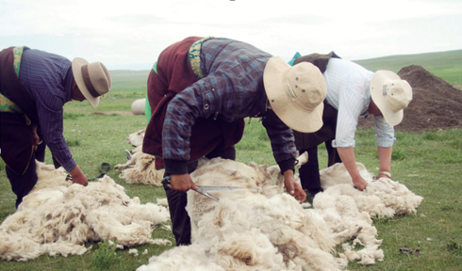
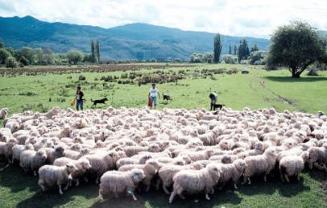
Why do sheep farmers wear special hats?
To keep the flies away.

Slide 28
3. Read and find out the photos.
Tony: Dad, I need your help. My teacher asked us to choose a country we want to visit,
imagine we were there, and write a letter to our parents back home. I’ve chosen
Australia. How can I do it?
Dad: Don’t worry. I have some photos that I took in Australia last year. They may help
you. Here we go. This is a rock called Ayers Rock, in central Australia. According
to the local people, it’s a special and magical place.
Tony: Oh, it looks huge. What’s its height?
Dad: 348 metres. And this is the Sydney Opera House. It’s like a huge sailing boat with
water on three sides. And this one is the Great Barrier Reef.
Tony: Does it lie off the northeast coast of Australia?
Dad: Yes, it’s over 2,600 kilometres long. It’s a great natural wonder. And here are
some photos of my Australian friends. They’re sheep farmers. They wear special
hats that keep the flies away. The scissors that they’re holding are to cut the wool off the sheep. Do you know that many Australians came from Britain?
Tony: Yes, of course! That’s why they speak English. Did you keep a diary while you
were there?
Dad: Yes, and you can read it.
Tony: That’s great! And what didn’t you like about Australia?
Dad: I hated the ants that were all over the place. I had to brush them off my clothes,
especially my trousers!
Tony: Ants in your trousers! That’s really funny!
Dad: It wasn’t funny at the time!

Slide 29
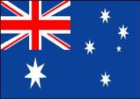
Discussion
1. Why do many Australians speak English?
Because many Australians came from Britain.
2. Why are these flags similar(相似)?
Many years ago, British people controlled this country.
Australia was the British Colonial.
[kələʊniəl] 殖民地

Slide 30
according to, ant, brush, central,
diary, hat, hate, height, scissors
Tony is going to write a letter about Australia. His dad helps him. He shows Tony some photos. Tony sees a photo of Ayers Rock in (1)________
Australia. Ayers Rock has a(n) (2) ________of 348 metres, and (3) ______________ the local
people, it is a magical place. Tony also sees some photos of some sheep farmers with special
central
height
according to

Slide 31
(4) _________ to keep away flies. The farmers use (5) ___________ to cut the wool off sheep. Tony’s dad says Tony can read his (6)______. He also says he (7) _______the (8) ______that he had to (9) _________ off his clothes!
hats
scissors
diary
hate
ants
brush

Slide 32
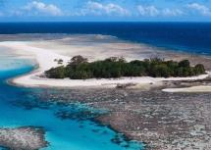
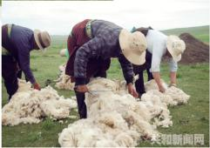
Which photo do you like best? Why? Can you descirbe it?
I like picture one best. It is called ---. It lies in/on/off ---. It’s --
wonder, magical, modern, largest coral reef, sea animals, enjoy the beaches,
listen to the opera, ------

Slide 33
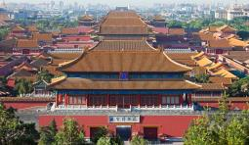
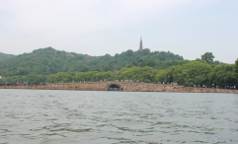
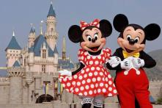
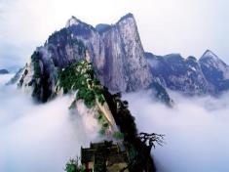
Think of a place you have visited. Make
notes about the best things you have seen there.
Homework
Work in pairs. Ask and answer.
● What is it called?
● Where is it?
● What is it special about?
A: What’s the name of the place
that you have visited?
B: It’s called Mount Hua.
A: ---
Mount Hua
In Shanxi province.
One of the Five Mountains in China.

