Slide 1
Section B Reading and Thinking
UNIT 2 Travelling Around
WWW.PPT818.COM

Slide 2
Ⅰ
Ⅱ
Ⅰ.知识体系图解
source
narrow
flat
emperor
site
official
recognise
type
flight
accommodation
unique
path
destination

Slide 3
Ⅰ
Ⅱ
admire
architecture
package
contact
transport
控制;接管
除……之外
构成;形成
包价旅游
浏览;看穿
独特的
使……结合在一起
在没有……的情况下生活

Slide 4
Ⅰ
Ⅱ

Slide 5
Ⅰ
Ⅱ
Ⅱ.阅读导学
根据P26课文内容,填写下面的表格。
Geography
1821
Inca Empire
Spanish

Slide 6
Ⅰ
Ⅱ
根据P26宣传册的内容,填写下面的表格。
Destination
walk
the Andes
four
rainforest
building

Slide 7
重点词汇
重点句式
随堂练习
1.look through 浏览;看穿
【课文原句】Look through them quickly.
迅速地浏览这两篇课文。
【词汇精讲】look through表示“浏览;看穿”。
Women of her mold are easy to look through.
她那种性格的女人是很容易被看穿的。
I looked through some magazines while I waited.
我边等边浏览几本杂志。

Slide 8
重点词汇
重点句式
随堂练习
【词汇拓展】

Slide 9
重点词汇
重点句式
随堂练习
Young people often look ahead to the future while the elderly look back on the past.
少年人常思将来,而老年人常思既往。
Nobody will look up to you if you look down on yourself.
如果你自己都瞧不起自己,没有人会瞧得起你。
It is reported that the police will soon look into the case of the two missing children.
据报道,警察将很快调查这两名失踪儿童的案件。
Look out!There is danger ahead!
当心!前面危险!

Slide 10
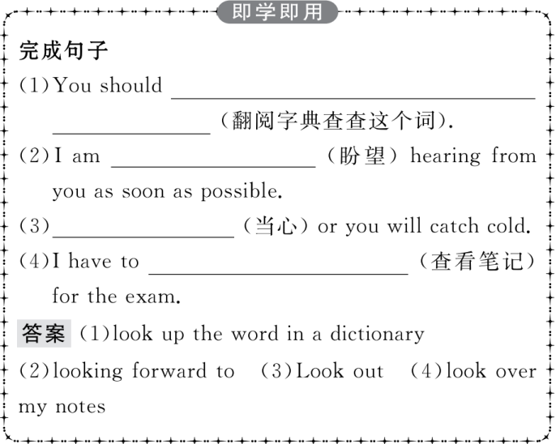
重点词汇
重点句式
随堂练习

Slide 11
重点词汇
重点句式
随堂练习
2.narrow adj.狭窄的 vi.& vt.(使)变窄
【课文原句】PERU is a country on the Pacific coast of South America with three main areas:narrow,dry,flat land running along the coast,the Andes Mountains,and the Amazon rainforest.
秘鲁是南美太平洋沿岸的一个国家,有三大主要区域:狭窄、干燥、平坦的沿海岸线陆地,安第斯山脉和亚马孙热带雨林。
【词汇精讲】本句中的narrow是形容词,与dry,flat并列,修饰后面的land,做定语。narrow意为“狭窄的”,可指空间、场所、物品或范围的狭窄。用于比喻可形容人“思路狭小”“眼光短浅”“看问题狭隘”或“有偏见”等。
Be careful when you back into the garage,the doorway is very narrow.
你倒车入库时要小心,门道很窄。
She has very narrow ideas about this problem.
她对这个问题的见解很狭隘。

Slide 12
重点词汇
重点句式
随堂练习
【词汇拓展】
I cannot narrow down the rules for this game.
我不能限制这场比赛的规则。
I am really lucky.Not many people survive such a narrow escape from death.
我的确很幸运。并不是很多人可以像我这样九死一生。

Slide 13
重点词汇
重点句式
随堂练习

Slide 14
重点词汇
重点句式
随堂练习
3.take control of 控制
【课文原句】Spain took control of Peru in the 16th century and ruled until 1821.
在16世纪西班牙控制了秘鲁,直至1821年。
【词汇精讲】take control of为固定词组,表示“控制”。
A self-driving car is a vehicle that is taken control of by a robot.
无人驾驶汽车由机器人完全操控的车。
The firemen were unable to take control of the fire.
消防队员无法控制这场大火。

Slide 15
重点词汇
重点句式
随堂练习
【词汇拓展】

Slide 16
重点词汇
重点句式
随堂练习
When you’re in control of your life,you’re able to surely get whatever you want.当你能主宰你自己的生活时,你就肯定可以得到你想要的。
You are so beyond control that you will have trouble one day.你如此不服管教,早晚是会出事的!

Slide 17
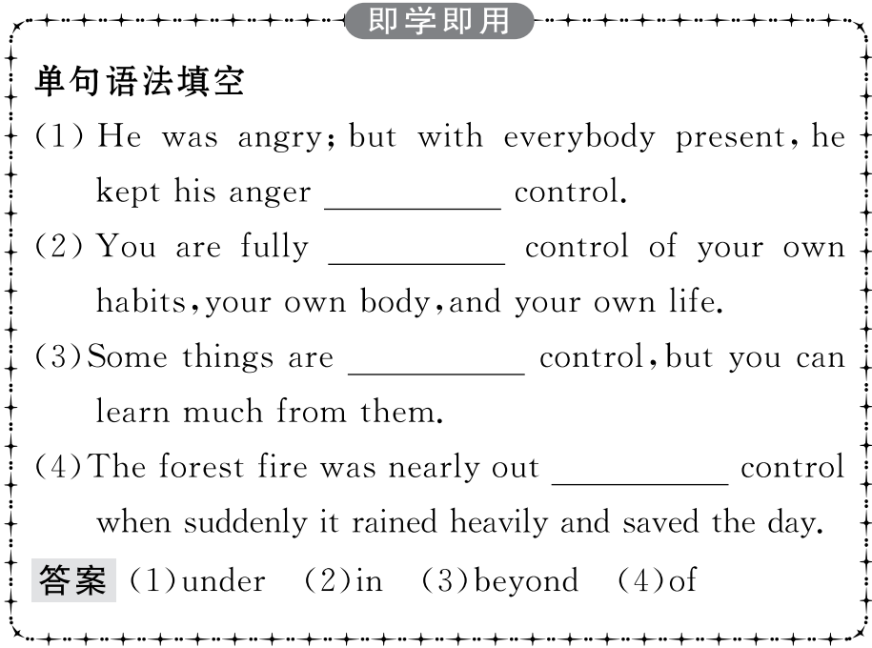
重点词汇
重点句式
随堂练习

Slide 18
重点词汇
重点句式
随堂练习
4.recognise vt.辨别出;承认;认可
【课文原句】Recognise text type识别短文类型
【词汇精讲】本短语中的recognise是及物动词,后面的text type是宾语。
The moment I answered the phone,I recognised his voice.我一接电话,就听出了他的声音。
He has the good sense to recognise a good man.
他真是慧眼识真才。

Slide 19
重点词汇
重点句式
随堂练习
【词汇拓展】

Slide 20
重点词汇
重点句式
随堂练习
I could hardly recognise my hometown;it had changed so much.我几乎认不出我的家乡,它变化太大了。
She hoped she would avoid recognition by wearing dark glasses and a hat.
她戴上墨镜和帽子,希望人们认不出她来。
It is recognised that you have a funny sense of fun.
大家都认为你的幽默感很有趣。

Slide 21
重点词汇
重点句式
随堂练习

Slide 22
重点词汇
重点句式
随堂练习
5.accommodation n.住处;停留处;膳宿
【课文原句】From there,you’ll spend one day travelling by boat to your accommodation in the middle of the forest.从那儿,你将花一天的时间,乘船来到位于森林中央的你的住处。
【词汇精讲】accommodation为名词,表示“住处;停留处;膳宿”。常用作复数形式accommodations。
He accompanied us to the place of interest and provided accommodations for us.
他陪我们去了那个旅游景点,还给我们安排了膳宿。

Slide 23
重点词汇
重点句式
随堂练习
【词汇拓展】
accommodate v.为……提供住宿/空间;适应;(房间、建筑物等)容纳;调节;适应

Slide 24
重点词汇
重点句式
随堂练习
The eye can accommodate itself to seeing objects at different distances.
眼睛能自动调节以便观看远近不同的事物。
The manufacturer offered to accommodate us with a computer free of charge.
厂家主动提出免费给我们提供一台电脑。

Slide 25
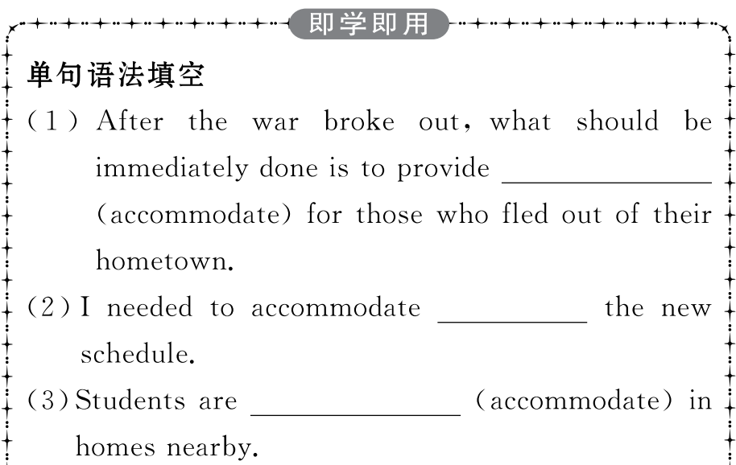
重点词汇
重点句式
随堂练习

Slide 26
重点词汇
重点句式
随堂练习

Slide 27
重点词汇
重点句式
随堂练习
6.unique adj.唯一的;独特的;特有的
【课文原句】You can then spend three days exploring the rainforest with a local guide and enjoying the plants and animals unique to the rainforest.在接下来的三天里,您可以在当地导游的陪同下,深入雨林进行探索,欣赏雨林特有的动植物。
【词汇精讲】unique是形容词,意为“唯一的;独特的;特有的”。unique to the rainforest是形容词短语,用作定语,修饰the plants and animals。
A diamond of this size is unique.
这种大小的钻石是独一无二的。
This interesting and charming creature is unique to China.
这种有趣迷人的动物是中国独有的。

Slide 28
重点词汇
重点句式
随堂练习
【词汇拓展】
This flower is unique to the area.
这种花是这一地区独有的。
Satellites are uniquely suited to provide this information.
人造卫星是唯一适合提供此类信息的。

Slide 29
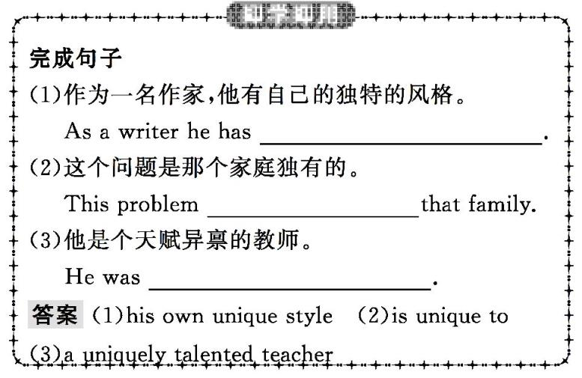
重点词汇
重点句式
随堂练习

Slide 30
重点词汇
重点句式
随堂练习
7.other than 除……之外
【课文原句】Inca builders cut stones to exact sizes so that nothing was needed to hold walls together other than the perfect fit of the stones.印加的建筑工人将石头切割成精确的尺寸,仅仅凭着石头间的完美契合,即可稳固墙体。
【词汇精讲】other than 是“除……之外”之意,用法较为正式,常用于表示否定的词之后。此外,other than的作用相当于介词。
There is nobody there other than the teacher.
这里除了老师外再无别人了。
The form cannot be signed by anyone other than yourself.
该表除了你本人,别人不能代签。

Slide 31
重点词汇
重点句式
随堂练习
【词汇拓展】

Slide 32
重点词汇
重点句式
随堂练习
Driverless cars may end up being a form of public transport rather than vehicles you own.
无人驾驶汽车可能成为一种公共交通工具而不是你自己的车辆。
There are not less than 6,000 students in our school.
我们学校至少有6 000名学生。
He is more than our teacher.He is also our good friend.他不仅仅是我们的老师,他还是我们的好朋友。

Slide 33
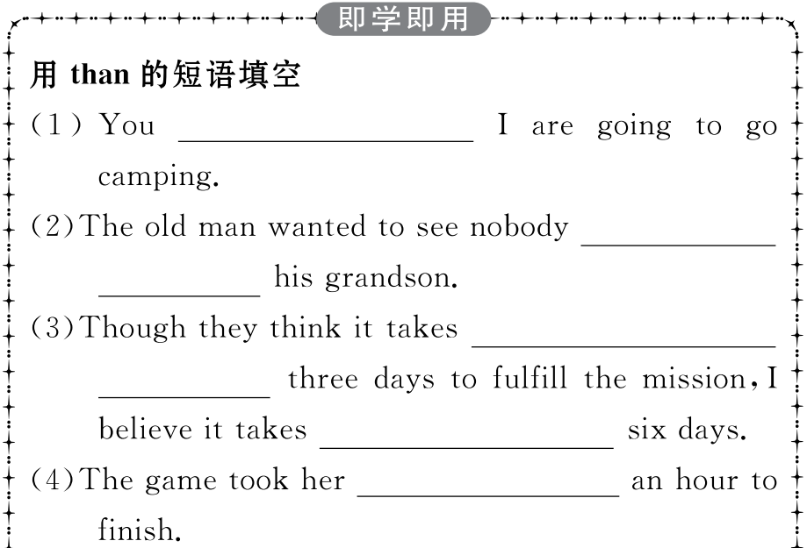
重点词汇
重点句式
随堂练习

Slide 34
重点词汇
重点句式
随堂练习

Slide 35
重点词汇
重点句式
随堂练习
8.make up 构成;形成
【课文原句】These Inca roads were made up of two north-south highways and many small roads crossing the mountains east to west.这些印加的道路由两条南北向的公路和许多东西横穿山脉的小型公路组成。
【词汇精讲】本句中的make up,表示“构成;形成”,经常用于被动语态。be made up of意为“由……构成”。
Society is made up of a variety of people;some are good,others (are) bad,and still others (are) in between.
社会由形形色色的人组成。有些人好,有些人坏,也有些人介乎两者之间。

Slide 36
重点词汇
重点句式
随堂练习
【词汇拓展】
The boy made a boat out of wood.
那男孩用木头做了一条船。
He tried to make up for all the trouble he had caused.
他设法弥补他所造成的一切麻烦。
They could hardly make out where the road was in the darkness.
黑暗中他们难以辨认出路在哪里。

Slide 37
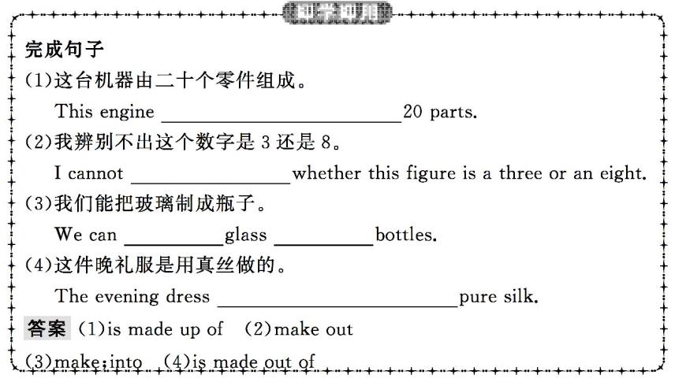
重点词汇
重点句式
随堂练习

Slide 38
重点词汇
重点句式
随堂练习
9.hike vi.徒步旅行 vt.去……远足 n.远足;徒步旅行
【课文原句】boating,hiking,exploring nature划船、远足、探索大自然
【词汇精讲】hike 在此处为动词,意为“徒步旅行”。
They went on a ten-mile hike through the forest.
他们进行了一次穿越森林的十英里徒步旅行。
At first all of us city boys hiked on sore feet.
起初,我们这些城市里的男孩子们迈着疼痛的双脚徒步旅行。

Slide 39
重点词汇
重点句式
随堂练习
【词汇拓展】
These strong shoes are suitable for hiking over rough country.
这些结实的鞋子适合在崎岖不平的山路徒步旅行。
They are going to hike to the top of a mountain.
他们打算徒步旅行到一座大山的顶端。

Slide 40
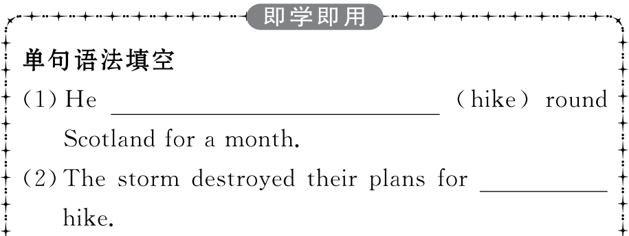
重点词汇
重点句式
随堂练习

Slide 41
重点词汇
重点句式
随堂练习
10.admire vt.钦佩;赞赏
【课文原句】Stay in a local hotel,visit the museums,admire the architecture,enjoy the excellent local food,and go shopping at the local markets.住在当地旅馆,参观博物馆,欣赏建筑物,享受当地美食,并且在当地市场购物。
【词汇精讲】本句中的admire是及物动词,表示“钦佩;赞赏”。
We admire him for his honesty.
我们钦佩他的正直。
When I was young,I admired clever people.Now that I am old,I admire kind people.
少时喜欢聪明人,老来喜欢仁厚的人。

Slide 42
重点词汇
重点句式
随堂练习
【词汇拓展】
I admired his bravery for saving the boy from the cold water.
我钦佩他从冰冷的水中救出那个男孩的勇敢。
Deeply moved by her performance,the whole audience was surprised with admiration.
被她的表演深深打动,全场观众赞叹不已。
She always has the followers of admiring young men.
她周围总是簇拥着追求她的年轻人。

Slide 43
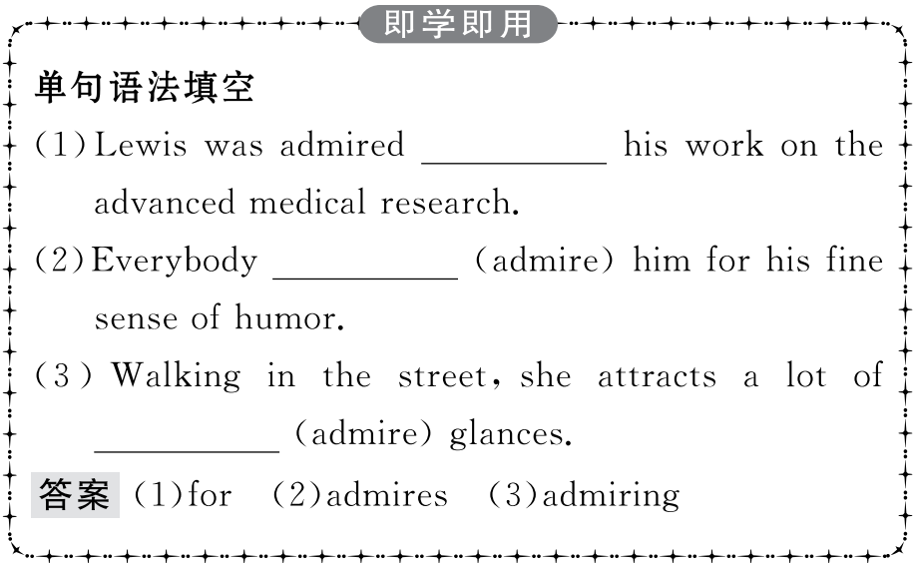
重点词汇
重点句式
随堂练习

Slide 44
重点词汇
重点句式
随堂练习
11.contact vt.联络;联系 n.联系;接触
【课文原句】For more brochures about other package tours around Peru,contact us at tourinfo@travelperu.org.
想要更多其他的关于在秘鲁包价旅游的资料手册,在tourinfo@travelperu.org上和我们联系。
【词汇精讲】本句中的contact是及物动词,表示“联络;联系”,指通过写信、电话、见面等方式直接联系。
Where can I contact you tomorrow?
明天我在哪里能跟你联系?

Slide 45
重点词汇
重点句式
随堂练习
【词汇拓展】
Have the children been in contact with the disease?
孩子们同这种疾病有过接触吗?
I’d hate to lose contact with my old school friends.
我不愿和旧时校友失去联系。
Many scientists want to make contact with spacemen.
许多科学家想要和航天员接触。

Slide 46
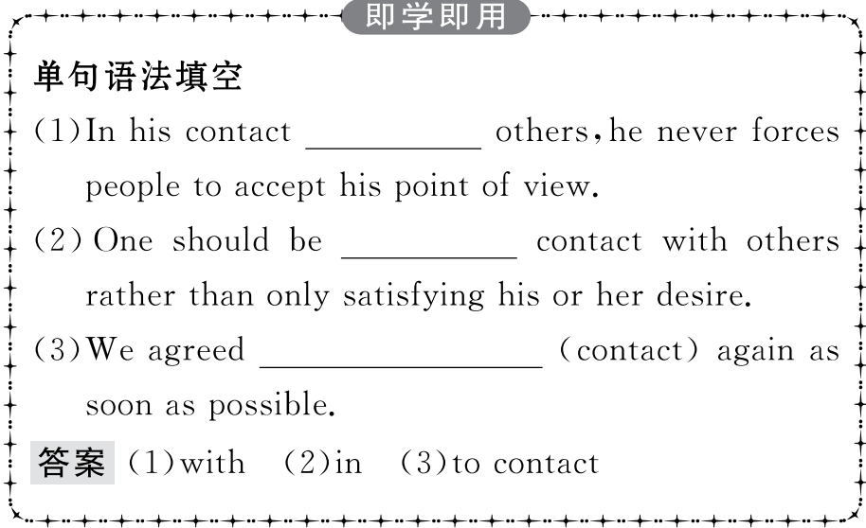
重点词汇
重点句式
随堂练习

Slide 47
重点词汇
重点句式
随堂练习
1.It is for this reason that Spanish is the main official language of Peru.
正是因为这个原因,西班牙语才成为秘鲁的主要官方语言。
【句式剖析】本句是一个强调句型。强调的是表示原因状语的介词短语for this reason。强调句型的结构为:It is/was+被强调部分+that/who+句子其余部分。其中,被强调的可以是主语、宾语、状语等,如果被强调的是人用that或who,其余情况用that。另外当强调时间或地点状语时,通常也不能用when/where代替that。
It was to you and not anyone else that I lent the money.我只借钱给你,不借给其他人。
It was his best suit that John wore to the dance last night.
约翰昨晚是穿着他最好的一套衣服去参加舞会的。

Slide 48
重点词汇
重点句式
随堂练习
【句式拓展】
(1)一般疑问句:Is/Was+it+被强调的部分+that/who/whom+句子其余部分?
(2)特殊疑问句:疑问词(Who/What/When/Where/Why/How)+is/was it that...?
(3)当被强调的是not...until句型中的until引导的时间状语时,要将not放在until的前面。

Slide 49
重点词汇
重点句式
随堂练习
(4)该句型可强调because引导的原因状语从句,但通常不能强调由 since,as引导的原因状语从句,另外也不强调由although引导的让步状语从句。
Was it you who put these books on my desk?
是你把这些书放到我桌上的吗?
Who was it that broke the window?
谁把窗子打破了?
It was not until I met you that I knew real happiness.
直到遇到你以后,我才体会到真正的幸福。
It was because I wanted to buy a dictionary that I went to town yesterday.
我昨天是由于想买本字典而进城的。

Slide 50
重点词汇
重点句式
随堂练习

Slide 51
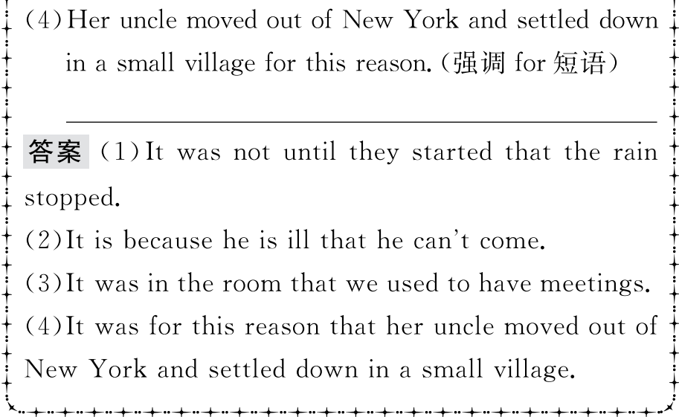
重点词汇
重点句式
随堂练习

Slide 52
重点词汇
重点句式
随堂练习
2.Especially amazing is the Incas’ dry stone method of building.特别令人惊叹的是印加人的干式石头搭砌的建造方法。
【句式剖析】这是一个倒装句,因语篇衔接和语义需要而使用。表语Especially amazing前置是为了突出和强调。正常的语序为:The Incas’ dry stone method of building is especially amazing.
Higher up was an old castle where a king once lived.
再往高处去就是一座旧城堡,一位国王曾在此居住。
Along the road are some tall trees.
沿路长着一些大树。

Slide 53
重点词汇
重点句式
随堂练习
【句式拓展】
(1)状语或表语位于句首时的倒装:为了保持句子平衡或使上下文衔接紧密,有时可将状语或表语置于句首,句中主语和谓语完全倒装。
(2)在表语置于句首的这类倒装结构中,要注意其中的谓语应与其后的主语保持一致,而不是与位于句首的表语保持一致。
(3)有时为了强调,可将谓语部分的分词或不定式置于句首,从而构成倒装。

Slide 54
重点词汇
重点句式
随堂练习
Among these people was his friend Jim.
他的朋友吉姆就在这些人当中。
In the box were some cats.
箱子里是一些猫。
Buried in the sands was an ancient village.
被埋在这沙土之中的是一个古老的村庄。
Standing beside the table was his wife.
站在桌旁的是他的妻子。
To be carefully considered are the following questions.
下列问题要仔细考虑。

Slide 55
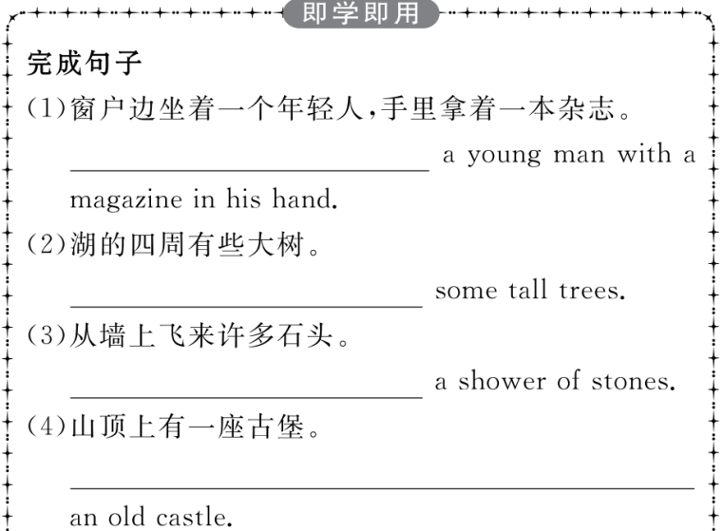
重点词汇
重点句式
随堂练习

Slide 56
重点词汇
重点句式
随堂练习

Slide 57
重点词汇
重点句式
随堂练习
Ⅰ.用适当的介词填空
1.No one can live breathing.
答案:without
2.This watch is made of 200 parts.
答案:up
3.The sun is the final source energy.
答案:of
4.I looked my drawer,but I could not find my keys.
答案:through
5.I feel like it’s time for me to take control the team.
答案:of
6.It is impossible to make many parts an exact size.
答案:to

Slide 58
重点词汇
重点句式
随堂练习
7.This interesting and attractive creature is unique Australia.
答案:to
8.He was nervous but managed to hold himself and win in the game.
答案:together
9.The method making meat in the lab is gradually popular with some scientists.
答案:of
10.He was amazed how much effort scientists have made to put together the image of Black Hole.
答案:at

Slide 59
重点词汇
重点句式
随堂练习
Ⅱ.单词拼写
1.We walked up the river to its s in the hills.
答案:source
2.At that point,a s opened fire on the car.
答案:soldier
3.Bicycles are a cheap and efficient means of t .
答案:transport
4.After years of study,Tim is now a famous (建筑师).
答案:architect
5.We arrived at our (目的地) tired and hungry.
答案:destination

Slide 60
重点词汇
重点句式
随堂练习
6.I’d recognise your handwriting anywhere—it’s (独特的).
答案:unique
7.There were so many different (类型) of bread that I didn’t know which to buy.
答案:types
8.The (道路) to success is filled with difficulties.
答案:path
9.The (小册子) offers a wide choice of hotels,apartments and holiday homes.
答案:brochure
10.People in every part of the Roman Empire knew what the (皇帝) looked like.
答案:emperor

