Slide 1
Unit 1 Topic 1
Our country has developed rapidly.
Section D
WWW.PPT818.COM

Slide 2
Read through Sections A-C and understand the underlined parts.
Functions
There goes the bell.
=That’s the bell. = The bell is ringing.
What a wonderful experience!
= How wonderful the experience is!
Though I had no time to travel, I still felt very happy.
= I had no time to travel, but I still felt very happy.
To help others makes us happy.
make sb./sth. + adj.
make sb./sth. do sth.
I think it is important to remember the past, live in the present and dream about the future.

Slide 3
Grammar
Present Perfect (Ⅰ)
I have been to Mount Huang with my parents.
She has gone to Cuba to be a volunteer.
China has developed rapidly since the reform and opening-up.
It has already succeeded in hosting the 2008 Olympic Games.
Great changes have taken place there…
I haven’t seen you for a long time.
Have you been to any other place? Yes, I have./ No, I haven’t.

Slide 4
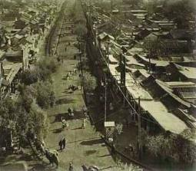
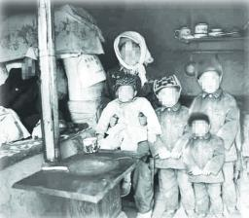
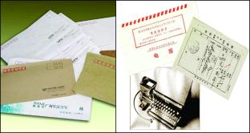
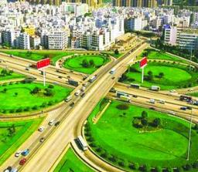
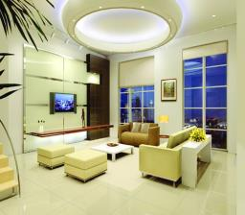
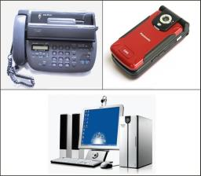
Retell 1a in Section C
In the past…
At present…
What about leisure activities?

Slide 5
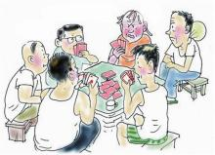
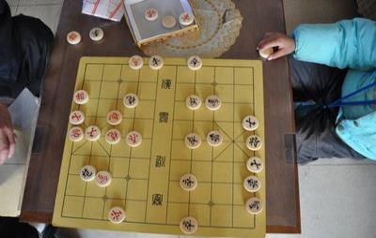
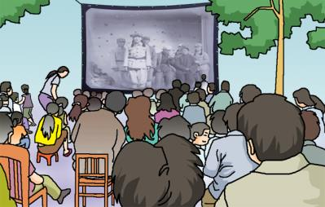
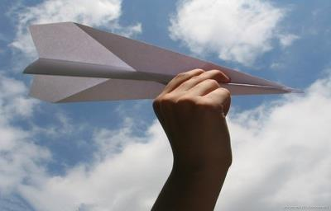
In the past…
play cards
play chess
Leisure activities
are the kinds of things people like to do to relax and enjoy themselves when they are not working or going to school.
watch movies in the open air
fly paper planes

Slide 6
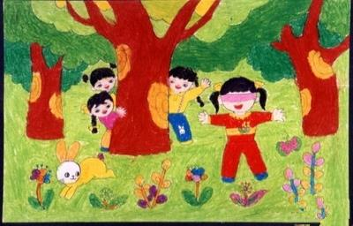
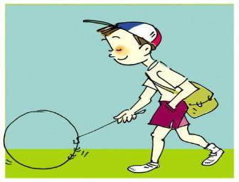
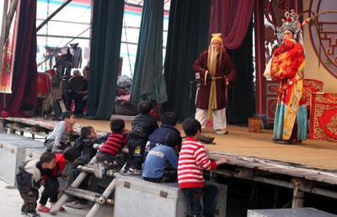
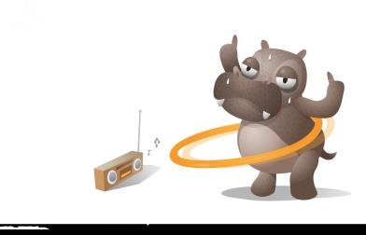
In the past…
play hide-and-seek
roll iron rings
watch operas
listen to the radio

Slide 7
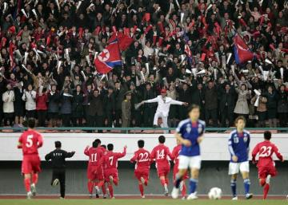
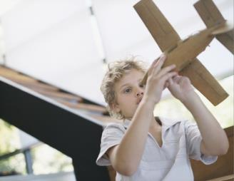
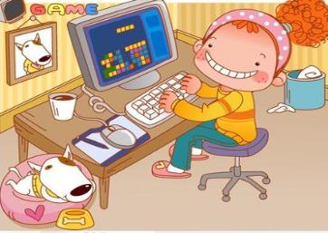
At present…
watch team sports
read books
fly model planes
play games on computers

Slide 8
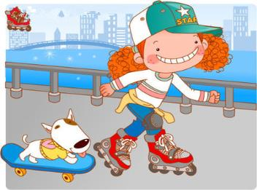
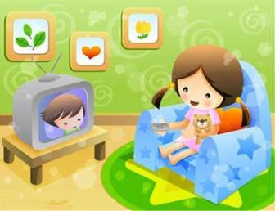
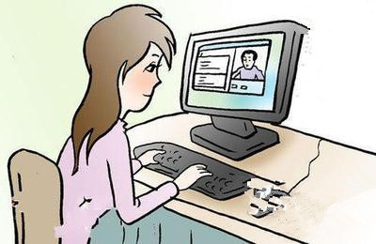
At present…
go roller skating
watch TV
chat on the Internet
make a tour abroad

Slide 9
Read 1a and choose the best answer.
1. How many leisure activities are there in the past?
A. Many. B. Little. C. None. D. Few.
2. Kids often got together to ______.
A. play cards B. listen to the radio
C. play hide-and-seek D. play games on computers
3. Why do Chinese people do all kinds of leisure activities
now?
A. Because they have a lot of money.
B. Because they have time and chance.
C. Because they don’t want to work.
D. Because they are too free.

Slide 10
1a Read the following passage and complete the table on Page8.
playing hide-and-seek
watching operas
In the past
playing cards or chess
listening to the radio
Leisure activity
playing and watching team sports
chatting on the Internet
At present
playing games on computers
traveling all over the world
Retell 1a according to the table.

Slide 11
Language points
1. Leisure activities play an important part in people’s lives. 休闲活动在人们的生活中起着重要的作用。
play a/an… part = play a/an… role
扮演……角色；起……作用；有……影响
e.g. Computer plays an important part in our
daily lives.
life--- lives n. 生活，生命
lives
live--- lives v. 居住，生活

Slide 12
Language points
2. Watching operas and listening to the radio were the main activities in their spare time. 看戏和听广播是他们在空闲时间的主要活动。
watching operas and listening to the radio 是动名词短语，作这个句子的主语。
e.g. Reading books plays an important part in
his life.
in one’s spare/free time 在某人的业余时间
e.g. She often goes shopping in her spare time.

Slide 13
Language points
3. They go to visit some places of interest, and some people even make a tour abroad to see the world. 他们去参观名胜古迹，有些人甚至去国外旅游。
make a tour abroad 去国外旅游
e.g. They plan to make a tour abroad next year.
be abroad 在国外
abroad
adv. 在国外，到国外
go abroad 去国外
at home and abroad 国内外

Slide 14
1b Read 1a and answer the following questions.
1. When do people usually have their leisure
activities?
2. How many kinds of leisure activities do
you know? Give some examples.
3. What are your favorite leisure activities?
When they are not working or going to school.

Slide 15
Project
Making a Poster About Changing Leisure Activities
1. Leisure activities for children have changed a lot. Look at the table
below and talk about them in groups.
In the past | Now
watch movies in the open air fly paper planes roll iron rings … | watch movies at home fly model planes go roller skating …
2. Try to find out more changes in leisure activities and their pictures.
You can ask your parents or grandparents for help if necessary.
3. Make a poster to show the changes with the topic Different Times,
Different Leisure Activities. Choose the best one in each group and
display it on the wall.

Slide 16
Exercises
Choose the best answer.
1. —The farmers in our village have been to the USA.
—Really ? When ______ there?
A. will they go B. did they go
C. do they go D. have they gone
2. We now ______ him by writing letters.
A. keep away from B. keep on
C. keep distance D. keep in touch with
3. Breakfast ______ an important part in our meals.
A. goes B. have C. plays D. get
4. Miss Green isn’t in the office . She ______ to the library.
Ａ. has gone Ｂ. went
Ｃ.will go Ｄ. has been

Slide 17
Exercises
Translate the following sentences into English.
1. 吉姆已做完作业，他现在有空了。
2. 孩子们喜欢玩捉迷藏。
3. 你想去国外旅游吗？
5. 他这些天上哪儿去了？
Jim has finished his homework already.
He is free now.
Children like playing hide-and-seek.
Would you like to make a tour abroad?
Where has he been these days？

Slide 18
summary
We learn:
1. Some words:
leisure, hide, hide-and-seek, chess, radio, spare,
recent, abroad
2. Some phrases:
play an important part in, play hide-and-seek, play
chess, in one’s spare time, make a tour abroad, in
the open air, roll iron rings
3. Some sentences:
Watching operas and listening to the radio were
the main activities in their spare time.
We can:
1. Talk about the changing leisure activities.
2. Make a poster.
3. Use the Present Perfect Tense.

Slide 19
Homework
1. Read 1a aloud.
2. Finish Section D in
your workbook.
3. Make a poster about
changing leisure activities.
4. Preview Section A in
Topic 2.

