Slide 1
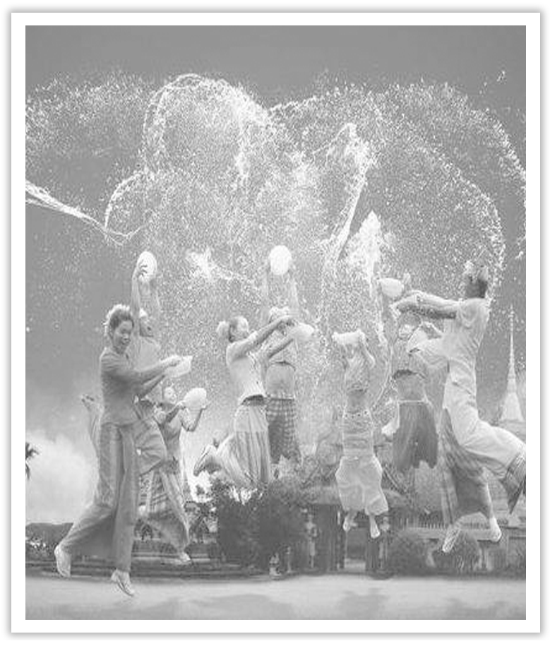
Unit 3 Diverse Cultures
Section Ⅳ Discovering Useful Structures——省略
WWW.PPT818.COM

Slide 2
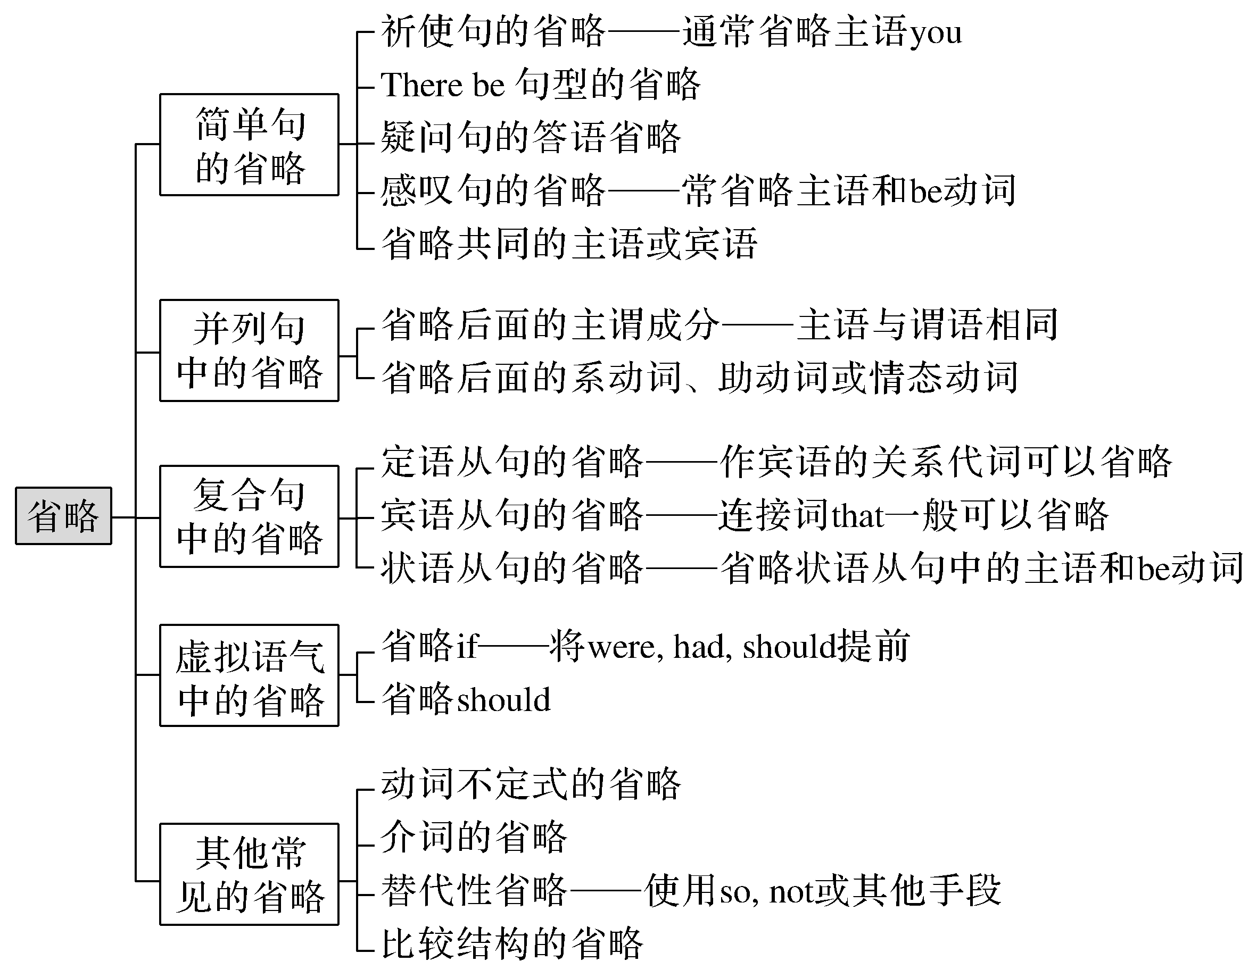

Slide 3
为了避免重复，将句子中的一个或几个成分省去，这种语法现象叫省略。省略是避免重复、突出新信息并使上下文紧密连接的一种语法手段。英语中的省略有下列几种情况。
一、简单句的省略
[合作探究]
①(You) Go down this street and turn right at the second crossing.
请(你)沿着这条街走，然后在第二个十字路口向右拐。

Slide 4
②(Is there) Anything else?
(还有)其他东西吗？
③—Are you from America?
—Yes，I am (from America).
——你来自美国吗？
——是的，我是(来自美国)。
④What a beautiful city (it is)!
(这是)多么美丽的城市呀！

Slide 5
[自主发现]
①祈使句的省略。在祈使句中，通常省略主语____________。②There be句型省略____________。③疑问句的答语省略。④感叹句的省略。在what和how引起的感叹句中常省略______________。
you
There be
主语和be动词

Slide 6
二、并列句中的省略
[合作探究]
①Tom picked up the book from the floor and (Tom) handed it to his brother.
汤姆从地板上捡起书并把它递给了他的哥哥。
②His performance made us amused，but (his performance made) himself tired.
他的表演使我们高兴，但是使他自己很累。
③Xiaoming must have been playing football at that time，and his sister (must have been) playing the piano.
那时小明一定在踢足球，而他妹妹一定在弹钢琴。

Slide 7
[自主发现]
①省略共同的____________或宾语。②若主语与谓语相同，则省略后面的____________成分。③若主语不同，而谓语部分的系动词、助动词或情态动词____________，则省略后面的系动词、助动词或情态动词。
主语
主谓
相同

Slide 8
三、复合句中的省略
1.定语从句的省略
[合作探究1]
Here is the man (whom) you’ve been looking for.
这位就是你一直在找的人。
[自主发现1]
如果关系代词在定语从句中作____________语，则关系代词可以省略。
宾

Slide 9
2.宾语从句的省略
[合作探究2]
He said (that) the text was very important and that we should learn it by heart.
他说这篇课文很重要，我们应该用心学习。
I know that a movie star will come to our city but I don’t know when (he will come to our city).
我知道一个电影明星要来我们城市，但我不知道他什么时候来。

Slide 10
[自主发现2]
(1)及物动词后接宾语从句时，连接词____________一般可以省略，但如果及物动词后接两个或两个以上由____________引导的宾语从句时，那么只有第一个that可以省略。
(2)when，where，how和why引导的宾语从句有时可以仅保留引导词。
that
that

Slide 11
3.状语从句的省略
[合作探究3]
When (the novel is) published，the novel will become one of the best sellers of the year.
一旦出版，那本小说会成为年度畅销书之一。
He runs as fast as Bob (runs).
他和鲍勃跑得一样快。

Slide 12
[自主发现3]
(1)当when，while，if，as if，though，as，until，unless等连接的状语从句的主语和主句的主语一致，且状语从句中含有be动词或从句的主语为it时，省略状语从句中的_______________。
[名师提醒] 省略句中的谓语动词和主语之间构成主动关系，则使用现在分词；若构成被动关系，则使用过去分词；若谓语动词表示的动作尚未发生，则使用不定式。
(2)在than，as等引导的____________状语从句中常省略某些成分。
主语和be动词
比较

Slide 13
四、虚拟语气中的省略
[合作探究]
Had you come here yesterday，you would have met her.
如果你昨天来这儿的话，你就会见到她了。
We insisted that they (should) go with us.
我们坚决要求他们和我们一起走。
It is necessary that we (should) learn more words by heart.
我们有必要多用心记一些单词。

Slide 14
[自主发现]
(1)虚拟条件句常省略____________，将were，had，should提前构成部分倒装。
(2)在一坚持(insist)，二命令(order，command)，三建议(suggest，propose，advise)，四要求(demand，require，request，desire)等后的宾语从句中，含这些词的派生词的其他主语从句、同位语从句、表语从句，以及It is strange/natural/necessary/important that...从句中常省略____________。
if
should

Slide 15
五、其他常见的省略
1.动词不定式的省略
[合作探究1]
He didn’t come，but he ought to have (come).他没来，但他本应该来。
I saw him enter the room just now.＝He was seen to enter the room just now by me.
刚才我看见他进了房间。
I can do nothing but wait.我能做的只有等待。
His wish is to earn a lot of money and (to) buy his mother a big house.
他的愿望是赚很多钱给妈妈买所大房子。
The purpose of new technologies is to make life easier，not to make it more difficult.
新科技的目的是使生活更方便而不是使它更困难。

Slide 16
[自主发现1]
(1)有些动词(词组)，如want，wish，expect，hope，would like，try，forget等后面的不定式作____________语时，为了避免重复，可以省略动词只保留到____________，但如果在省略的不定式结构中含有系动词be和助动词have，这些动词就要保留。
(2)感官动词(词组)see，look at，hear，listen to，notice，watch等和使役动词make，let，have等的后面作宾补的不定式要省略____________；但此类动词的被动语态中的to不可省略。
(3)在某些句式中，如介词but，except前有动词do的任何形式，后面的不定式要省略____________。
(4)两个或两个以上的不定式并列时，第一个带to，后面省去____________；但如果两个不定式表示对比、对照关系时，则to不可省略。
宾
to
to
to
to

Slide 17
2.介词的省略
[合作探究2]
She spends half an hour (in) doing some reading every day.
她每天花半小时读书。
We have a final exam (in) every term.
每学期我们举行一次期末考试。

Slide 18
[自主发现2]
(1)在英语中一些与动词、名词、形容词搭配的____________词常被省略，而只保留后面的动名词。如spend time/money (in) doing sth；have difficulty/trouble (in) doing sth；prevent/stop sb (from) doing sth。
(2)表示____________的介词at，on和in在next，last，this，each，these，yesterday，every，tomorrow等词之前，一般可省略。
介
时间

Slide 19
3.替代性省略
[合作探究3]
—Can they finish their work today? 他们今天能完成工作吗？
—I think so.我认为能。
—I don’t think so./I think not.我认为不能。

Slide 20
[自主发现3]
英语中，可以使用so，____________或其他手段来省略上文或问句中的一部分或整个句子。
not
[名师提醒] hope，guess，be afraid的否定形式只能用not的形式，不能用not...so的形式。
—The boys are not doing a good job at all，are they?
——男孩子们工作做得一点儿也不好，是吗？
—I guess not.
——我猜是没做好。

Slide 21
4.比较结构的省略
[合作探究4]
The sooner (you do it)，the better (it will be).
(你做得)越快(结果就会)越好。
[自主发现4]
在“the＋比较级，the＋比较级”结构中和由____________和as引导的比较句式中，常会有一些成分在上下文清楚的情况下被省略。
than

Slide 22
[巩固内化1]
用省略结构改写下列句子
①Is there anyone here to wait on us?
→_________________________________________________________________
②He is a programmer and I am a programmer，too.
→_________________________________________________________________
③It sounds interesting.
→_________________________________________________________________
④What a clever boy he is!
→_________________________________________________________________
Anyone here to wait on us?
He is a programmer and I am，too.
Sounds interesting.
What a clever boy!

Slide 23
[巩固内化2]
用省略结构改写下列句子
①I work in a factory and my brother works on a farm.
→I work in a factory and ________________________.
②We’re bound to win someday，but when are we to win?
→We’re bound to win someday，but ____________？
my brother on a farm
when

Slide 24
[巩固内化3]
用省略结构改写下列复合句
①Who is the man whom you were talking to?
→Who is the man ________________________？
②Someone has used my mobile phone，but I don’t know who has used it.
→Someone has used my mobile phone，but I don’t know ____________.
③When it is heated，a piece of ice will turn into water.
→________________，a piece of ice will turn into water.
you were talking to
who
When heated

Slide 25
④Although he was hard-working，he couldn’t earn enough to support himself.
→_______________________，he couldn’t earn enough to support himself.
⑤He’s the man that you can safely depend on.
→He’s the man ________________________.
⑥They don’t use more water than it is necessary.
→They don’t use more water ________________________.
Although hard-working
you can safely depend on
than necessary

Slide 26
[巩固内化4]
用省略结构改写下列各句
①If she were here，she would agree too.
→________________________，she would agree too.
②He ordered that we should go out at once.
→He ordered that ________________________.
③If Thomas Edison had stored his money，he would have died a wealthy man.
→__________________________________，he would have died a wealthy man.
Were she here
we go out at once
Had Thomas Edison stored his money

Slide 27
[巩固内化5] 单句语法填空
①I had great difficulty ____________ (find) the suitable food on the menu in that restaurant.
②—Do you think our team will win?
—I don’t think ____________.
③—Will you join us?
—I would love ____________.
④The busier (he is)，____________ (happy) he feels.
finding
so
to
the happier

Slide 28
[巩固内化6] 单句语法填空
①The exhibition is more interesting than ____________(expect).
②I have some trouble ____________(learn) English.
③The boy wanted to ride his bicycle in the street，but his mother told him not ____________.
expected
learning
to

