Slide 1
Unit 6 Colours
It’s Red
WWW.PPT818.COM

Slide 2
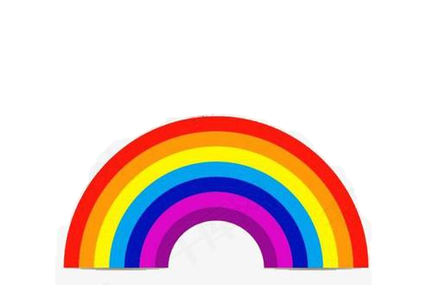
colour

Slide 3
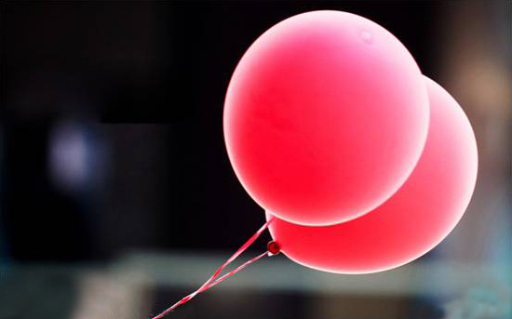
red

Slide 4
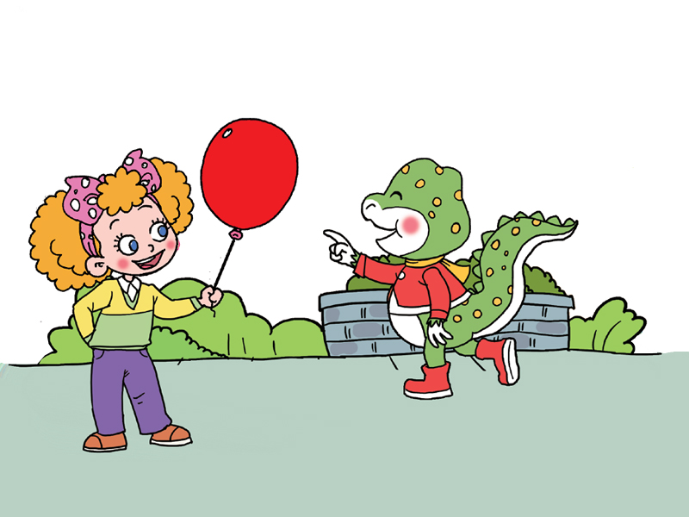
What colour is it?
It’s red.

Slide 5
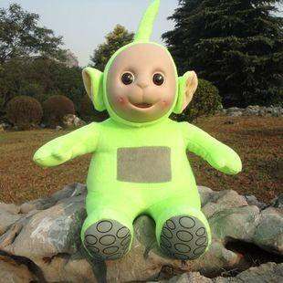
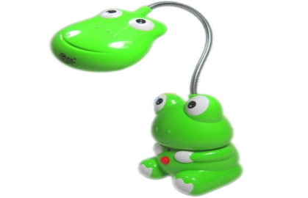
green

Slide 6
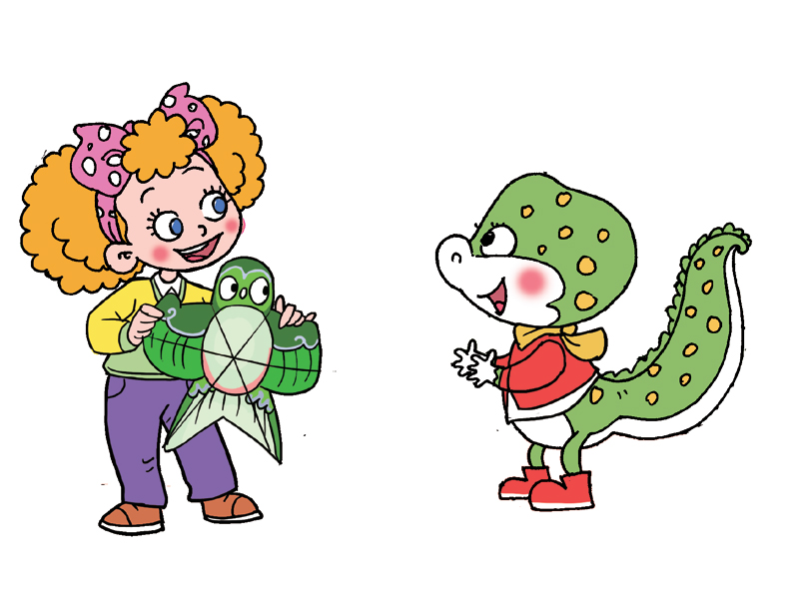
What colour is it?
It’s green.

Slide 7
yellow

Slide 8
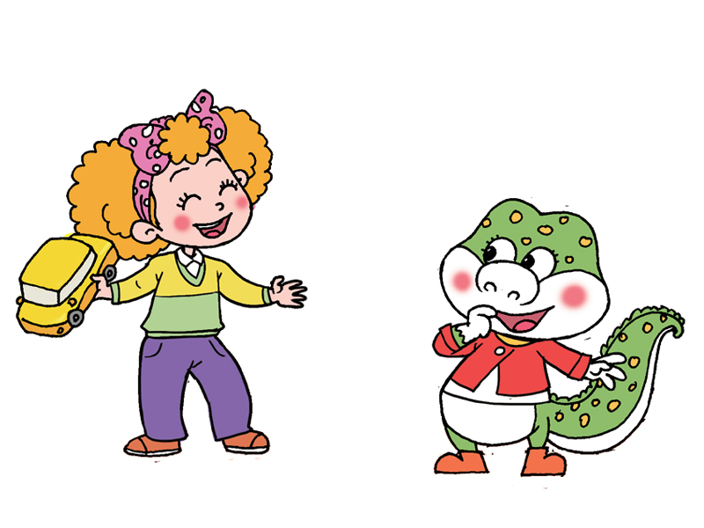
What colour is it?
It’s yellow.

Slide 9
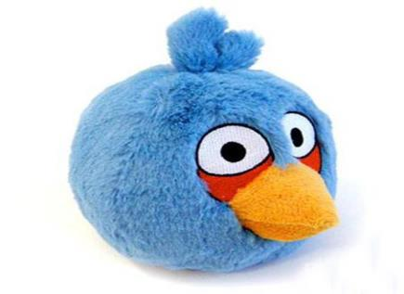
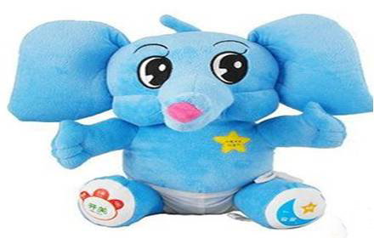
blue

Slide 10
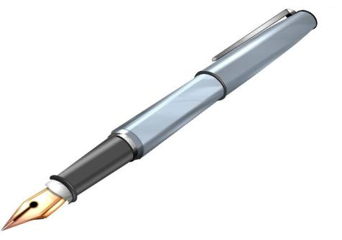
a pen
the pen
（这个）

Slide 11
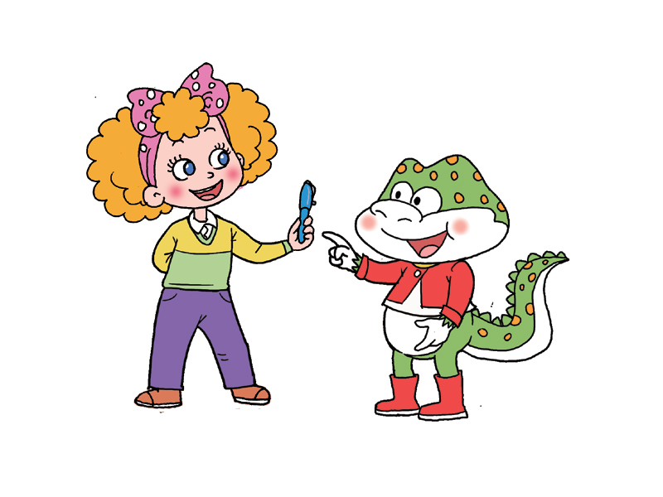
What colour is the pen?
It’s blue.

Slide 12
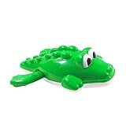
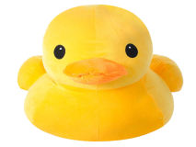
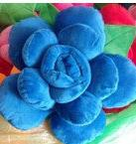
yellow
blue
red
green

Slide 13
relax

Slide 14
Homework:
Recite the text.

Slide 15
Thank you.

