Slide 1
Unit 6 I'm giong to study computer science.
Section A (2a-2d)
WWW.PPT818.COM

Slide 2
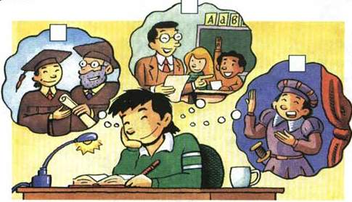
Listen and check (  ) the correct boxes in the picture.
2a


Slide 3
2b
Listen and fill in the chart.
What | Cheng Han is going to be a teacher.
Where
How
When
Cheng Han is going to move to Shanghai.
Cheng Han is going to learn how to teach childern.
He is going to finish high school and college first.

Slide 4
Ask and answer questions about Cheng Han’s plans.
What does Cheng Han want to be?
B. He wants to be …

Slide 5
小结训练
1. 你的弟弟想做什么工作？
_______________________________________________
2. 我打算明天去拜访我的老师。
_______________________________________________
3. 他将怎样做才能说好英语呢？
_______________________________________________
What does your brother want to be?
I’m going to visit my teacher tomorrow.
How is he going to speak English well?

Slide 6
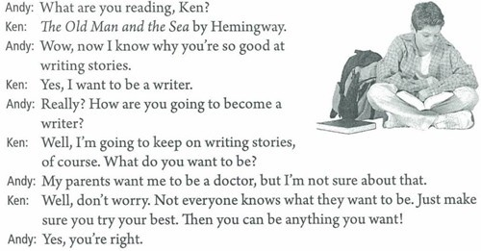
Read and answer.

Slide 7
1. What is Ken doing?
2. What does Ken want to be?
3. How is Ken going to become a writer?
4. Does Amy want to be a doctor?
He is reading The Old Man and the Sea by Hemingway.
He wants to be a writer.
He’s going to keep on writing stories.
No, she doesn’t.

Slide 8
Role-play the conversation.

Slide 9
小结训练
( )1. Look, the girl _____ English stories.
A.Read B. is reading
C. reads D. is going to read
( )2. ______ your sister good at ____ stories.
A. Does, writing B. Is, write
C. Is, writing D. Does, write
( )3. After a short break, he keeps on ____.
A. work B. to work C. working D. worked
( )4. I hear we are going to have a test, but I am not sure ____ it.
A. In B. on C. at D. about
B
C
C
D

Slide 10
问题探究
sure 的用法
1）我对这个答案有把握。I am sure about this answer.
2）我确信能做好这件事。I’m sure to do this thing well.
3）我确信他会努力学习。I’m sure he will study hard.
4）—你能关上门吗？—当然可以。
---Would you please close the door?
---Sure.
4）他确定他已经关上窗户了。
He makes sure that he has closed the window.

Slide 11
1）be sure + of / about + 名词或动名词， 意为 “ 确信… ” ; “ 对 … 有把握 ”。
2）be sure + 不定式，表示说话人对句子主语做出的判断，认为句子主语“ 必定 ”、“ 必然会 ”、“ 准会 ”如何如何。
3）be sure + 宾语从句，表示主语对宾语从句中所涉及的事物做出的判断，意为 “ 确信某事一定会… ”。
4）主要用于口语，此时的 “ sure ” 相当于 “ OK ” 或 “ Certainly ”。
5）sure 经常用到的短语是 make sure , 有弄清、确保之意，经常跟宾语从句。

