Slide 1
Unit 1 Topic 1
Our country has developed rapidly.
Section A
WWW.PPT818.COM

Slide 2
Welcome back to school
How was your summer holiday?
A: Where have you been?
B: I have been to...

Slide 3
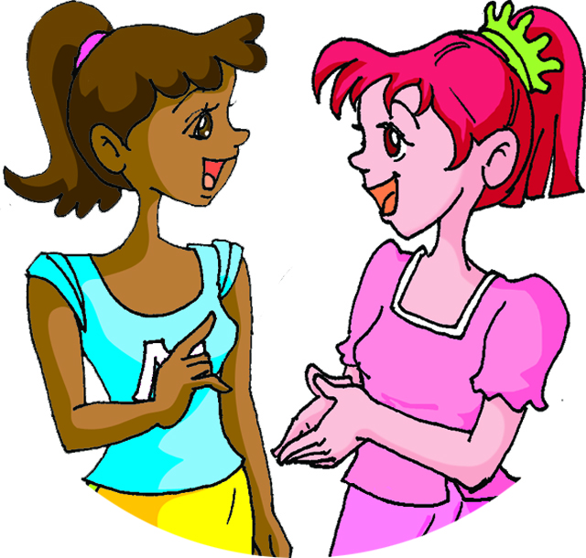
A: Where have you been?
B: I have been to the park.

Slide 4
A: Where have you been?
B: I have been to Sydney.

Slide 5
A: Where have you been?
B: I have been to the bank.

Slide 6
A: Where has Mr. Brown gone?
I can’t find him.
B: He has gone to the
restaurant.

Slide 7
A: Where has Jane gone?
I can’t find her.
B: She has gone to the
library.

Slide 8
A: Where have Maria and her
mother gone? I can’t find them.
B: They have gone to the
shop.

Slide 9
sb. have/has been to … 某人去过……（去而复返）
2b Work in groups and find out the differences between have/has been to and have/has gone to.
sb. have/has gone to … 某人去……了（去而未归）

Slide 10
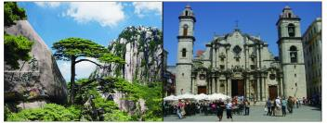
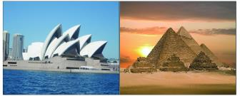
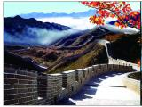
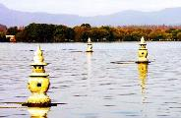
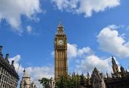
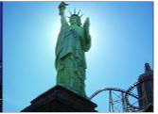
3 Look at the pictures and make conversations with your
partner with have/has been/gone to.
Example:
A: Where have you been?
B: I have been to Mount Huang. How about Maria?
A: She has gone to Cuba. She is still there and will be back
tomorrow.
Mount Huang Cuba
Australia Africa
the Great Wall Hangzhou
London America

Slide 11
Listen to 1a and complete the table.
Name | Rita | Jane | Kangkang | Maria
Place | India
Mount Huang
an English summer school
Cuba
Example:
Rita has been to India.
Kangkang has been to an English summer school.
Jane has been to Mount Huang.
Maria has gone to Cuba.

Slide 12
1b Listen to 1a and complete the table.
P1 1a mp3
Rita
has been to
places
hometown
many _______ near the home in ______
her __________ has become more and more __________
India
beautiful
Jane
Mount ________
with her _________
Huang
it is beautiful but there were too many ________
parents
people
Kangkang
summer
improve
an English _______ school
to _________ his English
has gone to
Maria
Cuba
______ to be a volunteer
and she will be back ___________
tomorrow
1c Retell the main information of 1a based on 1b.

Slide 13
Key phrases and expressions:
How was your trip?
1. 你的旅行如何？ _________________
2. 发生 _________________
3. 曾去过……(去而复返） _________________
4. 太……以至于…… _________________
5. 到……去了（去而未归）________________
6. 上课铃响了。 _________________
take place
have/has been to
so … that …
have/has gone to
There goes the bell.
=That’s the bell.
= The bell is ringing.

Slide 14
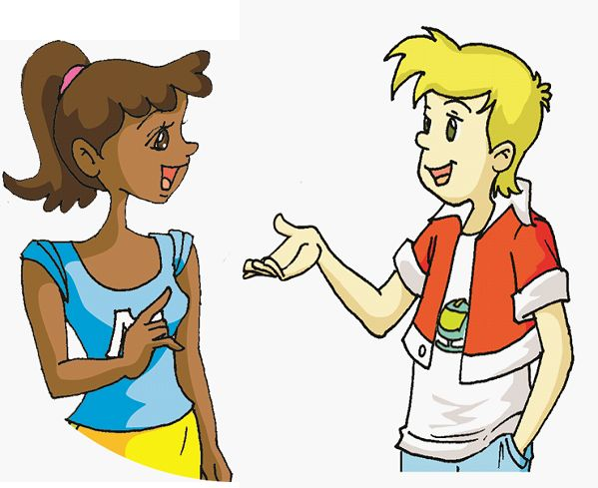
The next day, Maria came back. She met Michael in the school.
2a Listen to the conversation and fill in the blanks. Then practice it with your partner.
Michael: Hi, Maria, long time no see. Where ______ you ______?
Maria: I ___________ to Cuba to be a volunteer.
Michael: Really? It must be fun.
Maria: Yeah, I enjoyed the work. Do you know where Jane ________
for her summer holiday?
Michael: She __________ to Mount Huang for vacation.
Maria: Have you seen her this morning?
Michael: Oh, she _________ to the library.
Maria: I will go and find her. By the way, where is Kangkang?
Michael: He _________ to the library, too. Let’s go and find them.
have been
have been
has been
has been
has gone
has gone

Slide 15
Find the sentences with Present Perfect Tense in Section A.
Read them aloud.
You have just come back from your hometown.
Great changes have taken place there and my hometown has become more and more beautiful.
I have been to Mount Huang with my parents.
Oh, she has gone to the library.
现在完成时：
have/has + 过去分词

Slide 16
Exercises
Choose the best answer.
1. –– Where is Zhao Ming?
–– He ______ the playground. He is playing football there.
A. has been to B. has gone to
C. have been to D. goes to
2. Great changes ______ in my hometown.
A. have taken place B. take place
C. have happened D. happened
3. –– Hi, Kangkang, where have you______? –– The bank.
A. gone B. been to
C. been D. gone to
4. He got up ______ late ______ he was late for work today.
A. such...as B. so...that C. very ... that D. too...to
B
A
C
B

Slide 17
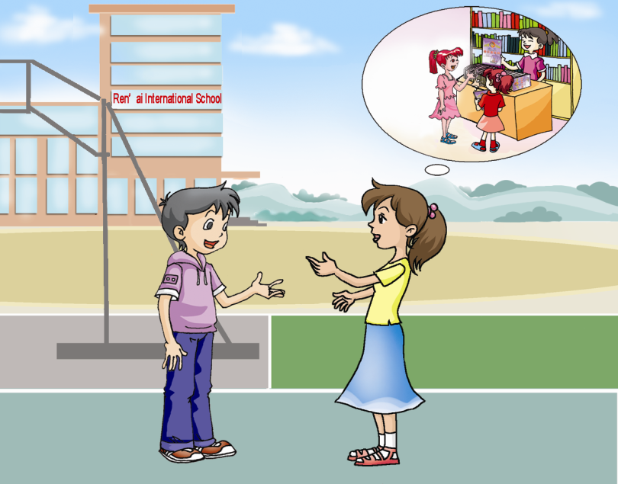
Fill in the blanks.
Exercises
1. A: Where ______ you ______?
B: I ______ ______ to my grandpa’s home.
2. A: I don’t feel well. I have a cold.
B: ______ you ______ to the hospital?
A: Yes, I have.
3. A: Where is our teacher? I have something
to tell her.
B: She ______ ______ to the library.
4. A: Where is your grandson ?
I haven’t seen him for a long time.
B: He ______ ______ to New York.
have
been
have been
Where have you been?
Have
been
Where’s
Jane?
I have been to the gym.
has gone
She has gone to the library.
has gone

Slide 18
summary
1. Some words:
volunteer, bell, Africa
2. Some phrases:
take place, come back from
3. Some sentences:
There goes the bell.
4. The Present Perfect Tense
We learn:
We can:
1.Tell the differences between have/has gone to and
have/has been to.
I have been to Mount Huang with my parents.
He has gone to the library, too.
2. Use them properly.

Slide 19
Homework
1. Read 1a aloud.
2. Make sentences with have/has gone to... and have/has been to...
3. Finish Section A in your workbook.
4. Preview Section B.

