Slide 1
Unit 4 Li Ming Comes Home
六年级下册
Lesson 22 Surprise！
WWW.PPT818.COM

Slide 2
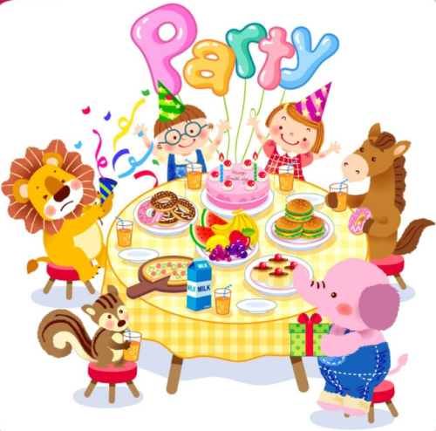

Slide 3
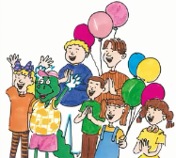
1. A surprise party
Mr. Wood: Today is Li Ming's surprise party. Mr. Smith and Li Ming are shopping. Mr. Smith will bring Li Ming home at 4:00.That's when the party begins! Mr. Smith knows about the party, but Li Ming doesn't.
Danny opens the door. It's Steven!
“Hi! I'm here early,” says Steven. “Do you need any help?”
“Yes! Come to the kitchen!” says Danny.
Danny, Jenny and Steven make a beautiful cake and nine cookies. Look! Every cookie has letters!
At 3:45，all of the people arrive for the party, but not Kim. Oh! Here she comes. She went to the shop and bought some ice cream.
At 4:00，Li Ming arrives with Mr. Smith. Li Ming opens the door.
Surprise!

Slide 4
知识点1
bring /brɪŋ/ v. 带来
例句：
Bring your sister to my home tomorrow.
明天把你妹妹带到我家来。
短语：
bring sth. to sb. 把某物带给某人
bring sb./sth. to sp.把某人/某物带到某地
take带走
对应词：
brought
过去式：

Slide 5
知识点 2
Do you need any help?你们需要帮助吗？
此句型用于询问对方是否需要帮助。
用法：
易错点
提示
any在此处意为“一些”，用于疑问句，修饰不可数名词help。

Slide 6
情景交际。
Tom看见一位老奶奶正拿着一个大包从旁边经过，他想问老奶奶是否需要帮助，他应该这样问老奶奶：______
A. Can you help me?
B. Do you need any help?
C. Do you need some help?
典例
B

Slide 7
知识点 3
cake /keɪk / n.蛋糕
We are making a birthday cake.
我们正在制作一个生日蛋糕。
例句：
make a cake做蛋糕
birthday cake生日蛋糕
短语：

Slide 8
知识点 4
every /'evri/ adj. 每个(人或物 )
Every student is wearing their sports clothes today.今天每个学生都穿着运动服。
例句：
every day 每天；every morning 每天早晨
短语：
each adj.每一个
同义词：

Slide 9
易错点
提示
every修饰可数名词的单数，一起作主语时，谓语动词要用单数形式。
加法记忆法：
e ＋very(非常)＝every

Slide 10
知识点 5
all /ɔːl /pron.全部；adj.所有的
All of us like the party.
我们都喜欢聚会。
例句：
发音：
字母组合al的发音是/ɔː/。
易错点
提示
all表示“三者或三者以上都”，在句中的位置是：行为动词的前面，be动词的后面。

Slide 11
all与all of的异同点：
一般说来，all与all of都可以放在有限定词（如冠词、物主代词等）修饰的名词之前。但是，如果名词前面没有限定词，则不能用all of。all of后面还可以跟人称代词宾格（us，you，them），all则不能。
拓展

Slide 12
All （of） the students are on the playground.
所有的学生都在操场上。
All of us are going to play basketball.
我们都将去打篮球。
例句：

Slide 13
单项选择。
We are ________ students.
A．all B．/ C．A and B
典例
C
点拨：
如果选A, 句意是：我们都是学生。如果选B，句意是：我们是学生。

Slide 14
2. Let's play!
Who can answer first?
•Does Li Ming go shopping with Mrs. Smith?
•Is Steven late for the party?
•Does Kim make the ice cream?
•Does the party begin at 4:00?
Is today Li Ming's surprise party?
Does Li Ming know about the party?
Yes.
No.
No.
No.
No.
Yes.

Slide 15
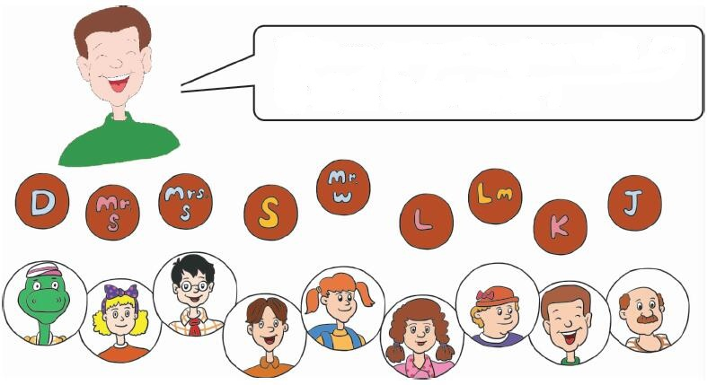
3. Let's do it!
Match and say.
Whose name begins with L？

Slide 16
一、按要求完成句子。
I need some help．(改为一般疑问句)
____________________________
Do you need any help?

Slide 17
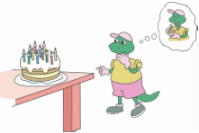
二、根据图片提示写出单词。
（1）Danny sees a beautiful ________on the table. He wants to eat it.
（2）—What can you see?
—I can see some ________.
cake
letters

Slide 18
（3）—What would you like to eat?
—I would like to eat an _______ _______.
（4）Kim went _________ with her parents and they bought some vegetables.
ice cream
shopping

Slide 19
三、花心大考验。在花心填入一个单词，使其与花瓣上的字母都能组成新单词。将组成的单词分别写在横线上，并写出其汉语意思。
(1) _________________________
(2) ________________________
(3) ________________________
(4) ________________________
(5) ________________________
b＋ all＝ball(球)
c ＋ all＝call(叫；喊)
all
f ＋all＝fall(落下)
t＋ all＝tall(高的)
w＋ all＝wall (墙)

Slide 20
本节课我们学习了以下知识，请同学们一定加强巩固，以便能和同学们进行灵活交流哦！
重点词汇： bring， cake， every，all
重点短语：bring sth. to sb.
重点句式：Do you need any help?

Slide 21
1 熟记本节课所学的句型、短语和单词，必须会听、说、读、写。
2 将A surprise party的对话朗读流利。
3 完成配套的课后作业。

