Slide 1
Unit 3 Sports and fitness
Section Ⅱ Reading and Thinking(1)
WWW.PPT818.COM

Slide 2
1.Discussing
(1)What do you think is the most impressive character of Jordan?
The answer is open.
____________________________________________________________________

Slide 3
(2)Do you know any other world-famous athletes at home and abroad？What can you learn from them?
The answer is open.
________________________________________________________________________
2.Predicting—Look at the pictures and the titles on Page 38 and predict what the text is probably about?
________________________________________________________________________
The text is probably about the life and the stories about Lang Ping and Jordan.

Slide 4
1.First reading—Read the two passages carefully and answer the following questions.
(1)As a coach，what achievements did Lang Ping make?
________________________________________________________________________
(2)What happened when the Chinese team was preparing for the 2015 World Cup?
________________________________________________________________________
(3)What made Jordan more impressive?
________________________________________________________________________
(4)What is the secret to his success?
________________________________________________________________________
She led the China women’s volleyball team to medals at world championships and the Olympics.
The team was falling apart.Some of the best players couldn’t play for the team.
His mental strength.
Learning from his failures.

Slide 5
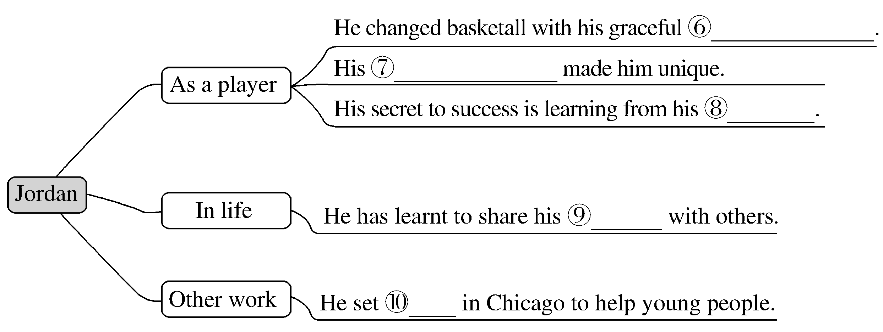
2.Second reading—Fill in the blanks according to the two passages.
coach
injured
leave
lose heart
Champions
moves and jumps
mental strength
failures
success
clubs

Slide 6
3.Third reading
(1)Summarizing：Read the two passages again and try to summarize their main idea in one sentence.
________________________________________________________________________
________________________________________________________________________
The two passages are about the achievements Lang Ping and Jordan have made and the reasons why they are successful.

Slide 7
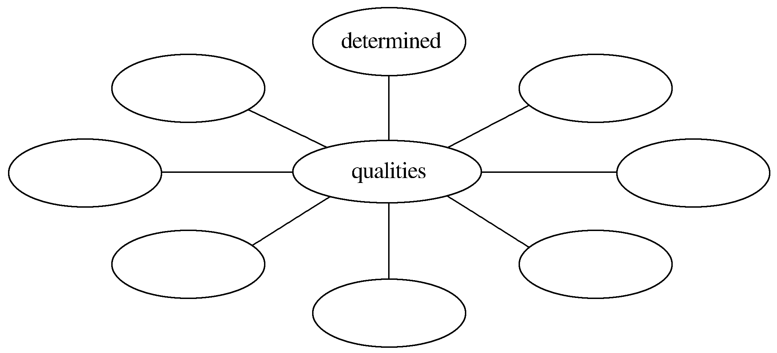
(2)Thinking and discussing：What are the common qualities of successful athletes？You can add more words to the mind map.
mental strength，not losing heart，learning from failures，hardworking，painstaking，aggressive，ambitious，persevering，purposeful
________________________________________________________________________
_______________________________________________________________________

Slide 8
1.Group work：If you are a journalist of your school English newspaper，please make an interview with Lang Ping or Jordan according to the passage.You may start like this.
A：Hello，I’m a journalist of our school English newspaper.What do you think makes you so successful?
B：...
2.You’re a freshman，and you maybe have a lot of difficulties in your studies.In order to be successful，what will you do in senior high school?
_____________________________________________________________________
The answer is open.

Slide 9
阅读技巧点拨
如何预测课文内容？
1.By looking at the pictures in the passage.
2.By thinking about the content before reading.
3.By relating what you will read to what you have known.

Slide 10
语言现象感知
Ⅰ.单词理解
体会句中加黑单词的词性和含义
1.When Michael Jordan’s feet left the ground，time seemed to stand still.____________
2.The player who became known as “Air Jordan” changed basketball with his graceful moves and jumps.______________
adj.静止的
n.移动；n.跳跃

Slide 11
Ⅱ.词块积累
写出下列词块的含义
1.at home and abroad____________
2.fall apart____________
3.because of heart problems____________
4.lose heart____________
5.two weeks later____________
6.mental strength____________
7.the secret to his success____________
8.learn from his failures_________________
在国内外
支离破碎
由于心脏疾病
失去信心
两周之后
精神力量
他成功的秘诀
从他的失败中学习

Slide 12
Ⅲ.句式欣赏
1.动名词短语作主语
①Losing two important players was a big challenge，but Lang Ping did not lose heart.
②Losing games taught him to practise harder and never give up.
2.英文排比句式
As a player，Lang Ping brought honour and glory to her country.As a coach，she led the China women’s volleyball team to medals at world championships and the Olympics.As a person，Lang Ping is loved by fans at home and abroad.

Slide 13
3.which引导定语从句
The Boys and Girls Club which he started in Chicago has been helping young people since 1996.
4.that引导定语从句
Jordan’s skills were impressive，but the mental strength that he showed made him unique.
5.who引导定语从句
The player who became known as “Air Jordan” changed basketball with his graceful moves and jumps.

