Slide 1
Module 5 Museums
Unit 2 If you ever go to London, make sure you visit the Science Museum.
WWW.PPT818.COM

Slide 2
学习目标
1. To find the differences between museums
2. To get specific information from the passage about visiting a museum
3. To learn some key words and useful expressions
4. To learn to use pronouns properly in writing

Slide 3
新课导入
Words and expressions
communications
physics
chemistry
dig
coal
energy
X-ray
experiment
n. [复数]通讯
n. 物理学
n. 化学
v. 挖掘；掘(洞)
n. 煤
n. 能量；能源
n. X射线；X光
n. 实验

Slide 4
新课导入
Words and expressions
sand
control
truck
wheel
compare…with
of all ages
whole
n. 沙；沙子
v. 操作；操纵
n. 卡车；货车
n. 轮子；车轮
比较……与……
所有年龄段的
adj. 全部的；整个的

Slide 5
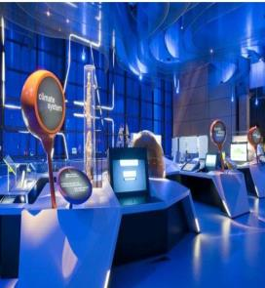
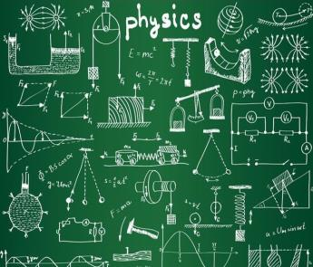
新课导入
思 考
communications
n. (复数)通讯
physics
n. 物理学

Slide 6
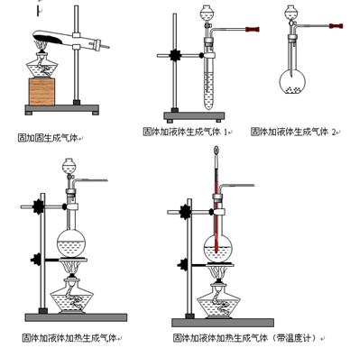
新课导入
思 考
chemistry
n. 化学

Slide 7
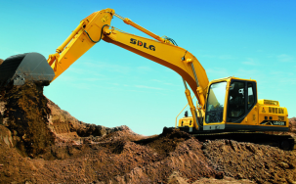
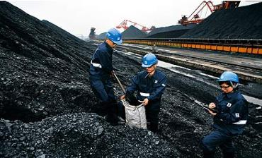
新课导入
dig
v. 挖掘; 掘(洞)
思 考
coal n. 煤

Slide 8
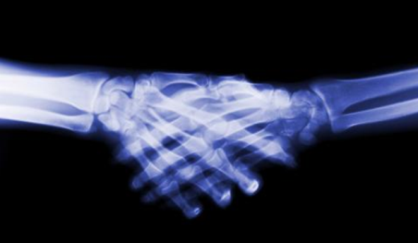
新课导入
思 考
X-ray
n. X射线; X光

Slide 9
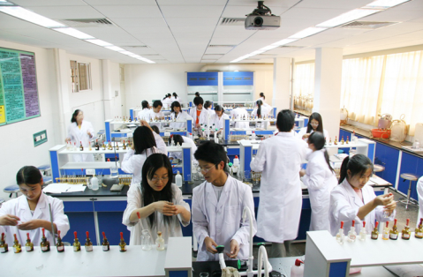
新课导入
思 考
experiment
n. 实验

Slide 10
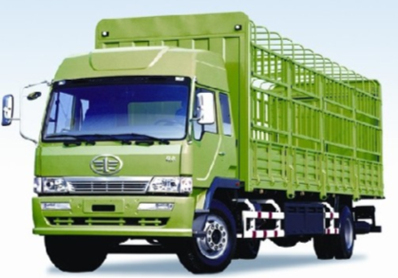
新课导入
思 考
sand
n. 沙; 沙子
wheel
n. 轮子; 车轮
truck
n.卡车; 货车

Slide 11
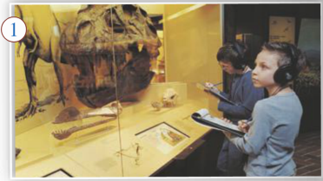
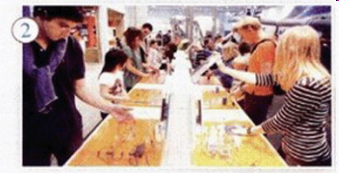
新课讲解
1
Work in pairs. Look at the pictures and talk about the differences between the two museums.
思 考

Slide 12
新课讲解
Think about:
1. What can you see in the pictures?
2. What other things can you see in each museum?
3. What kind of people go to these museums?
4. Which one do you prefer?
思 考

Slide 13
新课讲解
2
Read the passage and answer the question.
思 考
How is the Science Museum different from other museums?
It is noisy, and you can touch things and do experiments there.

Slide 14
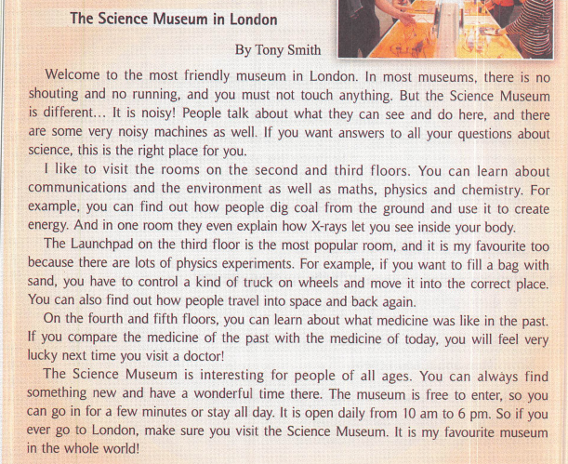
新课讲解
思 考

Slide 15
新课讲解
3
Complete the Tony's favourite museum column in the table.
思 考
 | Tony's favourite museum | Your favourite museum
Name
Place
Favourite room
Opening hours
Price
the Science Museum
London
The Launchpad
10 am – 6 pm
free

Slide 16
新课讲解
4
Answer the questions. Use the words in the box to help you.
思 考
chemistry communications control environment experiment physics X­ray
1. What can you learn about in the rooms on the second and third floors?
You can learn about communications and the environment as well as maths, physics and chemistry.

Slide 17
新课讲解
2. What allows you to see inside your body?
3. What can you do in the Launchpad?
4. What can you learn about on the fourth and fifth floors?
思 考
X-rays let you see inside your body.
You can do physics experiments and find out how people travel into space and back again.
You can learn about what medicine was like in the past.

Slide 18
新课讲解
Language point
1. …and there are some very noisy machines as well.
这也有一些噪声很大的机器。
思 考
as well表示“也”，常用于肯定句中，且位于句末。
1) Are they coming as well?
他们也来吗？
2) I like this movie, and my mother likes it as well.
我喜欢这部电影，我妈妈也很爱看它。

Slide 19
新课讲解
Language point
拓展
注意几个“也”的区别：
 | 使用句式 | 位置
as well | 肯定句 | 句末
also | 肯定句 | 句中
too | 肯定句 | 句末，常用逗号和前面的部分隔开
either | 否定句 | 句末

Slide 20
新课讲解
5
Decide what the underlined words in the sentences refer to.
1. But the Science Museum is different... It is noisy!
2. People talk about what they can see and do here．
3. You can always find something new and have a wonderful time there．
思 考

Slide 21
新课讲解
6
Complete the passage with it, they and there.
There are a lot of museums in London, and one of the most popular is the British Museum. Thousands of people visit (1) _______ every year. (2) ______ they can see lots of interesting things from different times and places. The British Museum is very traditional. Visitors must not make a noise, and (3) _______ must not touch anything or take photos. Entry to the museum is free, so people can visit (4) _______ as often as they like.
there
it
they
it

Slide 22
新课讲解
7
Write a passage about your favourite museum. Pay attention to the words it, they and there.
Step 1: Complete the Your favourite
museum column in the table.
 | Your favourite museum
Name
Place
Favourite room
Opening hours
Price

Slide 23
新课讲解
Step 2: Write a passage. Use the table and Activities 3 and 6 to help you.
1. Are there many museums in your hometown?
2. Which one is your favourite?
3. What is special about the museum?
4. What can you see or do there?

Slide 24
新课讲解
Possible answer:
There are several museum in my city, including the History Museum, the Science Museum, and even a Space Museum. I like all the museums, but I think I like the History Museum best. It has visiting exhibitions from all over the world. Once I saw some treasures from ancient Egypt there. Another time, they had an exhibition of Roman war engines. It was amazing! The museum is open every day except Thursday. I want to visit it again soon!

Slide 25
当堂小练
一、根据句意及汉语提示完成单词
1.The child dug his fingers into the （沙）.
2.I am good at （化学）.
3.—What subjects do you like？
—I like both （物理）and maths.
4.Look！The students are doing an (实验)now.
sand
chemistry
physics
experiment

Slide 26
当堂小练
二、用所给词的适当形式填空。
to, for, with, like, about, on
1. No one knows what our life will be _________ in the future. 2. That cup is empty. Please fill it __________tea, Tina. 3. I’m so sorry to learn __________ your illness. 4. Who can tell me the answer __________ the question? 5. Mr Wang has decided to remain here __________ two more days. 6. —Oh, there aren’t enough chairs. Do you mind sitting __________ the floor? —Not at all.
like
with
about
to
for
on

