Slide 1
Lesson 39
The Dove and the Olive Branch
WWW.PPT818.COM

Slide 2
Warming up：
Do you know the story of the dove and the olive branch?

Slide 3
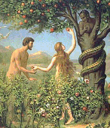
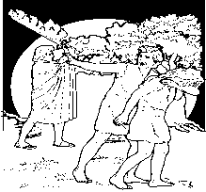
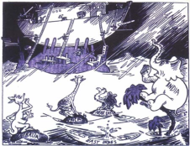
Tell students an old story

Slide 4
1. Adam and Eve
2. The garden of Eden
3. Driven out of the garden of Eden
4. Noah’s ship
5. The dove and the olive branch
温馨提示

Slide 5
New words
olive flood
snake lock

Slide 6
Listening Task: Listen to the tape and decide the following statements are true or false.
1.Noah is a good man.
2.Noah and his family in the Great Flood for a hundred days.
3.Since then, people use a picture of a dove with an olive branch in its mouth to show their love for peace.

Slide 7
Read the text and answer these questions:
After Adam and Eve were driven out of the Garden of Eden, what did they do?
What did God say?
How did Noah and his family escape?
How did they know the danger was over?
How long did they stay in the Great Hood?
What are symbols of peace?

Slide 8
Flood
作不可数名词，意为“洪水”，以它作主语时，谓语动词用单数形式。
e.g.
There was a serious flood here last month. 上个月这里发了一次大洪水。

Slide 9
2. To prepare for the flood, Noah made a large ship of wood. 为了给这次洪水做准备，诺亚做了一艘大木船。
句中的to prepare for the flood 是动词不定式短语用在句首作状语，表示目的，它也可用在动词后；短语 prepare for则表示“为……做准备”，与get ready for同义。
e.g.
Lisa is leading a happy life now.
丽萨正过着幸福的生活。

Slide 10
3. Since then, people have always taken the dove and the olive branch as symbols of peace. 自那以后，人们总是把鸽子和橄榄枝当作和平的标志。
句式take…as…意为“把……当作……”，其中的动词take可用have, look on等加以替换。
e.g.
I take you as my good friend all the time. 我一直把你当作我的好朋友。

Slide 11
[辨析]
: except, but, besides
except 意为 “除……之外（不再有）”，指从整体所接的人或物，前面常有 all, every, any, no 等词。
(2) but 意为 “除……之外”，常与有否定意思的词连用。当but 前有实义动词 do 时，but 后接动词原形。but 作为副词时同 only，意思是 “不过；只”。
(3) besides 意思是 “除了……之外（还有）”，它的意思是在原来的基础上加上 besides 除外的人或物，其前常有 other, another, others, a few 等词。

Slide 12
一、根据汉语提示写出单词。
A yellow leaf _______ (飘落)down on the wind.
Please _______ (抬高) your hand above your head.
He is very tall, and he is 1.9 meters ______ (高).
We live in a _________ (和平) period.
They made a ________ (木的) model ship yesterday evening.

Slide 13
二、用括号内所给单词的适当形式填空。
Who jumped ________ (far) of all in the long jump?
He is _______ (fly) to Canada tomorrow.
My car was broken by the ______ (branch).
He has no _________ (daughter) or sons, but he doesn’t feel lonely.
_____ (who) is she going to look for?

Slide 14
三、根据汉语意思完成句子。
1.我们应该开会讨论一下这件事情。
We should have a meeting ___ ________the matter.
2. 我们可以在网上与陌生人交朋友。
We can _____ _______ ____ strangers on the Internet.

Slide 15
3. 请抓住那个小偷！他愉了我的钱包。
Please _____ that thief! He has stolen my wallet.
4. 你知道鸽子和橄榄枝的故事吗？
Do you know ____ ____ ____ the dove and the olive branch?
5. 橄榄意味着和平生活。
The olive ______ the peaceful life.

Slide 16
Discussion
Do you think the story of Noah is real? Why or why not?
In Chinese culture, there are also famous stories about making peace. Tell one of these stories to your class. Then, write it out.

Slide 17
Homework
1.Write a passage about this lesson.
2. Preview next Lesson.

