Slide 1
Unit 5 Topic 1
China attracts millions of tourists from all over the world.
Section C
WWW.PPT818.COM

Slide 2
dragons/powerful animals/guard the whole nation
It’s said that dragons are powerful animals which/that guard the whole nation.

Slide 3
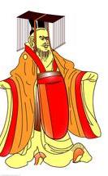
Emperors/persons/the sons of Heaven
It’s said that emperors are persons who/that are the sons of Heaven.

Slide 4
visit the buildings/
have yellow roofs
People are visiting the buildings which/that have yellow roofs.

Slide 5
the Great Wall/a wall/ about 8 800 km long
The Great Wall is a wall which/that is about
8 800 km long.

Slide 6
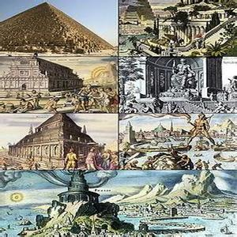
How much do you know about the Great Wall?
the Seven Wonders of the World

Slide 7
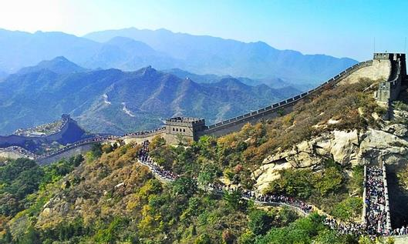
stretch from … to…

Slide 8
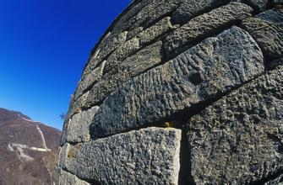
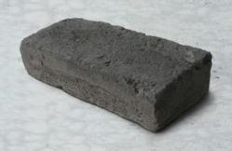
be made of packed earth and wood or of stone and brick
n.砖，砖块

Slide 9
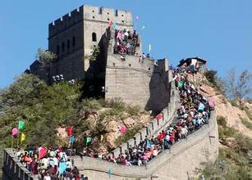
bring tourists
into China

Slide 10
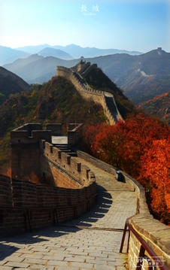
n.财富，珍宝
n.文明
a treasure of Chinese civilization

Slide 11
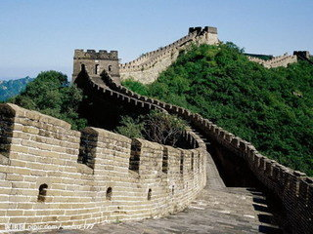
Read 1a and match the words with their meanings.
1b
1. separate a. to divide things into different parts or groups
2. enemy b. to think or believe that something will happen
3. expect c. gold or other things that are worth lots of money
4. treasure d. a person who hates you and wants to harm you

Slide 12
Read and understand.
1a
动画1a

Slide 13
Read 1a and match the words with their meanings.
1b
1. separate a. to divide things into different parts or groups
v.使分开，分离
2. enemy b. to think or believe that something will happen
n.敌人
3. expect c. gold or other things that are worth lots of money
v.预料，预期
4. treasure d. a person who hates you and wants to harm you
n.财富，珍宝

Slide 14
Read 1a again and complete the diagram.
1c
to ________their people
Purpose
to ________ them from
their _______
Material——The Great Wall a _______ of Chinese
civilization
Meaning
a _______ of the Chinese
nation
Qin dynasty
______________ ______________
total length
______________
______________
protect
packed earth
and wood
about 8 800
kilometers long
separate
enemies
treasure
Ming dynasty
_____________
_____________
beginning time
______________
______________
symbol
stone and
brick
about 2 500
years ago
录音P5-1a

Slide 15
Useful expressions
1. It stretches from Shanhaiguan in the east to
Jiayuguan in the west.
stretch from…to… 从……延伸到……
2. bring… into… 把……带进……
3. be regarded as… 被当作……

Slide 16
定语从句
The construction was begun during the Warring States Period, which was about
2 500 years ago.
The construction was begun during the Warring States Period.
The Warring States Period was about
25 00 years ago.

Slide 17
Work in groups and complete the following tasks. 1.Suppose you are a tourist guide and your group members are tourists from America who are very interested in the history of the Great Wall. Introduce the Great Wall to them. 2. How do you understand the saying, “He who has never been to the Great Wall is not a true man”?
2
不到长城非好汉。

Slide 18
Suppose your pen pal, David, is going to visit China. Write an e-mail to him to introduce a famous Chinese tourist attraction which you like best. The following questions may help you. 1. What is the tourist attraction and where is it? （tourist attraction 旅游胜地） 2. What is it famous for? （be famous for 以……而著名） 3. Why do you like it best?
3
Written work

Slide 19
Dear David,
The West Lake is my favorite tourist attraction. It lies in Hangzhou, Zhejiang Province and it attracts many people from all over the world.
I like the West Lake because it is one of the most beautiful lakes in China. There are lots of beautiful places which are worth visiting. The scenery is so beautiful that visitors often lose themselves in it.
The West Lake is famous for not only its special scenery but also some beautiful poems that were written by Bai Juyi and Su Dongpo. Besides, it is the home of the famous Longjing Tea.
Yours, Kangkang
Written work

Slide 20
Sum up
New words
state, remain, separate, enemy, expect, treasure, suppose
Phrases
stretch from…to…, bring… into…, be regarded as…,
be famous for…
Further learning the usage of attributive clauses
The construction was begun during the Warring States
period, which was about 2 500 years ago.
Have a better understanding of the background of the
Great Wall.

Slide 21
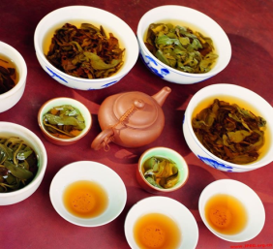
Homework
1. Finish the e-mail to David.
2. Search for something about the history
of tea from the Internet or related books.

