Slide 1
Be yourself!
WWW.PPT818.COM

Slide 2
Free talk
I am good at ...
This is my special talent.
This is my personal strength.
This makes me unique.
I am a unique person.
I am proud of myself.

Slide 3
Learning Aims
知识目标
掌握词汇: stupid, smart, impossible, weak
接触词汇: Sue, average, mirror
掌握短语: strong points, weak points
能力目标:能写出短文—Be myself

Slide 4
I am good at…
I am smart.
strong points
I can get good grades.
I am not good at…
I am weak in…
I make stupid mistakes.
weak points
I get average grades.
一般的，平均的

Slide 5
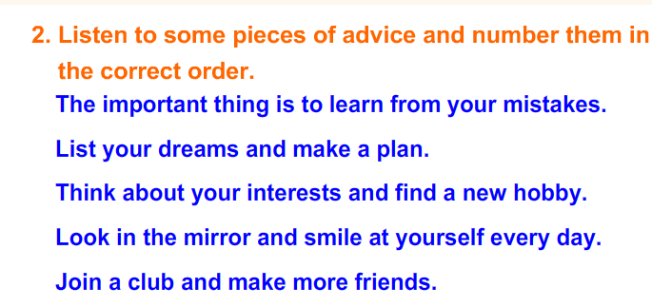
Listening

Slide 6
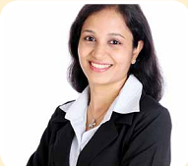
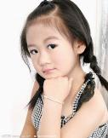
Sue
Fast Reading
Why does the girl write a letter to Sue?
A. Because she is good at everything.
B. Because she is pretty and smart.
C. Because she looks very common.
D. Because she feels bad about herself,
she doesn’t know what to do.

Slide 7
Detail Reading
1.The girl gets average grades in English.( )
2.What is Lisa good at?
3.The girl wants to be like her friend, but she knows
that’s _________.
4.What is the important thing?
5. 翻译
Don’t be too hard on yourself for making mistakes.
F
She is good at everything.
impossible
possible
The important thing is to learn from your mistakes.
不要因为犯错而对自己要求太苛刻。

Slide 8
Sue’s advice
1. Nobody is perfect in this world.
2. Think about your strong points.
3. Look in the mirror and smile at yourself
every day.
4. You are a special person and unique in
your own way.

Slide 9
Read and fill
A sad girl wrote to Sue. She told Sue that sometimes she made_______ mistakes. She wanted to be _____and pretty like her friend Lisa, but she knew that it was_________. She felt bad. Sue told her that everyone had strong points and _____points. She should not be too ______on herself for making mistakes. She should learn from mistakes. She is _______and _______in her own way.
stupid
smart
impossible
weak
hard
special
unique

Slide 10
We have learned
Words:
mirror
smart
weak
stupid
average
impossible
strong points
weak points
n.镜子
adj.聪敏的
adj.弱的，无气力的
adj.愚蠢的；傻的
adj.一般的；平均的
n.平均；一般水平
adj.不可能的
优点；强项
缺点；弱项
Phrases:

Slide 11
Exercises
B
1.Don’t be too hard _____your child.
A. off B. on C. to D. for
2. You can learn English _____him.
A. on B. in C. from D. at
3. Don’t be afraid to _____________.(犯错误）
4.Li Ming is a good person. He has many
_________.（优点）
5.to,the,time,it,work,is,on,finish,impossible,
_____________________________________
C
make mistakes
strong points
It is impossible to finish the work on time.

Slide 12
Writing Time
Be myself
Nobody is perfect in this world. I have strong points and
weak points.
_______________________________________________
___________________________________(strong points)
_______________________________________________
___________________________________(weak points)
But I must be myself. I am a special person and unique
in my own way.

Slide 13
Homework
完成短文
预习第46课。

Slide 14
Thank You Very Much!

