Slide 1
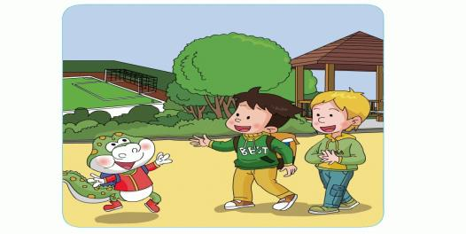
Unit 3 Days of the week What do you do on Saturday?
WWW.PPT818.COM

Slide 2
Let's enjoy a song.

Slide 3
Learning aims:
知识目标：
能听懂、会说、认读单词或短语：
Saturday, Sunday, hurry up.
能听懂、会说、认读句型：
What do you do on Saturday/Sunday?
I often play football.
能力目标：
能灵活运用本课所学的知识，询问他人的周末生活，并介绍自己的周末生活。

Slide 4
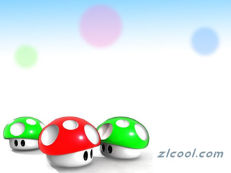
Sharp eyes:
play football
dance
play the erhu
play the drums
sing
read books
play basketball
skip
watch TV
play the piano
cook
draw pictures

Slide 5
Monday
Tuesday
s
Wednesay
Weekday工作日
Thuresday
Friday

Slide 6
Saturday
Sunday

Slide 7
Sunday
Monday
Tuesday
Weekdays
工作日
Week
Wednesay
Thuresday
Friday
Saturday

Slide 8
Monday
Tuesday
Weekdays
工作日
Wednesay
Week
Thuresday
Friday
Saturday
Weekend
周末
Sunday

Slide 9
Watch the CD-ROM, and try to find Danny's questions.

Slide 10
Danny's questions:
Listen and imitate the dialogue, then try to find the answers.
1.What do you do on Saturday?
2. What do you do on Sunday?

Slide 11
Read the dialogue and underline the answers.
1.What do you do on Saturday?
We often play football.
2. What do you do on Sunday?

Slide 12
OK.
Let's go and play.

Slide 13
Read the dialogue and underline the answers.
1.What do you do on Saturday?
We often play football.
2. What do you do on Sunday?
I often play the piano.

Slide 14
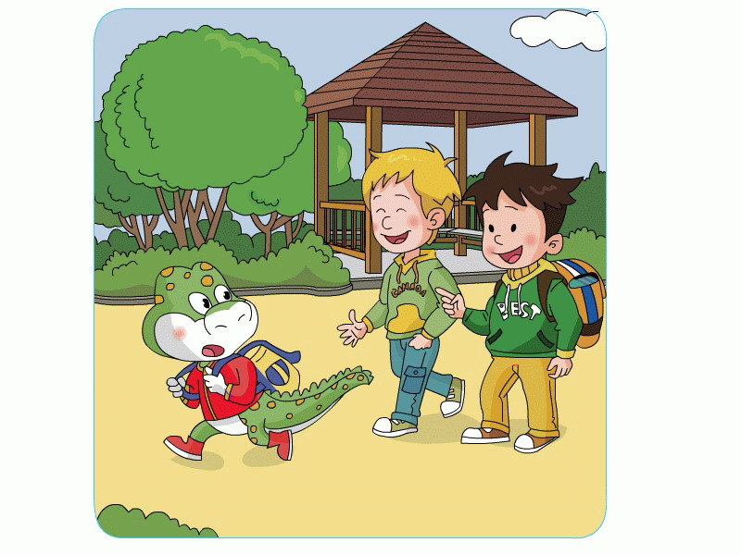
Hurry up!
It's time for school.

Slide 15
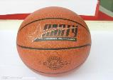
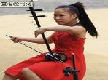
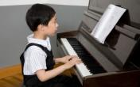
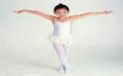
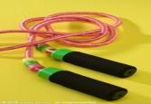
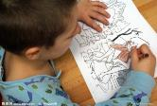
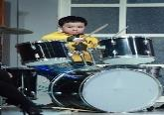
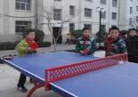
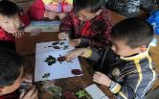
Talk in pairs.
A:What do you do on Saturday/Sunday?
B:I often …

Slide 16
My weekend
Read and judge.
Hello, boys and girls! On Saturday morning, I often go shopping. In the afternoon I often read books and watch TV. On Sunday morning, I often go to my parents' house. In the afternoon I often go to the park and play badminton. I can play it well. I'm very happy. I like my weekend. What about you?
1. I often go shopping on Sunday morning. ( )
2. I often read books on Saturday afternoon. ( )
3. I can play badminton well. ( )
4. I often go to the park on Saturday. ( )
X
√
√
X

Slide 17
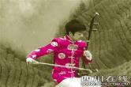
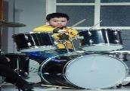
My weekend
Let's talk about our weekend.
Hello, friends! I often ... on Saturday...

Slide 18
What did we learn today?
(今天我们学习了什么？)
Let's check.
Can you read?
Saturday, Sunday, hurry up | 3 | I've got ____ .
What do you do on Sunday? We often play football. What do you do on Sunday? I often play the piano. | 4

Slide 19
Homework:
1. Listen and imitate the dialogue twice.
2. Do a survey. Ask your family or friend “What do you do on Saturday/Sunday?” and finish the table.
 | OnSaturday | On Sunday
Father
Mother
Good friend
...

