Slide 1
Unit 8 Culture Shapes Us
Different Manners
WWW.PPT818.COM

Slide 2
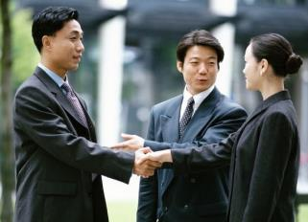
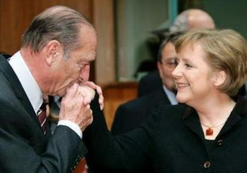
In your opinion, what are good manners?

Slide 3
New Words
manners n.礼仪;习俗;礼貌
though conj.虽然;尽管;即使;然而
modest adj.谦虚的;谦恭的
virtue n.美德
praise v.&n.称赞;赞扬
private adj.私人的;私有的
elderly adj.上了年纪的;较老的
guest n.客人
extra adj.额外的;另外的
waiter n.(餐馆的)男服务员
tip v.给小费

Slide 4
Read the lesson and match the behaviours with the correct countries.
asking an adult’s age
putting food on a guest’s plate
Canada
giving a tip to waiters and hotel workers
China
sharing the cost of a meal in a restaurant

Slide 5
Read the text and find out main phrases and main sentences.
Main phrase:
·take turns
Main sentences:
·In your opinion,what are good manners?
·Joe is an English name that sounds like Zhou.
·This is probably because North American manners and Chinese manners are so different.
·If someone praises you and says that your English is excellent,you should be modest and say,“No,no.My English is still poor.”

Slide 6
·In both China and North America,it is polite to offer an elderly person a seat on the bus.
·When Chinese people eat out in restaurants,they may take turns paying for the meal.
·In China,people seldom give extra money to waiters,waitresses,taxi drivers or hotel workers.
·It is called “tipping”.
·I think understanding cultural differences really helps us to understand each other,live together and work together.

Slide 7
☆教材解读☆
1.In your opinion,what are good manners?
in one’s opinion意为“在某人看来,依照某人的看法”。
2.Joe is an English name that sounds like Zhou.
sound like意为“听起来像”,sound可用作系动词,后跟形容词,表示“听起来……”。sound后还可跟as if引导的从句。

Slide 8
3.This is probably because North American manners and Chinese manners are so different.
◆句中的because North American manners and Chinese manners are so different为表语从句,用在系动词be后作表语,要使用陈述语序。
◆manner意为“方式;态度;习惯”。表示“礼貌,礼仪;风度;规矩;风俗;生活方式”时,要用manners。
4.If someone praises you and says that your English is excellent,you should be modest and say,“No,no.My English is still poor.”
praise为动词,意为“表扬,称赞,赞美”, praise…for
…意为“因……而表扬……”。praise还可以作名词,意为“赞扬,称赞,赞美”,为不可数名词。

Slide 9
5.In Canada,people only ask children about their age.
【辨析】 human,people,person,one,man
(1)human意为“人类”,表示区别于其他动物或者神的“人”,不用于日常生活中所指的人。
(2)people意为“人,人们”,是集体名词;但如果表示不同的民族时,有复数形式。
(3)person着重指“个人”,多和具体数词连用,可以有单数或复数形式。
(4)one意为“一个人”,为不定代词。表示人们应尽的职责与义务或经常性的习惯时,一般用“one”,其物主代词是“one’s”,反身代词为“oneself”。
(5)man可泛指人,包括男女在内,有单复数形式;作不可数名词时指“人类”。

Slide 10
6.In both China and North America,it is polite to offer an elderly person a seat on the bus.
both…and…意为“两者都,既……又……”,用于连接两个并列关系的成分。both…and…连接两个并列成分作主语时,谓语动词用复数形式。
7.When Chinese people eat out in restaurants,they may take turns paying for the meal.
take turns意为“依次,轮流”。表达“轮流做某事”可以用take turns doing sth.,也可以用take turns to do sth.,还可以搭配介词at,in,on或about。It’s one’s turn to do sth.表示“轮到某人做某事了”。

Slide 11
8.In China,people seldom give extra money to waiters,waitresses,taxi drivers or hotel workers.
seldom为副词,意为“很少,不常”,与often相对,在句中表示否定意义。
【拓展】 常用的表频度的副词,按频度由低到高的顺序排列: never→hardly→seldom→sometimes→often→usually→always

Slide 12
9.It is called “tipping”.
tip在此处为动词,意为“给小费”,
tipping是tip的v.-ing形式。
10.I think understanding cultural differences really helps us to understand each other,live together and work together.
由and或or连接的动词不定式,第二个及其后的动词不定式的to可以省略。如果两个动词不定式有对比的含义或者不用连词,要保留to。

Slide 13
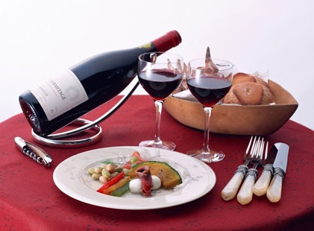
Work in groups. Talk about other manners you know in different countries. First write down what you know on the paper, then share them with other groups.

Slide 14
Match and complete the sentences.
Although people have different cultures and customs,
but he has already made many friends there.
Brian hasn’t been to China,
they have the same feelings.
He has been at the new school for only a few days,
he still feels lonely.
but he knows a lot about our country.
Though Liu Feng has many friends in America,

Slide 15
Ⅱ.Fill in the blanks with the words or phrases in the box.
pay for praise take turns modest private
praise
1.We should little Debbie for her courage.
2.It’s a long way.We can driving.
3.They asked him to the damage,but he refused.
4.Don’t talk about other people’s things. It’s not polite.
5.Jack is a man who is admired by many people.
take turns
pay for
private
modest

Slide 16
Ⅲ.Put the words in the correct order.
6.different,you,manners,know,do(?)
7.feel,why,he,embarrassed,does(?)
8.good,like,idea,it,a,sounds(.)
9.ask,adult’s,don’t,an,age(.)
10.common,seat,offer,to,it’s,a,person,elderly,an(.)
11.paid,meal,have,you,for,the(?)
Do you know different manners?
Why does he feel embarrassed?
It sounds like a good idea.
Don’t ask an adult’s age.
It’s common to offer an elderly person a seat.
Have you paid for the meal?

Slide 17
Homework
1.Finish off the remaining exercises in the activity book.
2.The students are required to read the next text in the student’s book.

