Slide 1
Unit 4
I used to be afraid of the dark.
Section A (第1课时)
WWW.PPT818.COM

Slide 2
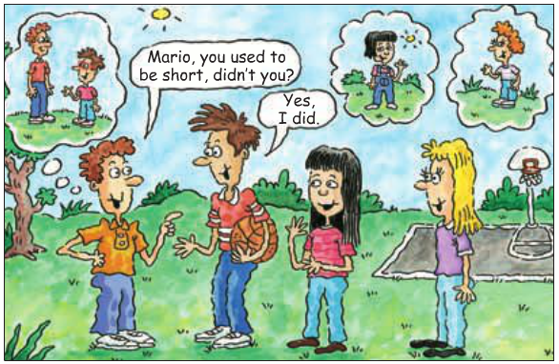
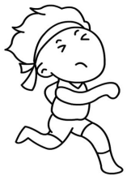
Warming up
1. Did Mario use to be short?
2. What's he like now?

Slide 3
1a
Fill in the chart with words to describe people.
Appearance | Personality
tall | outgoing
straight hair | funny

Slide 4
Listen. Bob is seeing some friends for the first
time in four years. What did his friends use to
look like?
1b
1. Mario used to be ______. He used to wear ________.
2. Amy used to be _____. She used to have ______ hair.
3. Tina used to have _______ and ______ hair.
short
glasses
tall
short
red
curly

Slide 5
Look at the picture in 1a and make conversations.
1c
A: Did Mario use to be short?
B: Yes, he did. He used to be really short.
A: What's he like now?
B: He's tall now.

Slide 6
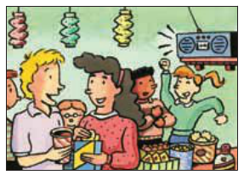
Listen and check( )the words you hear.
2a
___ friendly ___ outgoing ___ serious
___ humorous ___ silent ___ active
___ brave ___ quiet ___ helpful
✔
✔
✔
✔
✔
✔

Slide 7
Listen again and complete the chart about how
Paula has changed.
2b
In the past | Now
1. Paula used to be really _____. She was always silent in class. She wasn't very __________. She was never brave enough to ask questions. | 1. Now she's more interested in _______. She plays _______ almost every day. She’s also on a _____ team.
2. She got good grades in _______. She was also good in ___________. She used to play the ______. | 2. She still plays the ______ from time to time.
quiet
sports
soccer
outgoing
swim
science
piano
music class
piano

Slide 8
Make conversations about Paula using the information
in 2b.
2c
A: Paula used to be really quiet.
B: I know. She was always silent in class.

Slide 9
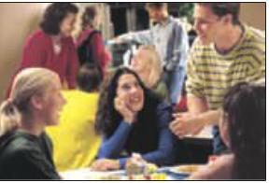
Role-play the conversation.
2d
Alfred: This party is such a great idea!
Gina: I agree. It's been three years since we last saw our
primary school classmates.
Alfred: It's interesting to see how people have changed.

Slide 10
Gina: Billy has changed so much!
He used to be so shy and quiet.
Alfred: Yeah, his face always turned red when he talked to girls!
Gina: I used to see him reading in the library every day.
Alfred: That's because he was a really good student.
He studied hard and got good scores on his exams.
Gina: Did he use to wear glasses?
Alfred: Yes, and he used to be thin, too.
But look how big and strong he is now!
Gina: He's so popular now. Look at all the girls around him!

Slide 11
Language Points
1. What's he like now? 他现在是什么样？(教材P25)
What's sb. like? 意为“……是什么样的人？”
多用于提问人的性格、品质等，也可用于提问人的相貌。
e.g.: —What's Alice like?
—She is quiet and a little shy.
What does sb. look like? 意为“……长得什么样？”
用于提问人的长相、外貌。
e.g.:—What does Tom look like ?
—He has short hair.

Slide 12
be like 意为“像……一样”,同义短语是look like。
e.g.:The girl is like her mother.
① be like 意为“像……一样”,指品德、相貌等像;
更侧重人的个性特征，常与look like互换。
e.g.:The twins are like their father.
② look like 意为“看起来像……”，强调外观上像。
e.g.:He looks like his father.

Slide 13
2. It's been three years since we last saw our primary school classmates. 自从我们上次见到我们的小学同学以来，已经三年了。（教材第26页）
“It's been+一段时间+since+从句”意为“自从……以来已经有多长时间了”，还可表示为“It is+一段时间+since+从句”。
e.g.: It has been five years since I began to learn English.
=It's five years since I began to learn English.
since此处用作连词，意为“自从，自……以来”。主句常用完成时，且动词需要用延续性动词。since后接从句，该从句用一般过去时态。
e.g.:She has taught us English since I came to this school.
【拓展】since还可以用作介词，意为“自从……以来”，后接表示时间点的词。
e.g.: He has worked there since 10 years ago.

Slide 14
3. I used to see him reading in the library every day.
我过去常常看见他每天都在图书室看书。（教材第26页）
see sb. doing sth. 意为“看见某人正在做某事”，doing 作宾语补足语，表示动作正在进行。
see sb. do sth. 意为“看见某人做了某事”，指看见动作发生的全过程。
e.g.:I saw him playing football on the playground.
I saw her run into the room.

Slide 15
Exercise
一、单项选择。
( )1.He used to ______ in a small village ,but now he has been used to
_____ in a big city.
A.live;living B.live;live C.living;living
( )2. _______work in Microsoft?
A.Did you use to B.Did you used
C.Did use to D.Do you use to
( )3. Now she is ______ a tall girl.She has changed _______ much.
A.so;so B.so;such C.such;such D.such;so
( )4. He used to ______ short hair and get good scores ______ his exams.
A.be;in B.be;on C.have;on D.have;in
A
A
D
C

Slide 16
二、根据汉语意思完成下列句子。
1. 你姐姐过去考试取得好成绩吗？
______ your sister ______ _____ get good grades on the exams?
2. 他总是在课堂上保持沉默。
He always _______ _________ in class.
3.自从到游泳队，已经有2个月了。
It's ______ two months ______ I was _____ the swimming team.
4.有时我看见那女孩在读书。
______ time _____ time, I see the girl ________books.
5. 她变化那么大。她过去是个那么活跃的女孩。
She's changed _____ much. She used to be ______ an active girl.
Did
use
to
keeps
silent
been
since
on
From
to
reading
so
such

Slide 17
Homework
1.Listen and read after the tape at home.
2.Read and recite 2d.

Slide 18
Thank you!

