Slide 1
Module 11 Photos
Unit 3
Language in use
WWW.PPT818.COM

Slide 2
Language practice
He’s the boy who won the photo competition last year!
The photo which we liked best in the City and People group was taken by Zhao Min.
A group of photos which show Beijing and Cambridge in England have won the prize.

Slide 3
Complete the poster for the photo competition. Use that, which or who. There may be more than one answer.
Photo competition
Send us your photos and win a new camera!
We need photos ___________ show daily life at school.
that /which

Slide 4
Your photos should record interesting things ___________ happen at school, inside the classroom or outside.
The photos __________ you take should be active, beautiful and true.
The photos ___________ you send should include some words about them.
The size of the photos ___________ you take should be 9cm×13cm.
that /which
that /which
that /which
that /which

Slide 5
Students __________ enter the competition should be between 10 and 16 years old.
The last date _______ you should send your photos on is 30th November.
The lucky person ___________ wins the competition will receive a new camera.
who / that
which
who / that

Slide 6
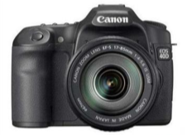
Get your camera and start taking your photos now!

Slide 7
Learning to learn
In many English-speaking countries, two systems of measurement are used: imperial (inch, foot, yard, mile, pound) and metric (millimetre, centimetre, metre, kilometre, kilogram). You also need to recognise their short forms (in, ft, yd, ml, lb; mm, cm, m, km, kg).

Slide 8
定语从句
在复合句中修饰名词或代词的从句叫做定语从句。被定语从句修饰的名词或代词叫先行词。定语从句必须放在先行词之后。引导从句的关系代词有who(人-主格), whom(人-宾客), whose(人-所有格), which(物), that(人/物)。
引导从句的关系副词有where(地点), when(时间), why(原因)。

Slide 9
人
( )
The man who lives next to us is a teacher.
You must do everything that I do.
We will never forget the day when we
visited our headmaster.
先行词
定 语 从 句
物
( )
先行词
定语从句
时间
(
)
定语从句
先行词

Slide 10
从句的谓语动词和先行词的关系。
主谓关系
He asked the man (作从句主语) who/that was smoking.
b. 动宾关系
The noodles (作从句宾语) that/which I cooked were delicious.

Slide 11
which 引导的定语从句
which 引导的定语从句修饰的是无生命物体, which 在从句中可以作主语, 也可以作宾语。
只能用which的情况:
a. 关系代词前有介词。
This is the house in which we lived
last year.

Slide 12
b. 先行词本身是that。
The clock is that which I bought
yesterday.
c. 非限制性定语从句。
His English, which used to be very poor,
is now excellent.

Slide 13
who引导的定语从句
如果先行词指人那么定语从句的引导词就可以用who。如果先行词指人, 引导词在从句中充当宾语, 那么引导词就要用who的宾格形式whom, 口语中也可以用who代替。
She has two brothers, who are both doctors.
The man whom I saw is called Smith.

Slide 14
定语从句中引导词的省略
不管定语从句修饰的是人还是物, 如果引导词在从句中作宾语, 通常就可以省略。
e.g. Did you go to the talk (that/ which)
the famous scientist gave at your
school?
你去听那位著名科学家在你们学校做
的演讲了吗？

Slide 15
Is that the car (that/which) you bought last month?
那是你上个月买的车吗？
A friend is a person (who/whom) you know very well and like.
朋友是你十分了解并且喜欢的人。

Slide 16
引导词作宾语时可以省略是因为省略后的从句仍然有主语和谓语, 仍然可以分辨出哪部分是定语从句。但是, 引导词在从句中作主语时就不能省略, 否则会造成结构混乱。
e.g. I’d like to have a teacher who is good
at speaking.
我想拥有一位擅长演讲的老师。
He can make lessons that are usually
boring interesting.
他能把枯燥乏味的课讲得生动有趣。

Slide 17
以上两句中的引导词 who 和 that 在从句中作主语, 不能省略。此外, 需要注意的是, 虽然在定语从句中作宾语的引导词在口语中往往被省略, 但在正式文体中则常常被保留。

Slide 18
中考真题
“What do you think of the school uniforms?” “Very good. I like clothes ______ make me feel comfortable.”
【2012贵州贵阳】
A. that B. what C. who
A

Slide 19
【解析】
考查定语从句引导词的用法。定语从句的先行词clothes是“物”, 所以, 定语从句的引导词用which或that引导。根据句意：你觉得校服怎么样呀? 很好, 我喜欢让我穿着舒服的衣服。

Slide 20
2. It’s interesting that there are many people ____ speak French in Canada.
【2012四川成都】
A. which B. where C. who
C
D
3. I can never forget the stories ______ my grandma told me. 【2012绵阳市】
A. what B. who
C. them D. that

Slide 21
4. Please pass me the cartoon book
_______ has a Mickey Mouse on
the cover. 【2012天津】
A. whom B. whose
C. who D. which
D

Slide 22
Exercises
Complete the sentences so that they are true for you.
I like the writer who __________________________.
2. I would like to visit a place that __________________________.
3. I go to a school which _____________
________________________________.
wrote the Harry Potter books
has lots of sunny beaches
only accepts students who are good at English

Slide 23
4. My favourite band is the
one that ___________________________.
5. I have never seen a doctor who _________________________________.
6. I want to take a photo which _______________________________
_______________________________.
7. Our teacher is the man who ______________________________.
we saw at the concert last week
wears shorts in the operating theatre
shows my pet cat playing in a cardboard box
is wearing a purple shirt

Slide 24
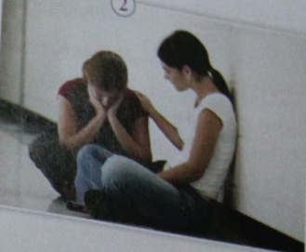
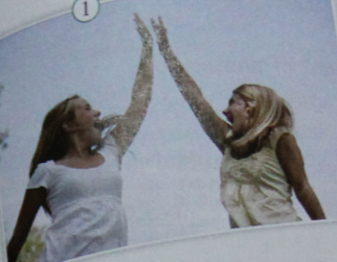
Work in pairs
Talk about the two photos.

Slide 25
I like the photo which …
I don’t like the photo which …
The photo which … is …

Slide 26
Then talk about the people in the photos.
The girl who …
Now ask questions about the photos and write down your answers.
— Which photo …?
— The one …

Slide 27
Look around the class and describe someone or something to your partner. Can your partner guess who or what you are describing?

Slide 28
It is something that you use to paint pictures.
She is a girl who has glasses and long hair.

Slide 29
Exercises
Complete the conversation with the expressions in the box.
by the way even though far from
thousand of try … out
Jerry: Hi, how are you? I haven’t seen you for a long time … Wow, is that a new camera, ___________?
by the way

Slide 30
Tina: Yes. I dropped my old one, and it was too expensive to repair. So I bought a new one. This one is much better. It’s so much lighter and easier to use than the old one. I’ve learnt how to work it already, ____________ I’ve only had it for a couple of days. And I don’t have to worry about getting prints of all the photos — I can store _____________ photos on my computer!
even though
thousands of

Slide 31
Jerry: Wow, that’s great! I’m thinking of getting a camera too. Do you mind if I _____ it _____?
Tina: Of course not. Let’s go to the lake. It’s not __________ here. The lake would make a really good photo.
try out
far from

Slide 32
Reading
Read the passage and complete the table.
When | What happened
In 1827
In the early 1830s
Niepce invented a camera and the first successful photograph was produced.
A new kind of camera was invented.

Slide 33
When | What happened
After 1840
In the 1880s
By the end of the nineteenth century
People could take pictures of moving things.
People could buy film in small boxes.
Photography became a kind of art.

Slide 34
Listen and complete the sentences.
The first successful photo was produced in _________.
2. Because it took a long time to take a photo, people in early photos did not ________.
3. The first photographers needed to know how to _____________ and _________ them.
1827
smile
take photos
develop

Slide 35
4. Kodak introduced a camera that could be used by everyone in ______.
5. Kodak’s camera was ____________ and ______ than any of the earlier
cameras.
6. Cameras with computer technology were introduced in ___________.
1888
smaller
lighter
the 1990s

Slide 36
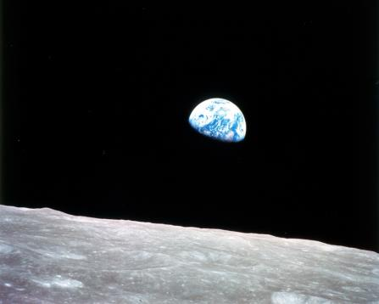
Around the world
A famous photo

Slide 37
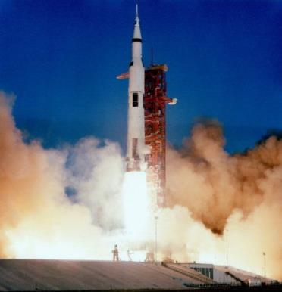
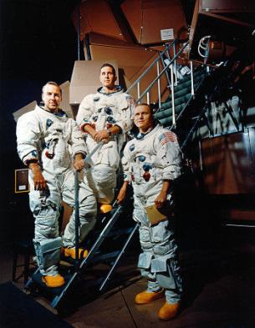
The picture of the earth from space was taken by William Anders on the Apollo 8 trip into space.

Slide 38
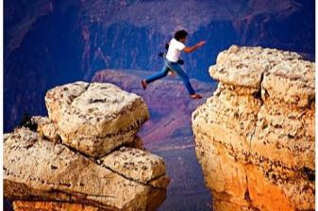
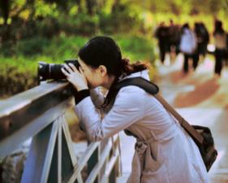
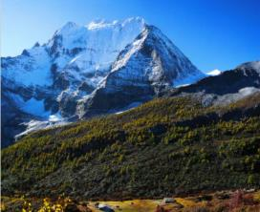
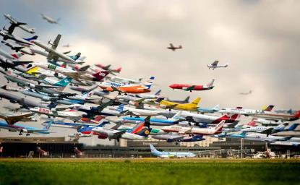
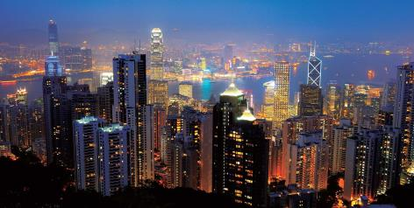
Module task
Making a photo display

Slide 39
Choose your favourite photo and describe it.
Choose one photo you like best.
Write a passage or story about it.
Say what/who it is in the photo, and
why it is important to you.

Slide 40
Work in groups
Talk about your photo. Use the passage or story you have written in Activity 8 to help you.

Slide 41
Show the group your photo. Tell them why you like it, and why it is important to you.
Answer questions your group may have.
Listen to the other members of your group talk about their photos.

Slide 42
Show your photos from the group to the whole class and talk about them.

Slide 43
Homework
Choose your favourite photos and give a brief introduction.

Slide 44
Thank you!

