Slide 1
Unit 3 Lesson 1 I want to eat noodles.
WWW.PPT818.COM

Slide 2
Listen and answer
jiaozi
Tom wants to eat_______.
And Tom’s father,Jack wants to eat______ .
noodles

Slide 3
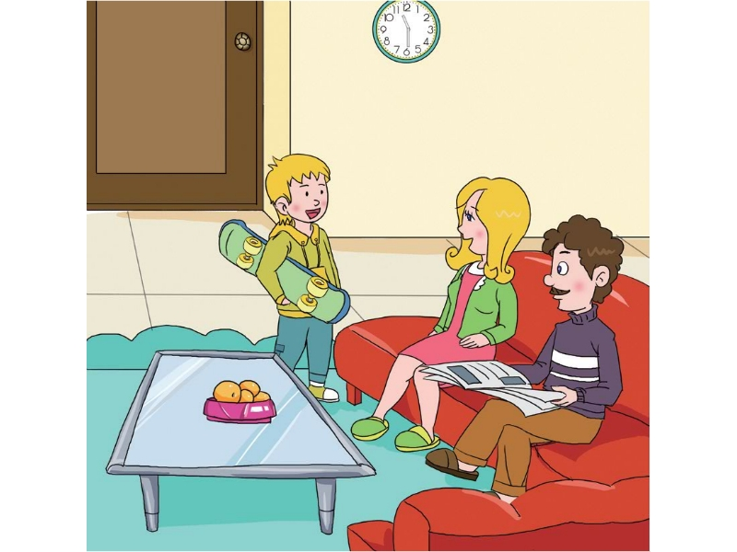
Listen again and find out the sentences “how does Tom’s mother ask the question?” (找出Tom’mother是如何用英语问他们想吃什么的句子.)
What do you want to eat?

Slide 4
: I want to eat jiaozi.
Chinese food（中餐）
: I want to eat noodles.

Slide 5
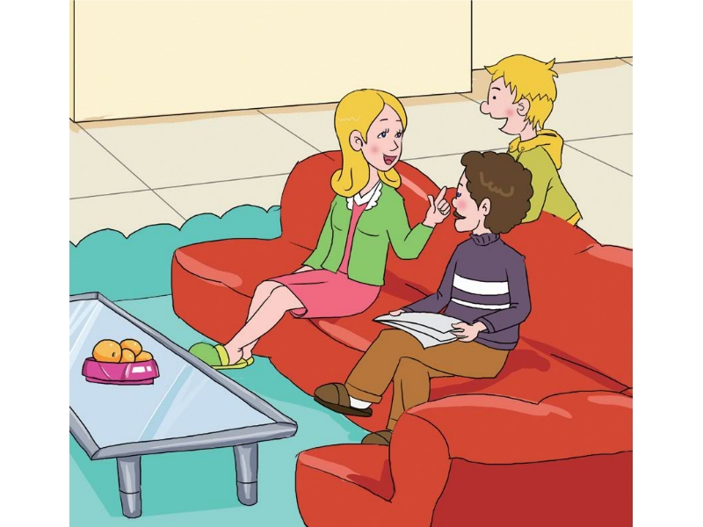
Can mum cook Chinese food?
Sorry,I can’t cook Chinese food.Shall we eat out?

Slide 6
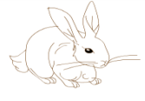
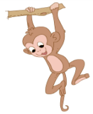
Production (拓展)
同学们，小动物们也来了，它们在一起交流自己想吃的食物。同学们，你可以选择扮演自己喜欢的小动物，可用动作，也可用头饰来扮演小动物。
A:Hello!I’m___.I’m hungry.
Danny:What do you want to eat?
A:I want to eat_____.
Danny:Here you are.
A:Thank you!

Slide 7
No frolicing during the meal,no running after the meal. :“吃饭不要闹，吃饱不要跑”:
Wanna be healthy?Do please treat yourself a nice breakfast :“要想身体好，早餐要吃饱”:

