Slide 1
Unit 7 Summer holiday plans
六年级
WWW.PPT818.COM

Slide 2
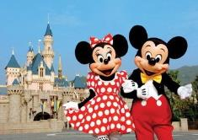
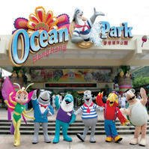
I’ll go to Hong Kong by plane this summer holiday. I’ll visit…
Disneyland
迪士尼乐园
Ocean Park
海洋公园

Slide 3
A: Will you go to Hong Kong for the summer holiday?
B: Yes, I will. / No, I won’t.
won’t=will not
A: Where will you go for the summer holiday?
B: I’ll go to…
A: How will you go there? /Will you go there by…?
B: I’ll go there by… / Yes,I will. / No,I won’t. I’ll...
A: How long will you stay there?
你将在那里停留多长时间？
B: I’ll stay there for …

Slide 4
Do you want to know something
about their summer holidays?
试着对孩子的暑假计划提一些问题吧
The children are talking about their plans for the summer holiday .

Slide 5
Listen and choose
Who will Mike visit in London?
1. Mike will go back to London. How long will he stay there? A. For a week. B. For a month. C. For three days. 2.Who will Yang Ling visit in Beijing? A. Her friends. B.Her grandparents. C.Her aunt and uncle. 3.How will Yang Ling go to Beijing? A. By plane. B. By bus. C. By train.
回去

Slide 6
Read and judgeT/F(P69)
1.Su Hai will go to Disneyland and Ocean Park in Hong Kong. ( )
2.Liu Tao will go to Taipei with his classmates. ( )
3.Su Hai will show some photos to Liu Tao after the holiday . ( )
T
F
parents
F
Liu Tao
Su Hai
Tip:轻声朗读69页对话，然后判断，用横线画出关键句。

Slide 7
Read and judgeT/F(P69)
Liu Tao: Where will you go for the summer holiday, Su Hai?
Su Hai: I’ll go to Hong Kong with my family.
Liu Tao: Will you go to Disneyland?
Su Hai: Yes,I will.We’ll go to Ocean park too. What about you, Liu Tao?
Liu Tao: I’ll go to Taipei with my parents.
Su Hai: That’s wonderful.I want to see the city too.
Liu Tao: OK.I’ll show you some photos after the holiday.
Su Hai: Thanks!

Slide 8
选择你喜欢的方式朗读课文。
1.Read it together
齐读课文
2. Read in roles
分角色朗读

Slide 9
Read and write
Mike is writing about everyone's summer holiday plans. Complete his notes.
Our summer holiday
My friends and I will be busy in the summer holiday.
London
My family and I will visit Grandma and Grandpa in .
a month
We will stay there for .
Yang Ling’s
aunt and uncle
live in Beijing. She will
train
visit them this summer. She will go there by .
Su Hai and her family will visit
Disneyland
and
Ocean Park
in Hong Kong.
Liu Tao will go to
Taipei
with his parents. He will take
some and show them after the holiday.
photos

Slide 10
Task1: Listen and answer.
Tip:
When you read, pay attention to(注意) the intonation(语调).
Where will and go for the holiday?
回去
will go back to London.
will go to Beijing.

Slide 11
Task2: Listen and answer.
Tip:
When you read, pay attention to(注意) the intonation(语调).
Q1: How long will Mike stay in London?
He will stay there for a month.
Q2: What will Yang Ling do in Beijing?
She will visit her aunt and uncle.
Q3: Will Yang Ling go to Beijing by plane?
No, she won’t.
= will not

Slide 12
Let's read.
Tip:
When you read, pay attention to(注意) the intonation(语调).
Where will you go for the holiday, Mike?
I will
I’ll go back to London.
How long will you stay there?
I’ll stay there for a month.
What about you?

Slide 13
Let's read.
Tip:
When you read, pay attention to(注意) the intonation(语调).
I’ll visit my aunt and uncle in Beijing.
说话者的语气？
That sounds great. Will you go to Beijing by plane?
No, I won’t. I’ll go by train.

Slide 14
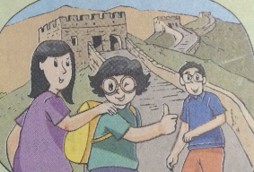
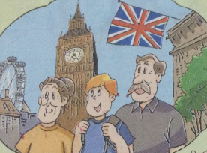
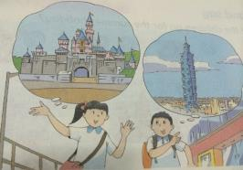
Try to retell .
Tip:
When you read, pay attention to(注意) the intonation(语调).
Tip：复述课文内容时，可以借助课文插图和思维图板书。

Slide 15
proverb
Tip:
When you read, pay attention to(注意) the intonation(语调).
Enjoy your travelling! 享受旅游！
Have great fun! 玩得开心！
Enjoy your summer holiday! 享受暑假！
Have a happy life! 快乐生活！

Slide 16
Story time
1. 我会读 Ocean Park/ photo/Disneyland/Taipei/stay/sound/ go back to/how long。
2.我能理解对话内容并能根据插图和板书进行简单复述。
3.I know :be going to= will
4.我能理解并表达句子： Will you…?Where will you go for summer holiday?及其答语

Slide 17
Homework:
1. Listen to the tape and read the text for three times.听磁带，熟读课文3遍。
2. Talk about your plans for summer holiday with your friends.
和朋友讨论你的暑假计划。
3. Finish Exercise1.完成练习1。

