Slide 1
冀教版 八年级下册
Environment Club
WWW.PPT818.COM

Slide 2
reduce [rɪ’djuːs]

Slide 3
reusable [riː'juːzəbl]

Slide 4
least [liːst]

Slide 5
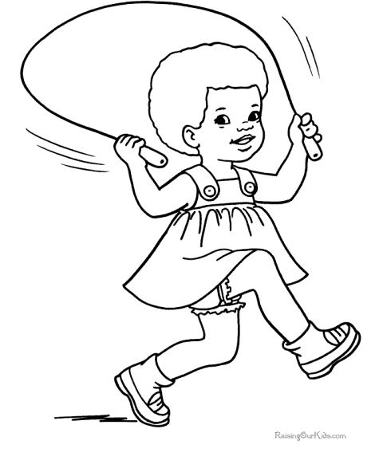
skip [skɪp]

Slide 6
packaging ['pækɪdʒɪŋ]

Slide 7
leaky
['liːki]

Slide 8
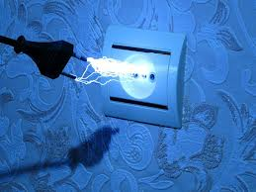
electricity [ɪˌlek'trɪsəti]

Slide 9
close
reusable [riː'juːzəbl]

Slide 10
Listen to the lesson and tick the activities mentioned.
No-garbage lunches
No-garbage schoolyard
Save water
No smoking in public
Save electricity
No-car days

Slide 11
Read the lesson and do the following tasks.
1. In North America, few students join environment clubs. ( )
2. In an environment club, students work together to reduce __________ and _________ the environment.
3. What do environment clubs encourage students to do at lunch?
4. How to reduce packaging?
5. Turn off the television and shut down the computer when you are not using them.
F
pollution
protect
Bring lunches in reusable bags and dishes.
By bringing our own shopping bag when we go shopping.
当你不使用电脑和电视的时候请关闭它们。

Slide 12
Read the lesson and retell with the key words and phrases.
join, environment clubs, reduce, protect.
a list of, activities, advice.
No-garbage lunches, throw away, make… clean, encourage…to, reusable
No-car days, neither… nor …
shopping bag, packaging.
Save water, leaky toilet, fill, fix
Save electricity, turn off, shut down
Let’s retell with the key words and phrases

Slide 13
Fill in the blanks with the correct forms of the words in the box.
waste least nobody shut pollute
1. The soap factory ________ the drinking water in this area.
2. Students should not ________ paper.
3. ________ knows when life on the earth started.
4. He who talks the most knows the ________.
5. I couldn’t ________ the window because it was stuck.
polluted
waste
Nobody
least
shut

Slide 14
Extended reading
I’m Jack, I think Education and action are key elements (要素) in change. Stamford's school students have many ways to take part in environmental activities, or join a school environment club. Everyone should consider what you can do to help make your school and neighborhood cleaner and greener.
High school courses now give Environmental Science. We may think we know the basics of “being green,” but there’s still a lot more to be studied and the knowledge will be surely good for the environment and ourselves in the future.
Some Stamford schools give after-school programs that include lessons and tours to environmental education institutions (教育机构) such as Soundwaters.
Through these programs, we not only learn about your hometown, we learn about how to keep this ecosystem (生态系统) alive and how we can help protect it as well.
Tasks: 1. Find out the topic sentence for the first paragraph.
2. What after-school programs do Stamford schools give?

Slide 15
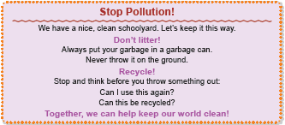
Task 1
I am leader of the environment club at my school. My club is getting ready to have some activities and I was wondering if any of you have good ideas!! Any ideas would be nice... We’ve already had some activities, such as No-garbage lunches, No-car days... So I need more new ideas! Please, please post with anything you can come up with...
Task 2
Suppose your school’s environment club wants to make a poster about littering and recycling. Can you make one? Here is an example:
Task1
Task2

Slide 16
Homework
1. Finish exercises of Lesson 44.
2. Preview next lesson.
3. Better your ideas for Task1 or Task 2 and write down your work on your exercise book.

