Slide 1
Unit 2 She looks cute.
WWW.PPT818.COM

Slide 2
Introduce yourselves .
My name is …/ I’m …
I’m …
I come from …(I’m from… )
I live in / on …

Slide 3
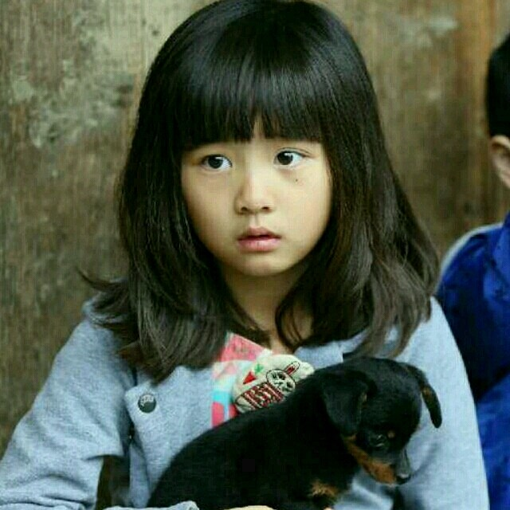
Let’s say .
clever

Slide 4
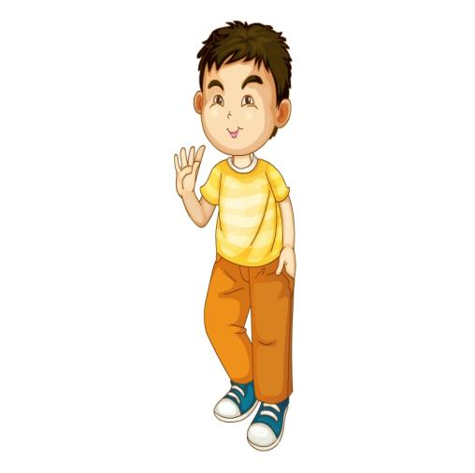
clever
Who's this boy?
He's ...

Slide 5
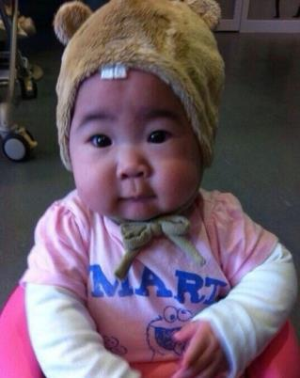
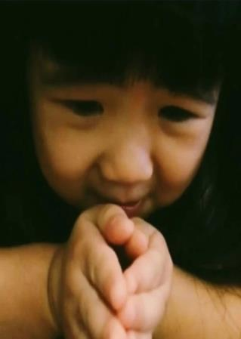
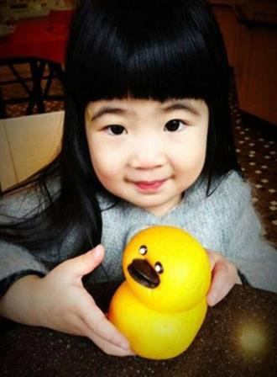
What's her name?
Her name is sister.
cute

Slide 6
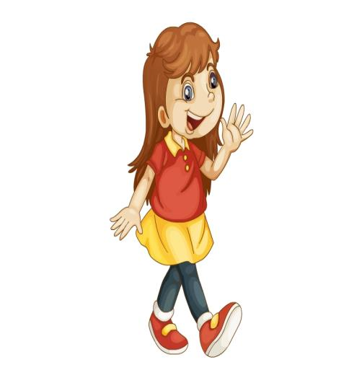
pretty
She has big eyes and long hair .
She’s pretty .

Slide 7
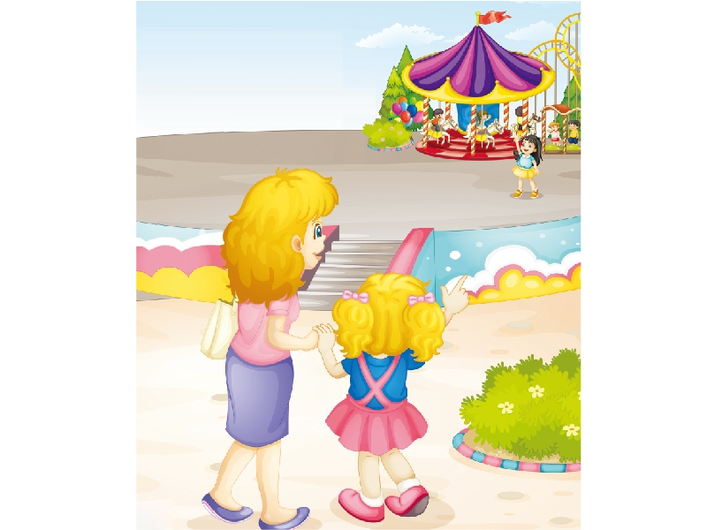
Let’s learn .

