Slide 1
I’m cleaning my room.
WWW.PPT818.COM

Slide 2
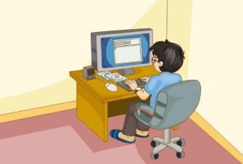
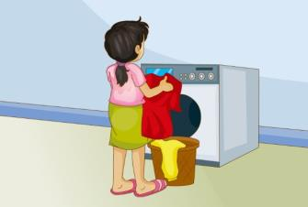
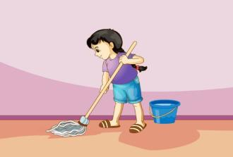
Let’s review
write an email
wash the clothes
clean the room

Slide 3
cleaning
I’m ________ the room.
writing
Dad is ________ an email.
washing
Mum is ________ the clothes.

Slide 4
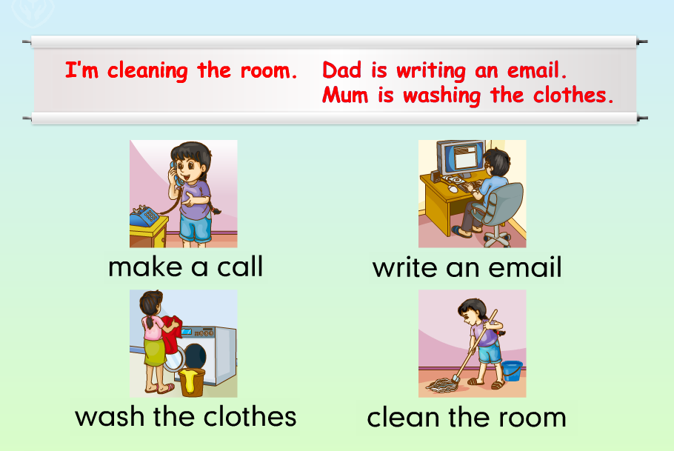
Just practise

Slide 5
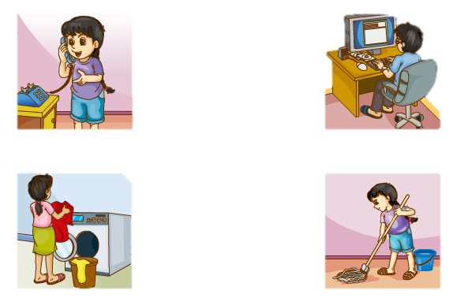
Just practise
make a call
write an email
wash the clothes
clean the room

Slide 6
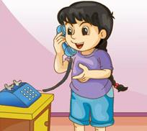
Just talk
Who’s she?
She’s Lily. She’s making a call.

Slide 7
Who’s she?
Who’s he?
Who’s she?
He’s Lily’s Dad.
He’s writing an email.
She’s Lily.
She’s cleaning the room.
She’s Lily’s mum.
She’s washing the clothes.

Slide 8
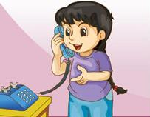
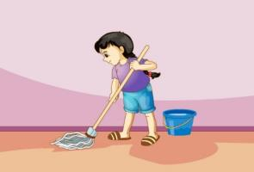
Just write
Can you write them?
make a call
wash the clothes
write an email
clean the room
I’m cleaning my the room.

Slide 9
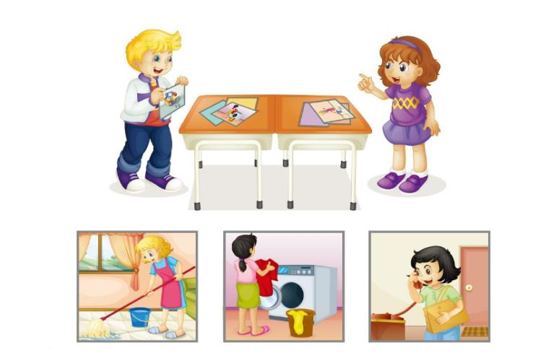
Let’s talk
He’s Tom.
He’s writing an email.
Who’s he?

Slide 10
Let’s chant
U
It is a nice afternoon in June.
The pupils are listening to the tune.
They say they like the nice tune.
They say they like the nice June.

Slide 11
四会词组：
make a call
write an email
wash the clothes
clean the room
如何询问对方是谁？
Who’s he/she?
如何表达他/她正在做某事？
He/She is v-ing.

