Slide 1
七年级上册
Unit 3 Is this your pencil?
Section A (第3课时)
WWW.PPT818.COM

Slide 2
学习目标
1.掌握本节课的单词和短语，能听懂有关谈论物主的对话并进行自由交际。
2.熟练运用识别物主的句型。 The blue pen is his.
These /Those are my...
--Excuse me, Is this/that your pencil?
-- Yes, thank you. / No , it isn't. It’s hers.
3.掌握交际用语：What about...？ Thank you for...。

Slide 3
知识回顾
Yes, it is.
It’s mine.
Is that your pen?
It’s my pen.
Is that your pencil box?
No, it isn’t.
It’s hers.
It’s her pencil box.

Slide 4
自主反馈
Grammar Focus
Questions | Answers
Is this your pencil? | Yes, it is. It’s mine. / No, it isn’t. It’s hers.
Is this his green pen? | Yes, it is. / No, it isn’t. The blue pen is his.
Is that your schoolbag? | Yes, it is. / No, it isn’t. It’s his.
Are these your books? | Yes, they are. / No, they aren’t. They’re hers.
Are those her keys? | Yes, they are. / No, they aren’t. They’re mine.

Slide 5
自主反馈
Attention!
it’s ＝ it is | isn’t＝ is not | aren’t＝ are not

Slide 6
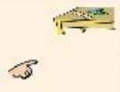
自主反馈
3a Complete the questions and answers about each picture.
 | Is your book? | Yes, it is. No, it .
 | Are my pencils? | Yes, are. No, they aren’t.
 | Is his ruler? | Yes, it . No, it isn’t.
 | Are her pens? | Yes, they are. No, they .
this
isn’t
they
these
is
that
those
aren’t

Slide 7
自主反馈
3b Read the questions and complete the answers.
Is this her ruler?
Is that Eric’s schoolbag?
Are these his pencils?
Are those Anna’s books?
Yes, . It’s .
No, . Sally’s.
Yes, . They’re .
No, .
Mine.
it is
hers
it isn’t
It is
they are
his
they aren’t
They’re

Slide 8
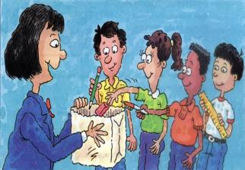
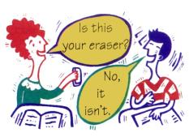
新课学习
3c Put some things into the teacher’s box.
Then take something out of the box and find
the owner. You only have two guesses!
Is this your eraser?
No, it isn’t.

Slide 9
新课学习
Conversation 1
A: Is this your book?
B: Yes, it is.

Slide 10
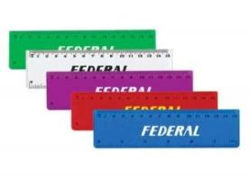
新课学习
Conversation 2
A: Are these your rulers?
B: No, they aren’t . They are hers.

Slide 11
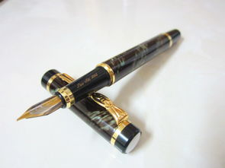
新课学习
Conversation 3
A: Is that your pen?
B: Yes, it is. It’s mine.

Slide 12
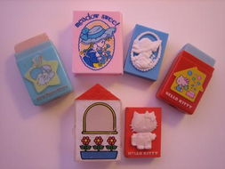
新课学习
Conversation 4
A: Are those your erasers?
B: Yes, they are. They’re mine.

Slide 13
新课学习
※ 1. 学习指示代词, 应注意以下几点:
① this与is, these与are没有缩写形式。
This is a Chinese car. 这是一辆国产轿车。
② 指示代词作主语指物并用于问句中时,
回答一般用:
it代替this和that; they代替these和those。
-- Is that a ruler？那是尺子吗？
-- No, it isn’t. It’s a pen. 不, 不是。是钢笔。
-- Are these your books? 这些是你的书吗?
-- Yes, they are. 是的。

Slide 14
新课学习
※ 2. no和not
二者都是“不”的意思, 用法不同。
no: 可单独使用，用于回答一般疑问句，
反义词为yes；
not: 不能单独使用，要和be动词、助动
词等一起构成否定句。
--- Is this your pencil? 这是你的铅笔吗?
--- No, it isn’t. 不, 不是。
It is not my book. 这不是我的书。

Slide 15
新课学习
※ 3. sorry adj. 抱歉的
sorry：是I’m sorry的省略形式, 用于冒犯、冲撞
了他人或伤害了对方等场合。
常用的回答：
Not at all. 没关系。
That’s all right. 没关系。
It doesn’t matter. 不要紧, 没关系。
Never mind. 别在意, 没关系。
sorry还可表示“遗憾的; 难过的”等。
I’m sorry to hear that. 听到那个消息我很遗憾。

Slide 16
新课学习
※ 4. Thanks for… 意为 “谢谢”, 因某事感谢某人。
后接名词/动名词。= thank sb.(某人) for sth.
Thanks for your help.
=Thank you for your help.
谢谢你对我的帮助。
Thanks for his beautiful card.
=Thank him for the beautiful card.
谢谢你给我这么漂亮的卡片。

Slide 17
新课学习
※ 5. in prep. 用……(方法、媒介、工具等)；
使用……(语言)。如：
John is drawing a car in pencil.
约翰正用铅笔画汽车。
We always speak in English.
我们总是用英语交谈。

Slide 18
新课学习
※ 6. What about …? ……怎么样？/好吗？
= How about…?
(询问消息或提出建议)
What about a drink?
=how about a drink? 喝杯酒怎么样？
--Where do we go? 我们去哪里呢？
--How about Hawaii?夏威夷怎么样？
=What about Hongkong?杭州好吗？

Slide 19
新课学习
Grammar focus
This is a pencil.
Is this a pencil?

Slide 20
新课学习
This is my pencil.
Is this your pencil?

Slide 21
新课学习
一般疑问句
一、含义
以动词be, 助动词、情态动词开头，
以yes或no作回答的问句叫做一般疑问句。
回答时大多数情况下只需作简略回答。

Slide 22
新课学习
二、构成及答语
句中有动词be (am, is, are)，将动词
提到主语前，并大写开头字母，句末用
问号，主语第一人称变第二人称，即变成了一般疑问句。
一般疑问句要用Yes或No来回答。
它的肯定答语是Yes, it is.
否定答语是No，it isn’t.
注意：答语用it代替this/that。

Slide 23
新课学习
含有be动词的陈述句变为一般疑问句的步骤
This
is
my
pencil.
Is
this
your
pencil?

Slide 24
知识运用
Complete these sentences with “am”, “is”, “are”.
1. ______ this his book?
Is
Yes, it ______.
is
is
2. What _____ that?
It _____ a book.
is
are
3. How ______ you?
I _____ fine, thank you
am

Slide 25
知识运用
句型转换
1. This is her eraser. (改为一般疑问句, 并作肯定回答)
2. That is his pencil sharpener. (改为一般疑问句, 并作否定回答)
Is this her eraser? Yes, it is.
Is that his pencil sharpener? No, it isn’t.

Slide 26
知识运用
3.The picture is on the wall. (一般疑问句)
4. Is that a soccer ball? (否定回答)
5. I’m Cindy. (同义句)
6. Is this your brother. (肯定回答)
Is the picture on the wall?
No, it isn’t.
My name’s Cindy.
Yes, it is.

Slide 27
分组活动
小组讨论
1 组
2 组
3 组
4 组
总结本课自己的收获，小组内交流。

