Slide 1
What Is Your Hobby?
WWW.PPT818.COM

Slide 2
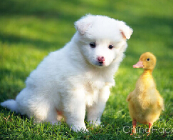
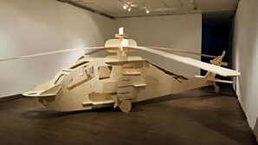
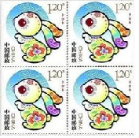
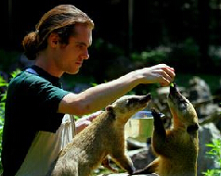
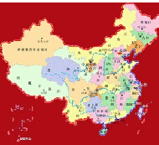
New words(新单词)
model
/ɔ/
stamp
/æ/
animal
/æ/
model plane
collect stamps
集邮
country
/ʌ/
keep animals
饲养动物
countries
（复数）

Slide 3
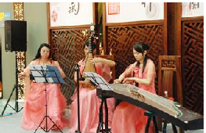
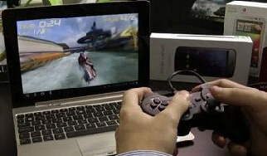
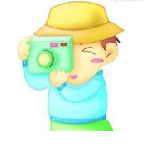
play music
表演音乐
play computer games
玩电脑游戏
hobby
take photos
拍照
read books
读书

Slide 4
Let’s talk
Janet: What are you doing, Jiamin?
Jiamin: I’m making models. It’s my hobby.
be + Ving 现在进行时 （你现在在做什么？）
make models 制作模型

Slide 5
Xiaoling: What’s your hobby, Janet?
Janet: I collect stamps. I have more than
500 stamps from 20 countries.
country
collect stamps 集邮 collect 收集
收集照片 ______ photos
collect
收集模型 ______ _______
collect models
more than 多于 ….
我们班有多于10个女生
There are ____ _____ 10 girls in our class
more than

Slide 6
Xiaoling: Wow! So many stamps!
Jiamin: What’s your hobby, Xiaoling?
Xiaoling: My hobby is keeping pets. I love animals, you know. I have two dogs, a cat and three birds.
so many 如此的多
keep pets 饲养宠物

Slide 7
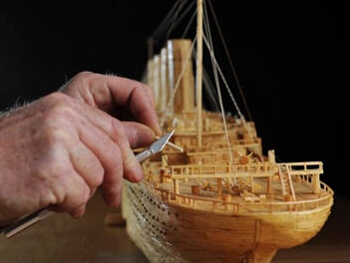
have a try
-- What’s your hobby?
-- My hobby is _________________.
I have __________________ .
making model ships
more than 20 ships
make model ships
more than 20 ships
多于，超过

Slide 8
have a try
-- What’s your hobby?
-- My hobby is _________________.
I have __________________ .
playing computer games
about 50 games
play computer games
about 50 games
大约

Slide 9
have a try
-- What’s your hobby?
-- My hobby is _________________.
I __________________ .
时间放在句子后面
reading books
read books every night
read books
every night
every + 时间
每

Slide 10
have a try
-- What’s your hobby?
-- My hobby is _________________.
I __________________ .
playing music
play music every day
play music
every day

Slide 11
have a try
-- What’s your hobby?
-- My hobby is _________________.
I __________________ .
taking photos
during my holiday
take photos
during my holiday
在…期间

Slide 12
homework
1.抄写unit1 单词
2.抄写unit1课文并翻译一次
3.读unit1 课文3次，并背诵（家长签名，周2检查）

