Slide 1
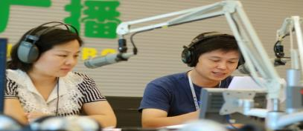
Module 10 On the radio
Unit 1 I hope that you can join us one day.
WWW.PPT818.COM

Slide 2
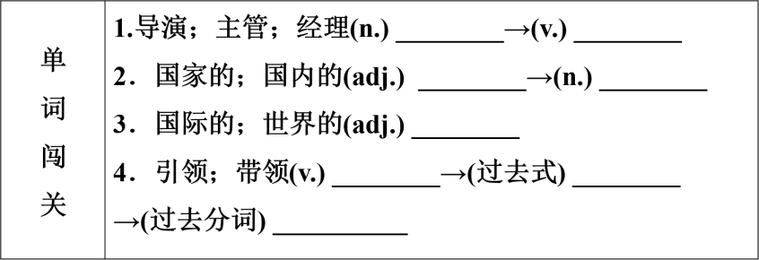
Words and expressions
director direct
national nation
international
show showed
showed/shown

Slide 3
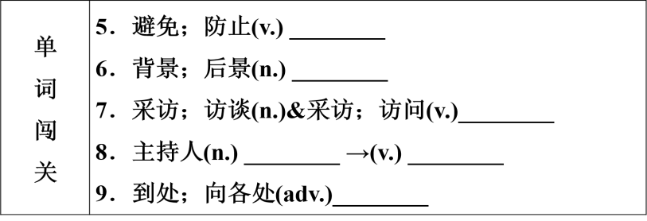
Words and expressions
avoid
background
interview
presenter present
around

Slide 4
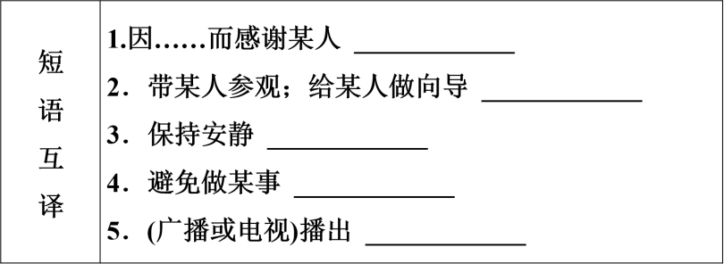
Words and expressions
thank sb. for…
show sb. around
keep quiet
avoid doing sth.
on air

Slide 5
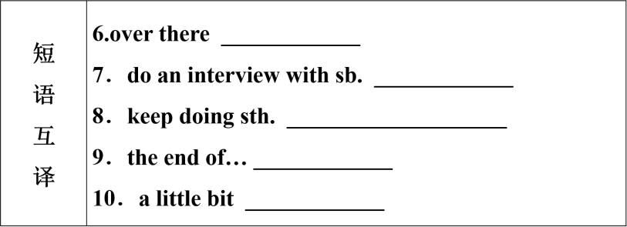
Words and expressions
在那边
采访某人
继续做某事；坚持做某事
……的结尾
有点儿；稍微

Slide 6
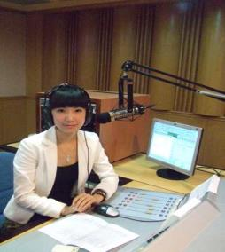
Do you listen to the radio?

Slide 7
Do you like listening to the sports news programme?

Slide 8
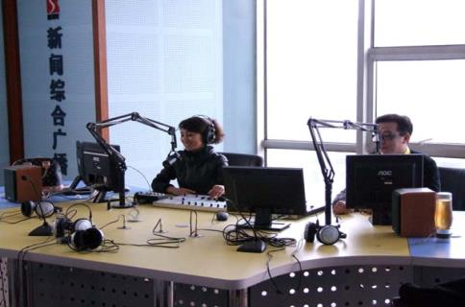
Do you like listening to the news programme?

Slide 9
Do you like listening to music?

Slide 10
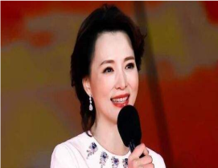
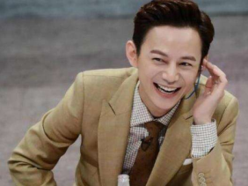
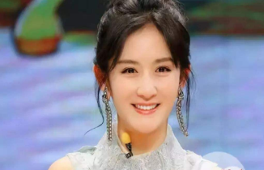
Which presenter do you like best?

Slide 11
Listen and check (√) the types of news you hear.
culture government sports weather
√
√

Slide 12
Listen again and complete the sentences.
1. Zhang Li reads ________________
______________________ on radio Beijing.
2. The president of Russian will stay in
China for ________.
3. The match is between ______ and
________.
the latest news from China and around the world
3 days
China
England

Slide 13
Listen to Part 3 and answer the following questions.
1. What should we avoid doing in the
background?
We should avoid making any noise.
2. Do they collect the latest national and
international news in the newsroom?
Yes, they do.

Slide 14
Read the dialogue and complete the notes.
When the red light is on, it means ________
____________.
We collect ______________________
________________ and write reports in the newsroom.
You should ______________________ if you want to be a presenter.
This is also where we _____________ with the big sports stars.
we’re
on air
the latest national and international news
speak English really well
do interviews

Slide 15
Read the dialogue again and find out the object clauses in the dialogue.
1. I think you need to speak English really well.
2. So keep studying, and I hope that you can join us one day.
3. Remember what I said: we need to keep quiet if the red light is on.
4. Finally, we’ve just heard that Germany has won the football match, 2-1 against England.

Slide 16
Language points
1. I’m the news director at Radio Beijing.我是北京新闻电视台的主任
director ：名词，异味“导演，主管，经理”，其动词为direct。
This film is directed by Zhang Yimou.
2. When it’s on, it means we’re on air.当它亮时，就意味着我们正在广播
on air, “（广播或电视）播出，正在广播”。
e.g. We will be on air in about five minutes.我们将在大约五分钟后开始广播。
3. We collect the lasted national and international news and write reports here.
我们收集最新国内外的新闻，并在这里写报道。
national：adj. 国家的；国内的→名词,nation
nation | 意为“国家”，强调“国民”或政治意义上的“国家”。
country | 意为“国家”，侧重指“疆土，国土”这种地理概念。

Slide 17
Language points
4. Thank you for showing us around.
thank you for doing sth. = thanks for doing sth.感谢某人做某事
show “引领，带领”show sb. around, “带某人参观，给某人做向导”。
e.g. Shall I show you around the factory? 我带你去参观工厂, 好吗?
5. And we should avoid making any noise in the background!要避免背景中的任何杂音
avoid “避免，防止”；avoid + doing sth, “避免做某事”
e.g. Please try to avoid making the same
mistake next time.
下次请尽量避免犯同样的错误。

Slide 18
Language points
6. So keep studying, and I hope that you can join us one day.
keep (on) doing sth.表示“坚持做某事”，keep后不能接短暂性动词，必须接延续性动词。
They still kept working although it was dark. 尽管天黑了，但他们仍然在继续工作。
keep sb. from doing sth.“阻止某人做某事”与“stop/prevent sb. (from) doing sth.”同义。
“keep＋adj.”意为“保持某种状态”，此时，keep是系动词。
e.g. It's a good way to keep healthy. 这是一个保持健康的好方法。
7. And it is where we do interviews with the big sports stars.
interview 采访，访谈”。是可数名词。
do an interview with sb. “采访某人”
give an interview to… “接受……采访”
e.g. I want to do interviews with the headmaster at school next month.我想下个月采访校长

Slide 19
Complete the sentences with the words in the box。
avoid, background, international interviews, national
interviews
Newspapers and television programmes often have __________ with famous people.
More and more ___________ students are coming to China to learn Chinese.
Every country has its own ________ hero-a person who did something very important for the country and its people.
Try to ______ drinking too much tea or coffee, or you will not be able to sleep well.
Could you speak a little bit louder, please? It is very noisy in the ___________.
international
national
avoid
background

Slide 20
Thank you for listening

