Slide 1
Unit 2 Travelling Study skills & Task
WWW.PPT818.COM

Slide 2
Study skills
Main points and details

Slide 3
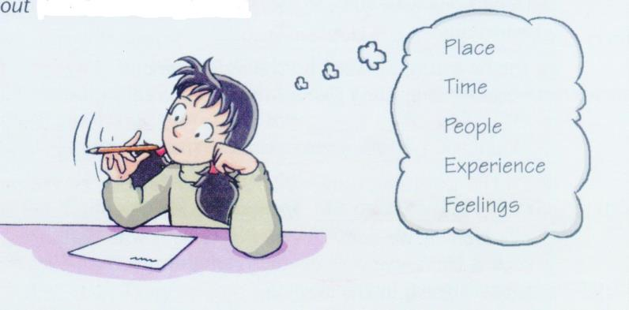

Slide 4
Main points and details
Main
points
When:
Where:
Who:
What: Visited Hong kong Disneyland
How (Feelings):had a fantastic time
Enjoyed the Space Mountain
Watched a parade
Saw a 4-D film
Did some shopping
Watched the fireworks
Details

Slide 5
Finish the exercise on page 31

Slide 6
Task

Slide 7
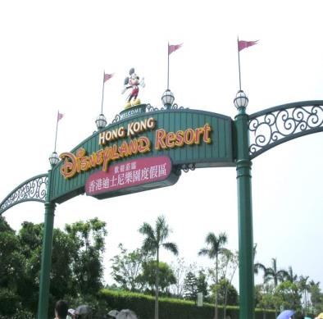
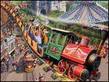
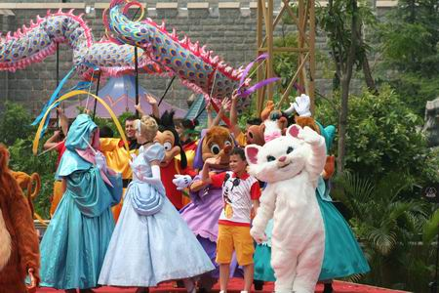
the Space Mountain ride
Parade of Disney characters

Slide 8
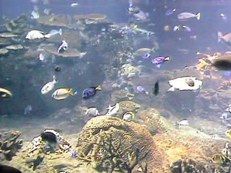
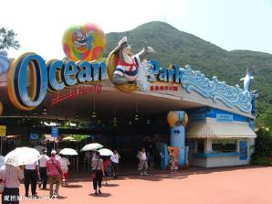
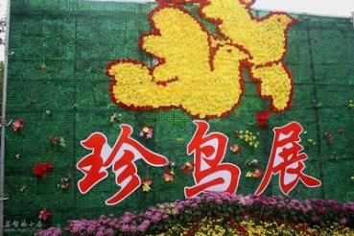
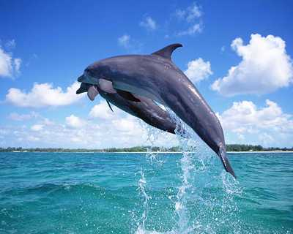
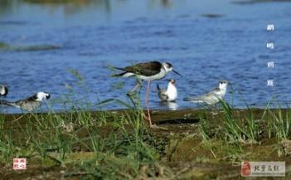
Ocean Park
dolphin show
bird show

Slide 9
Kitty’s best holiday
Go through Part A, then ask and answer about her fact file.

Slide 10
1.Read Part B and help Kitty complete her article With the help of Part A.
2.Check the answers.

Slide 11
Read the article and answer the questions.
Who went to HongKong?
2. How did they go?
3. How long did it take them to go there?
4. What places of interest do they visit?
5. What other activities did they do?
6. How did Kitty feel about the trip?
Kitty and her parents.
By plane/air.
It took them three and a half hours.
Disneyland and Ocean Park.
They visited some museums, did some shopping and eat some seafood
She enjoyed the trip very much.

Slide 12
A.Write a plan for your holiday.
Main points
When：
Where：
Who：
What/details
How(Feelings):
Visiting
Activities
Eating or living:
B.Write down the article.

Slide 13
Homework
Write an article about your trip in Suzhou.
Do some more exercises after class.

