Slide 1
Unit 6
I’m going to study computer science
WWW.PPT818.COM

Slide 2
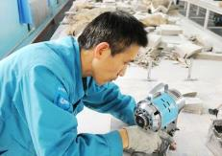
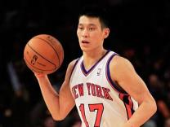
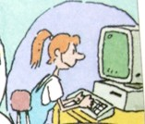
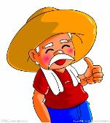

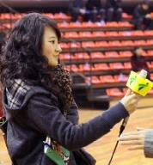
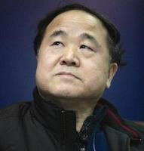
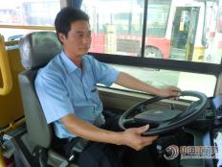
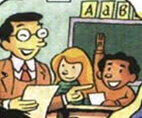
basketball player
worker
computer programmer
farmer
jobs 1
engineer
reporter
writer
bus driver
teacher

Slide 3
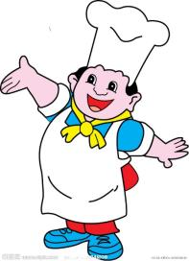
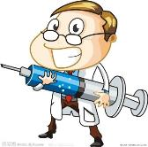
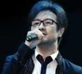
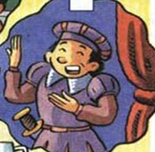

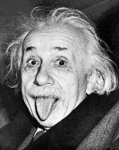
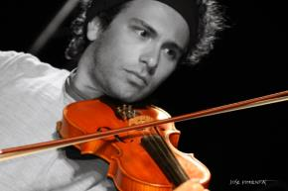
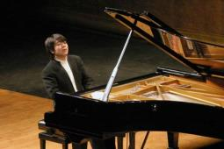
doctor
cook
singer
jobs 2
actor
pilot
scientist
violinist
pianist

Slide 4



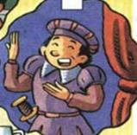



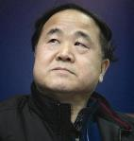
You have a good memory!

Slide 5

What do you want to be when you grow up?
I want to be
a cook.

Slide 6
What does your brother want to be when he grows up?
He wants to be
a teacher.

Slide 7

What does your cousin want to be when she grows up?
She wants to be
a scientist.

Slide 8
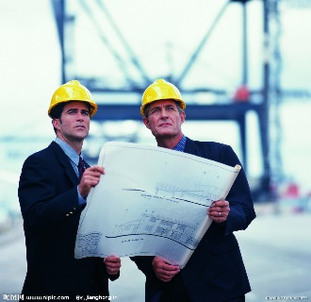
What do your friend and you want to be when you grow up?
We want to be
engineers.

Slide 9
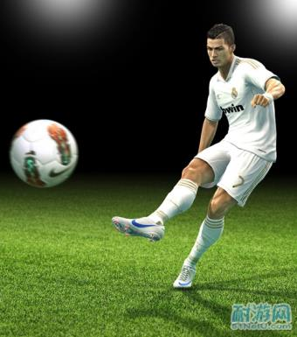
What do those boys want to be when they grow up?
They want to be
soccer players.

Slide 10
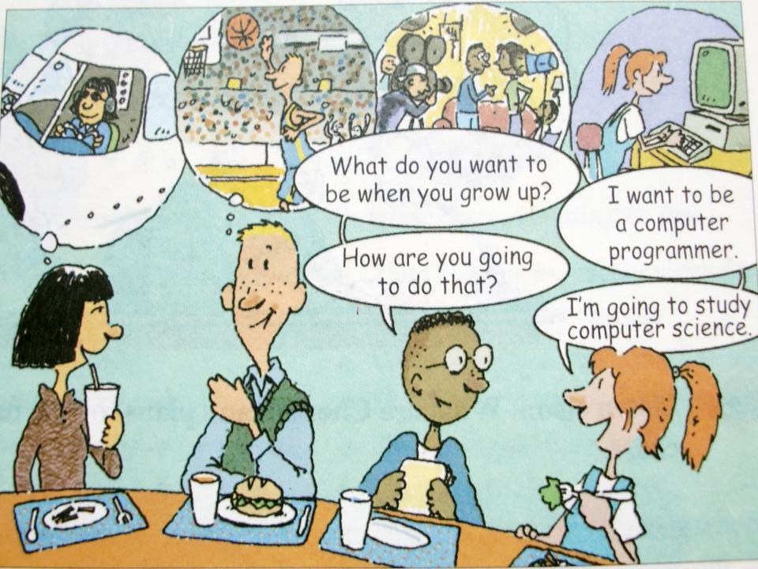

Slide 11
1b
Listen and fill in the blanks. Then
match the items.
acting
a. take _______ lessons
b. study _______
science
c. practice _________every day
d. study ________ really hard
1. computer
programmer
2. basketball player
3. engineer
4. actor
computer
basketball
math

Slide 12
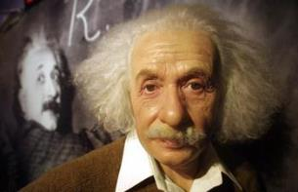
说理想，谈打算。
--What do you want to be when you grow up?
--I want to be …
--How are you going to do that?
--I’m going to …..
a scientist
study science

Slide 13
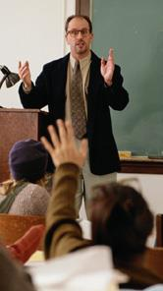
说理想，谈打算。
--What do you want to be when you ….?
--I want to be …
--How are you going to do that?
--I’m going to …..
a school teacher
learn how to teach children

Slide 14

What do you want to be when you grow up?
I want to be an engineer.

Slide 15
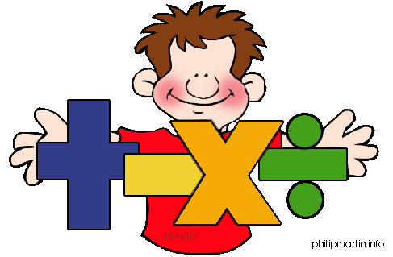
How are you going to do that?
I’m going to study math.

Slide 16
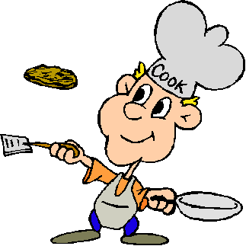
What do you want to be when you grow up?
I want to be a cook.

Slide 17
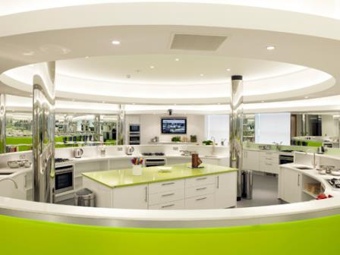
How are you going to do that?
I’m going to take cooking lesson.

Slide 18
Key points
1. grow作不及物动词, 意为“成长, 长大” Vegetables here grow well because of
enough rain.
由于雨水充足, 这儿的蔬菜长势很好。
2. grow作及物动词，意为“种植”
They grew many trees on both sides of
the road.
他们在路的两边种了很多树。

Slide 19
3. grow up 长大；成长
He grew up in the countryside.
他在农村长大。
A warm friendship grew up between the two men.
两人之间逐渐产生了友情。

Slide 20
用所给词语的正确形式填空。
1). He _______(种植) many vegetables in his garden last year.
2). Mary wants to be a teacher when she __________(长大).
grow up, grow
grew
grows up

Slide 21
(2013广州中考) Although you may meet some difficulties, you should never ______．
A. turn up B. get up
C. give up D. grow up
(2012河源中考) ______, Tom! It’s time to get up and go to school.
A. Wake up B. Make up
C. Grow up D. look up
C
A

Slide 22
2a
Listen. What is Cheng Han going to
do? Check （√） the correct boxes
in the picture.
√
√

Slide 23
Listen again. What are Cheng Han’s plans for the future? Complete the chart.
2b
What
Where
How
When
a teacher
Cheng Han wants to be___________.
Shanghai
He is going to move to__________.
He is going to learn how to ________ ___________.
teach children
high school
He is going to finish ______ ______ and college first.

Slide 24
Life will be more enjoyable in the future!
Thanks for listening !

