Slide 1

Unit 8 I like English best.
WWW.PPT818.COM

Slide 2


Let’s chant.
Music,music,I like music.
Art,art,I like art.
PE,PE,I like PE best.

Slide 3
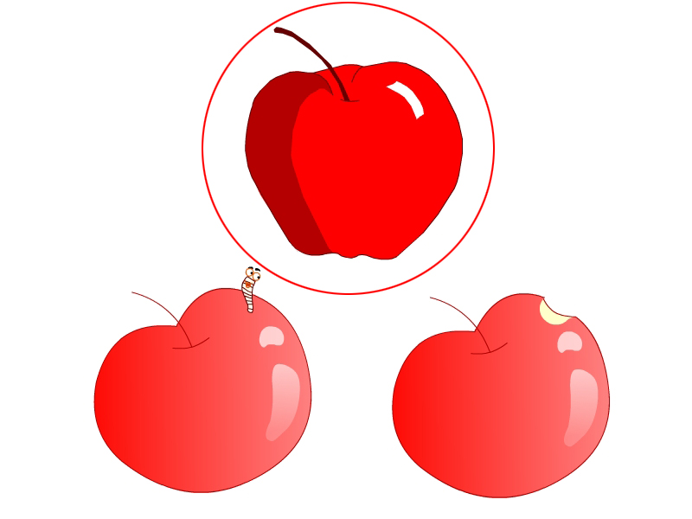
best
最好
best

Slide 4
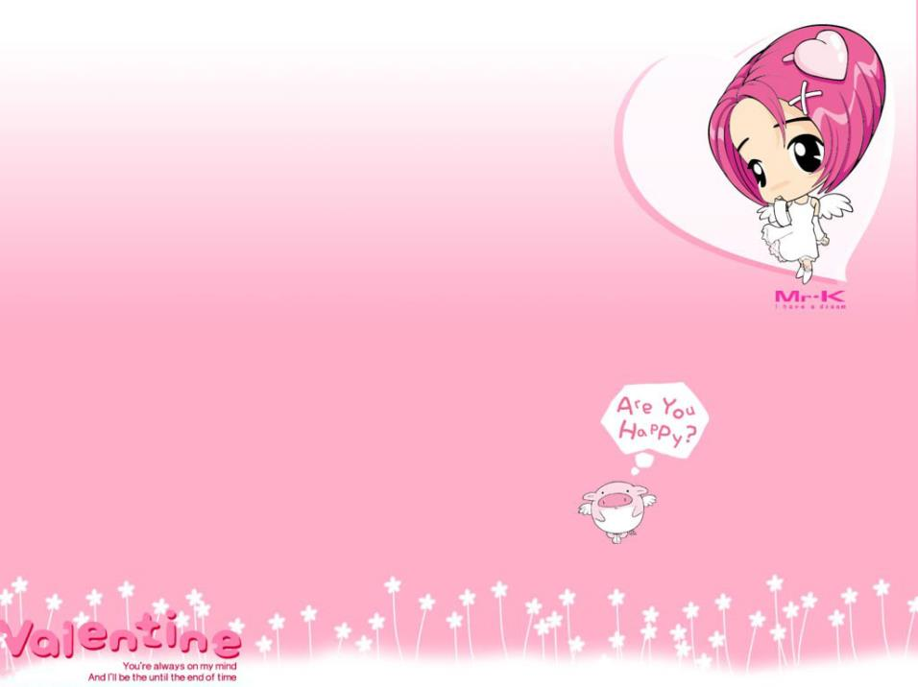

How many subjects do you have?

Slide 5
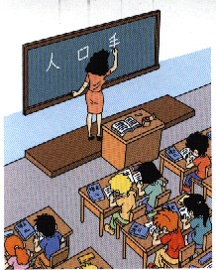
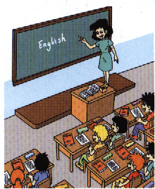
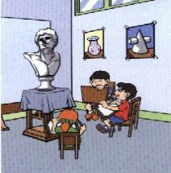

Try to guess what subject it is!
Chinese
English
maths
music
computer
art

Slide 6

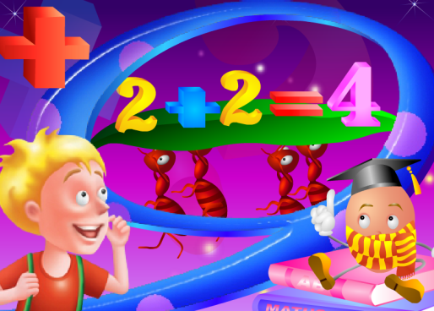
Let’s talk.
My favourite subject is maths.
I like to use numbers.
What about you?
在复习上一节句型的同时，学习What about you?/And you? 的用法。

Slide 7
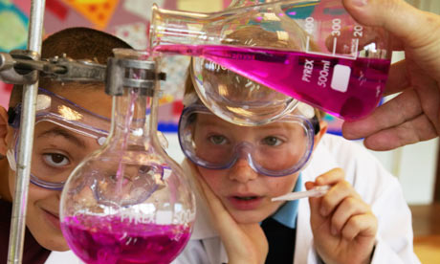
What’s your favourite subject?
My favourite subject is ______.
/ I like _______ best.
science
science

Slide 8

Thinking
What is your favourite subject ?
最喜欢的

Slide 9
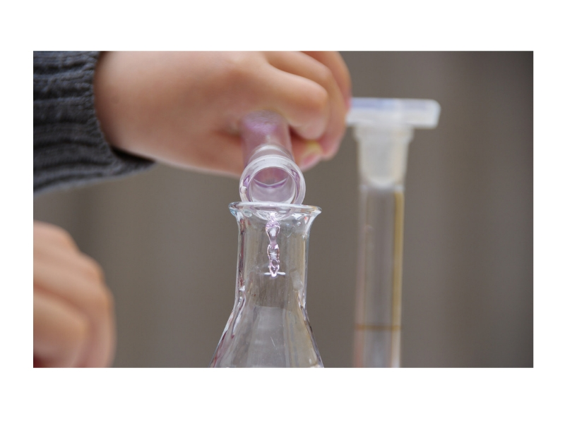
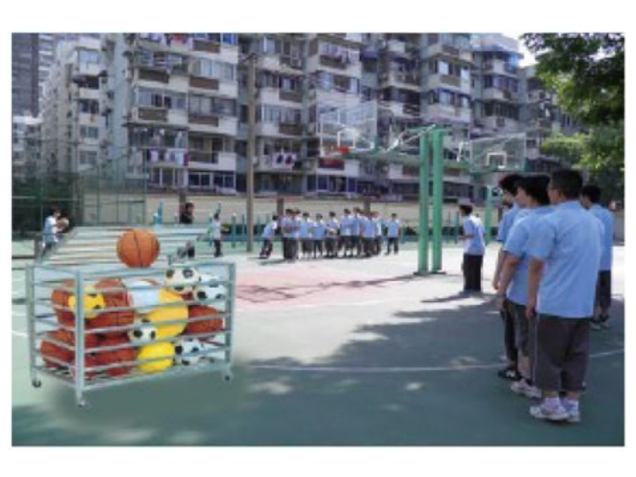
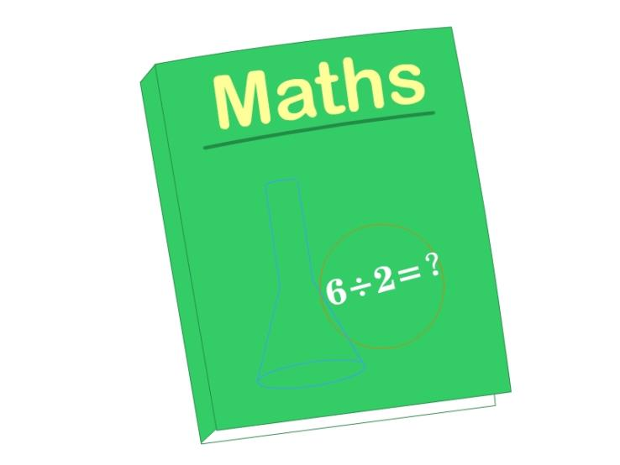
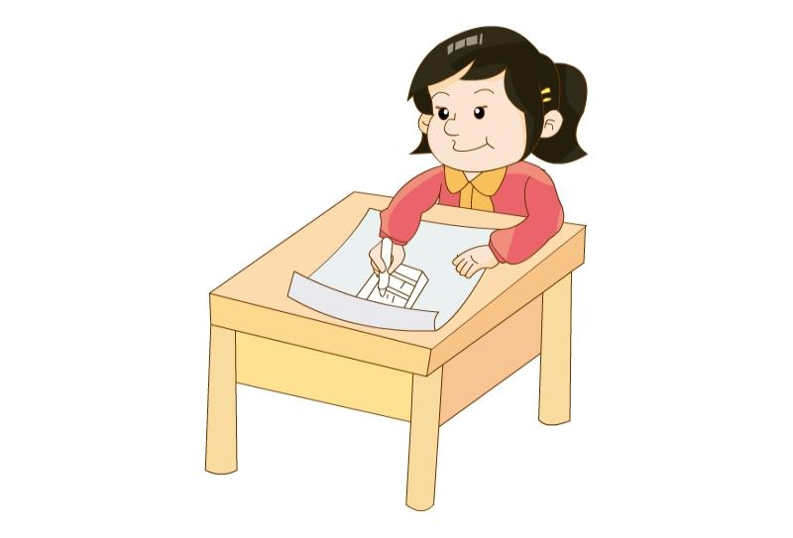
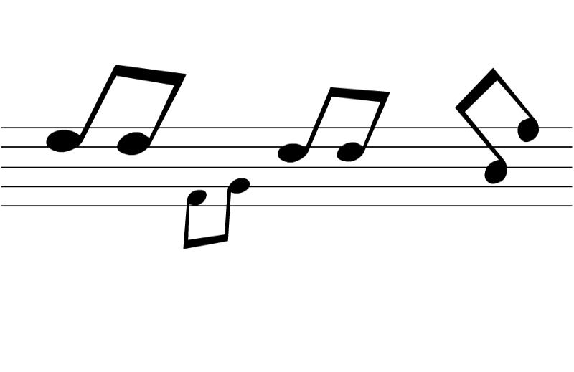
What is your favourite subject?
My favourite subject is…
I like… best.

Slide 10
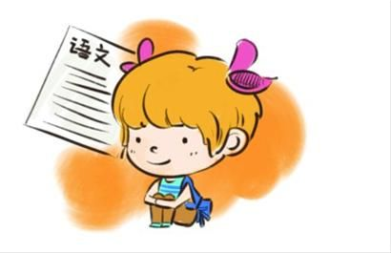
Guess and say.
复习巩固跟科目有关的动词短语。
What’s your favourite subject?
Chinese
My favourite subject is _______.
/ I like _______ best.
Chinese

Slide 11
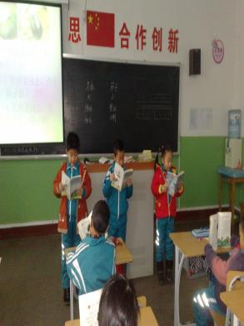
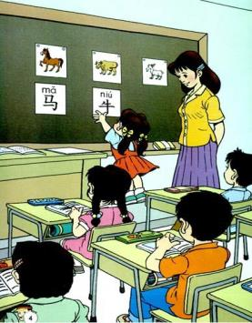
I like to__________________ in Chinese lessons.
引导学生运用所学的短语说句子，也可进行拓展。
write stories
read books
listen to stories
play games
…

Slide 12

maths—to use numbers
My favourite subject is maths,
I like to use numbers.

Slide 13
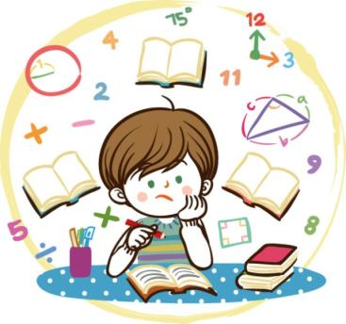
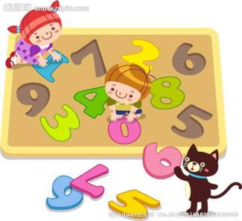
I like to ____________________ in maths lessons.
use numbers
read books
play games
…

Slide 14
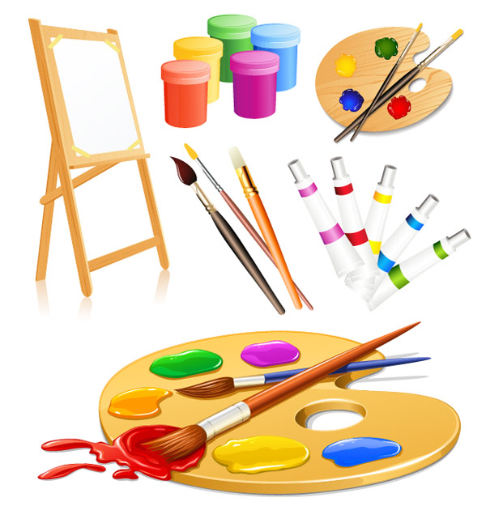
art— to draw pictures
My favourite subject is art,
I like to draw pictures.

Slide 15
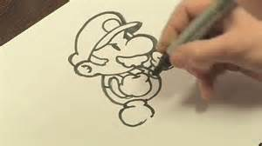
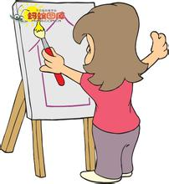

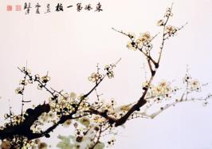
I like to ____________________ in art lessons.
draw pictures
colour the pictures
enjoy beautiful pictures
…

Slide 16
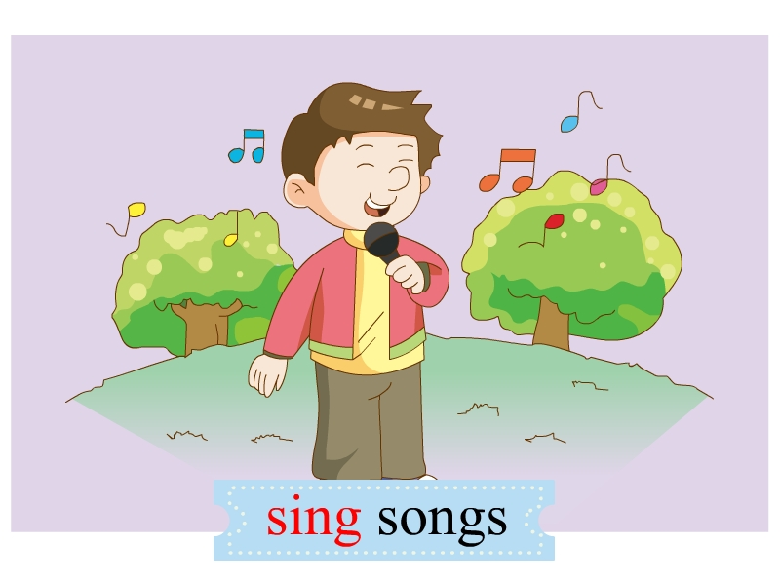
music — to
My favourite subject is music,
I like to sing songs.

Slide 17
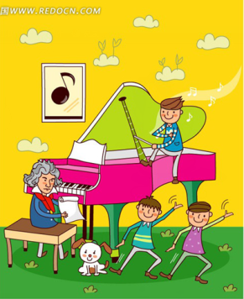
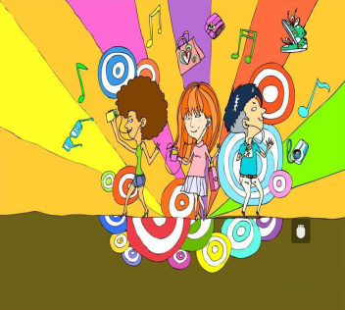
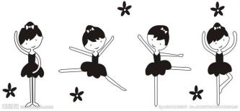
I like to ____________________ in music lessons.
dance
sing songs
play music
have a party
…

Slide 18
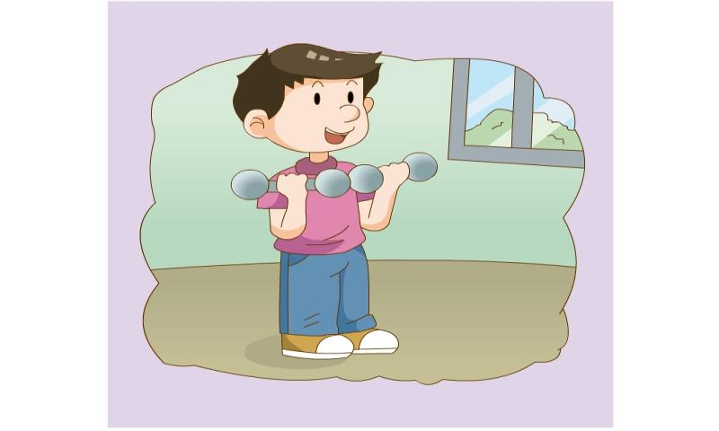
PE— to play sports
My favourite subject is PE,
I like to play sports.

Slide 19
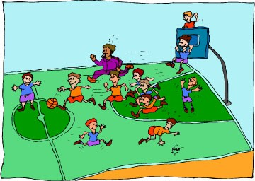
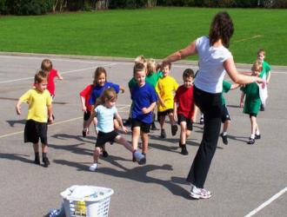
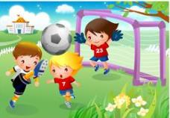
I like to _______________ in PE lessons.
play sports
play games
run
jump
play basketball
play football
…

Slide 20
science—to understand the world
My favourite subject is science,
I like to understand the world.

Slide 21
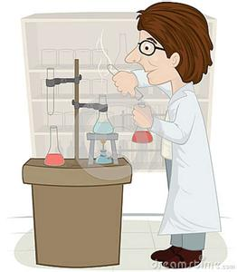
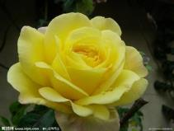
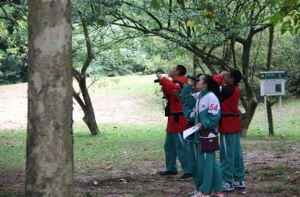
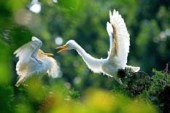
I like to _______________ in science lessons.
understand the world
learn about animals
learn about flowers
watch birds
…

Slide 22


We love to
everything!!

Slide 23
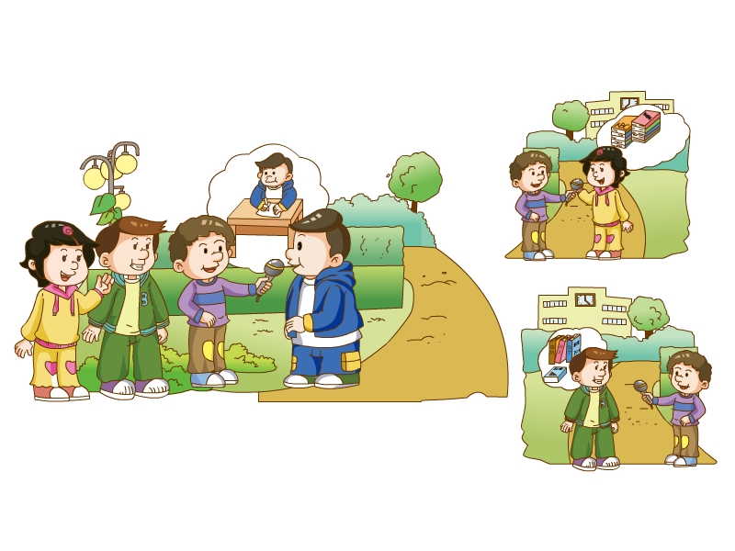

Slide 24
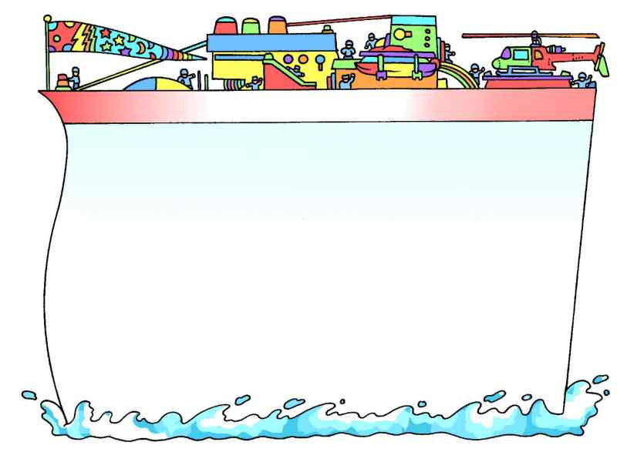

1.How many subjects do they have?
They have seven subjects.
2.What is Jiamin’s favourite subject?
Jiamin’s favourite subject is Chinese.
3. What is Xiaoling’s favourite subject?
Xiaoling’s favourite subject is English.

Slide 25


Subject
Description
art
science
music
PE
maths
to use numbers
to play sports
to draw pictures
to sing songs
to understand the world.

Slide 26
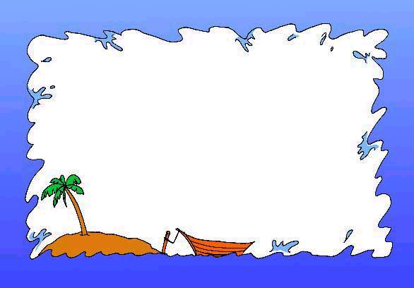
Homework
以My favorite subject is……为题准备2分钟讲演内容，下节课作演讲。

