Slide 1
Unit4 At the Sports Meeting
陕旅版六年级下册
第四课时
WWW.PPT818.COM

Slide 2
>>Review
Play a game
high
jump
have a
sports
meeting
throwing
running race
What’s missing?
100-meter
race
long jump

Slide 3
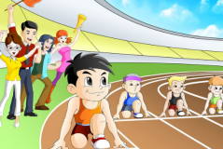
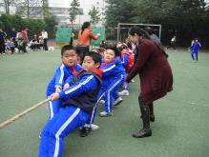
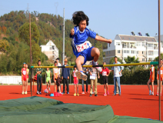
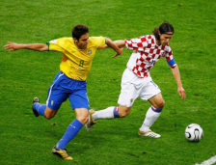
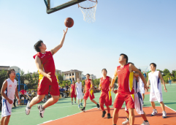
>>Lead-in
>>Lead-in
Free talk
What sport did you watch?
What kind of sports do the pupils take part in?
Look at the other pupils. How are they feeling?

Slide 4
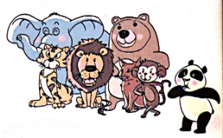
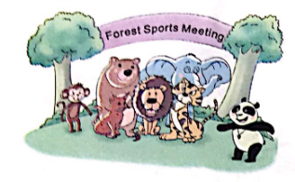
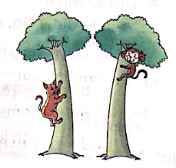
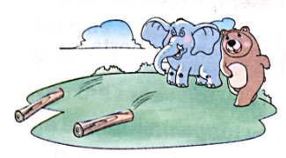
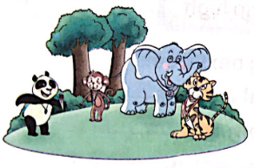
>>Presentation
Look and imagine

Slide 5
>>Presentation
Read, then ask and answer
Who had a sports meeting last week?
The animals.
Who won the 1000-meter race?
The tiger.
Did the bear won the throwing match?
No, it isn’t. The elephant won.
Who won the tree climbing?
The monkey won the tree climbing.

Slide 6
>>Presentation
Read a story
The animals had a sports meeting last week. Many animals took part in it.

Slide 7
>>Presentation
Read a story
The first game was the 1000-meter race.
“Ready? Go!”
All the animals started to run.
Finally, the tiger won the race.

Slide 8
>>Presentation
Read a story
The second match was throwing.
The bear did well at first,
but the elephant won.

Slide 9
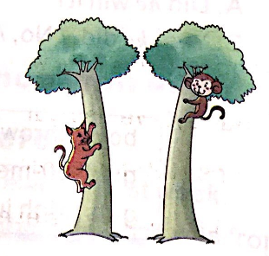
>>Presentation
Read a story
The third sport was tree climbing.
Who won the game?
Of course the monkey did.
He climbed very high.

Slide 10
>>Presentation
Read a story
The panda said, “We’d better play sports every day.
Let’s be faster, higher and stronger!”

Slide 11
>>Practice
Read a story
两人一组，先朗读再表演这个有趣的故事吧。
1
2
3
Read together.
(齐读)
Act in roles.
(分角色演）
Read in roles.
（分角色读）

Slide 12
>>Practice
Look at the pictures and order the story
1
4
2
3
5

Slide 13
>>Practice
Order and act
2
( )We have a sports meeting once a year.
( ) When do you usually have it?
( ) What sport do you usually take part in?
( ) How often do you have a sports meeting?
( ) We usually have it in May.
( ) I usually take part in the 100-meter race.
3
5
1
4
6

Slide 14
>>Practice
Read and choose
win when well boys’
take jump first about
when
A: Li Fan, ______ did you have the sports meeting?
B: We had it last week.
A: What sport did you _____ part in?
B: I took part in the high _____ and the ______ 100-meter race.
A: Did you ____ the high jump?
take
jump
boys’
win

Slide 15
>>Practice
Read and choose
win when well boys’
take jump first about
B: Yes, I did.
A: How ______ the 100-metre race?
B: I was the ______, too.
A: You did really _____.
B: Thank you.
about
first
well

Slide 16
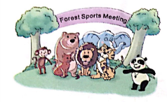
>>Summary
能够根据图片简要复述课文故事：
1
2
3
4
5

Slide 17
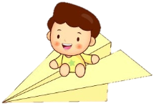
>>Homework
1.听课文录音并跟读，按照正确的语音、语调朗读并表演课文对话。 2.复述课文Read a story，并向自己的家人复述。
3.预习 Unit5 A Let’s learn。
close

