Slide 1
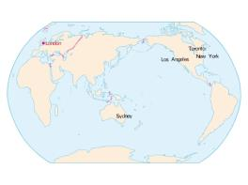
人教精通版六年级下册
Unit 3 We are going to travel.
WWW.PPT818.COM

Slide 2
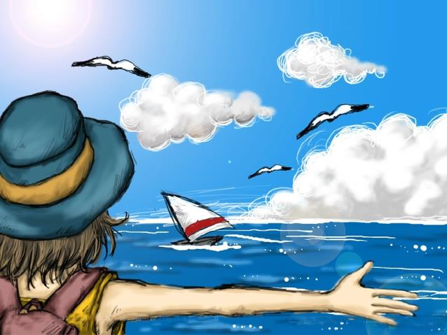
>>Warm-up
歌曲欣赏

Slide 3
>>Lead-in
Free Talk
What’s your travel plan for summer vacation?

Slide 4
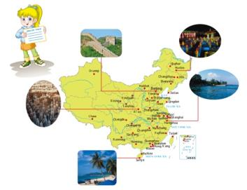
>>Presentation
Just read and talk
1. Where is Lily from?
She is from America.
2. Where is she going to visit?
She is going to visit Beijing, Harbin, Xi’an,
Shanghai, Hangzhou and Sanya.

Slide 5
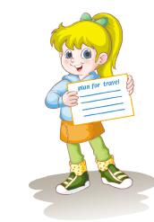
>>Presentation
Just read and talk
Hello, I’m Lily.
I’m from America.
This is my family’s travel plan.
We are going to travel around China during the summer holidays.
We’re going to stay in China for two weeks.
In the first week, we are going to visit Beijing, Harbin and Xi’an.

Slide 6
>>Presentation
Just read and talk
I know the Great Wall is in Beijing.
It is the longest wall in the world.
The second week, we are going to visit Shanghai, Hangzhou and Sanya.
I know the West Lake is in Hangzhou.
I hear it is a very beautiful lake.
Can you tell me something more about Harbin, Xi’an, Sanya and other places?

Slide 7
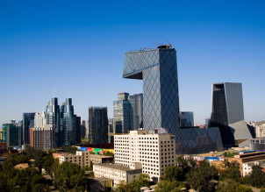
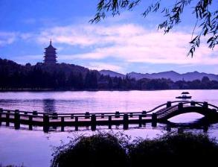
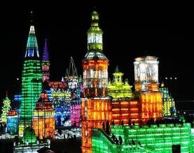
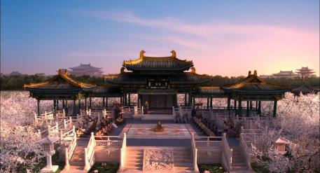
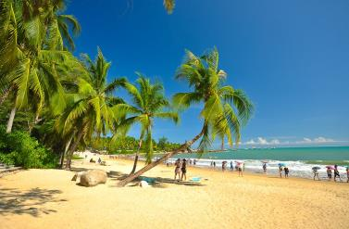
>>Presentation
Beijing
Hangzhou
Harbin
Xi’an
Sanya

Slide 8
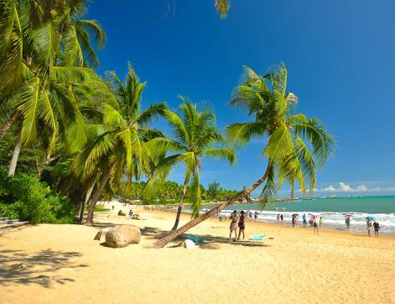
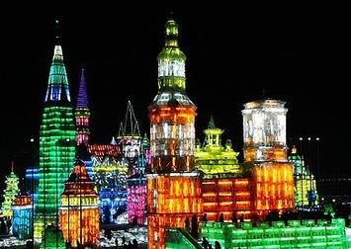
>>Practice
Beijing
Harbin
Sanya
We’re going to visit ___________.

Slide 9
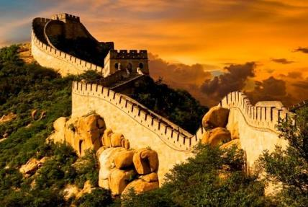
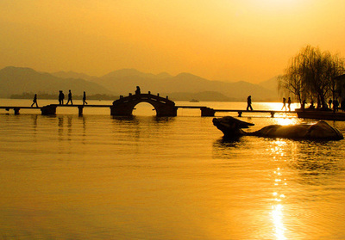
>>Presentation
the Great Wall
the West Lake
We’re going to visit the Great Wall/ West Lake.

Slide 10
>>Presentation
Beijing is the capital of China.
There are many interesting places to visit.

Slide 11
>>Presentation
Harbin is in the north of China.
It is in Heilongjiang Province.

Slide 12
>>Presentation
Xi’an is in Shaanxi Province.
It is famous for the terracotta army.

Slide 13
>>Presentation
Hangzhou is in Zhejiang Province in the east of China.
The most famous place there is the West Lake.

Slide 14
>>Presentation
Sanya is in the south of China.
It is in Hainan Province.

Slide 15
>>Practice
I’m going to…

Slide 16
>>Summary
重要城市和景点：
Beijing
Harbin
Hangzhou
Xi’an
Sanya
the Great Wall
the West Lake
如何表达“我们打算在中国旅游”？
We’re going to travel around China.

Slide 17
>>Homework
1. 观看课文动画，按照正确的语音、语调朗读课文。
2 . 找出一张自己旅游的照片，并做口头介绍。
3 . 预习Lesson14。
close

