Slide 1
Unit 4 Topic 1
What can I do for you?
Section D
WWW.PPT818.COM

Slide 2
怎么记住1—999的基数词呢？
看看下面的口诀吧~
巧记 100 以内的基数词 基数词，不难记，十二以内词各异；
13数到19去，后加 -teen，莫忘记；
20、30至90，整十之后有 -ty / ti /；
要说基数“几十几”，连字符号“-”别丢弃；
a hundred 是“一百”，请你记住别大意。

Slide 3
Exercise
21
22
23
24
25
26
27
28
29
twenty-one
——————
twenty-three
twenty-four
——————
twenty-six
——————
twenty-eight
——————
30
40
50
60
70
80
90
thirty
——-
——-
sixty
seventy
——-
——-
one hundred/a hundred
————————————
————————————
————————————
nine hundred (and) ninety-nine
100
101
185
315
999

Slide 4
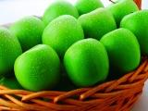
Countable noun vs. Uncountable noun
an apple
milk
three apples
×
×
√
×
three milk
5 kilo
5 kilos
1 kilos
√
three bottles of milk
five kilos of apples

Slide 5
让我们来总结可数名词与不可数名词吧！

Slide 6
可数名词
Sum Up
名词
不可数名词
可数名词： cake egg apple banana
vegetable noodle pencil car
(some+可数名词) some cakes
eggs
vegetables
不可数名词：fish meat rice chicken milk
water tea
(some+不可数名词) some fish
meat
milk

Slide 7
食 物 面 包 大 米 饭，
(food, bread, rice)
牛 奶 茶 水 橘 汁 甜，
(milk, tea, orange juice)
家 务 工 作 作 业 多，
(housework, work, homework)
幸 福 生 活 鱼 肉 鲜。
(happiness, life, fish, meat)
巧记不可数名词

Slide 8
some 与 any 的用法
I want to buy some clothes for my daughter. How about some bread? Oh, we don’t have any milk. Do you have any vegetables?

Slide 9
Complete the conversation with some or any.
Then practice the conversation with your partner.
2
some
Mother: Would you like to buy _________ food for us?
Helen: Sure. What do we need?
Mother: Mm, _______ apples, ________ chicken and ________
bread. Oh, we don’t have _________ milk.
Helen: OK. I’ll buy ________. Do we need ______ juice?
Mother: Er, how about __________ juice?
Helen: Yes. Good idea!
some
some
some
any
some
any
some

Slide 10
how many + 可数名词(复数)
表示数量：
how much + 不可数名词
How many bottles of milk do you need?
How much rice do you need?

Slide 11
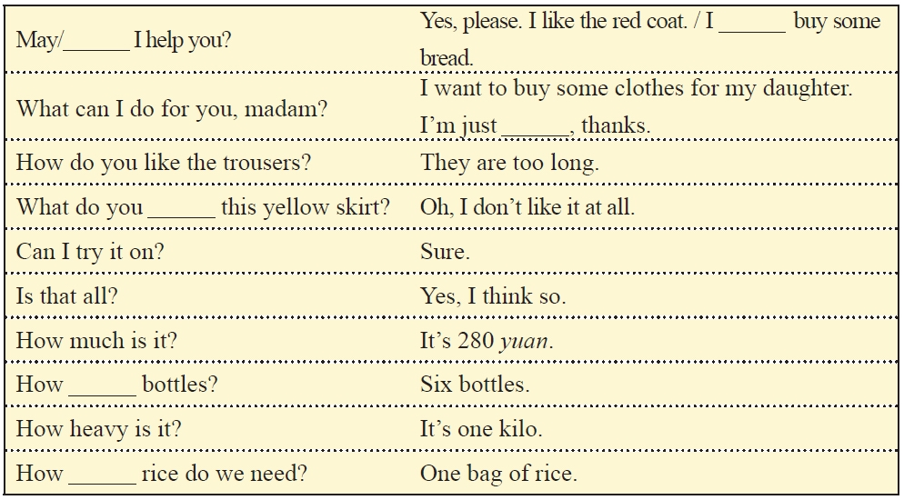
Functions
want to
Can
looking
think of
many
much

Slide 12
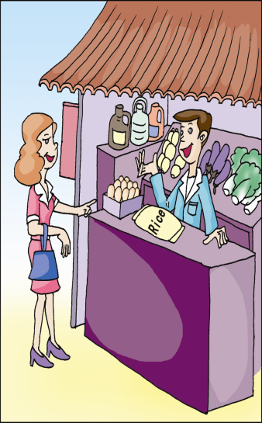
Listen and complete the table.
Item | Price | Quantity
apples | ￥___ a kilo | ____ kilos
______ | ￥___ a kilo | ____ kilos
Total:￥_____
6
2
rice
3
4
24.00

Slide 13
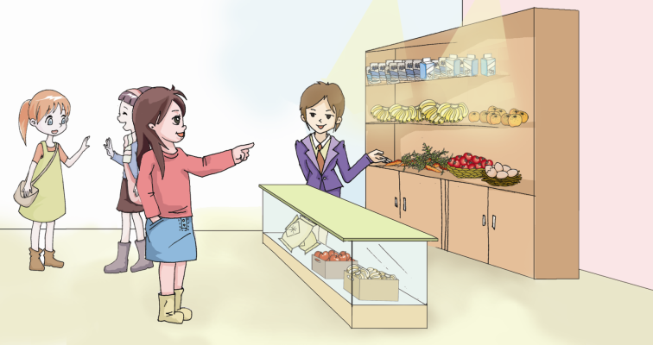
How much is it/are they?
How many /How much … do you want?
I want to buy …
Can I help you?
…

Slide 14
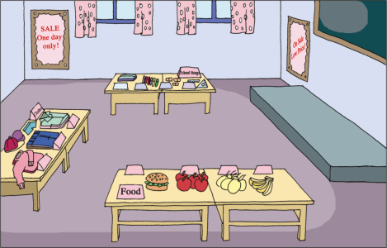
Project
Collect things to sell.
Make price tags.
Role-play the salespeople and customers.

Slide 15
Sum Up
What do you think of …?
=How do you like …?
Why not try on that pair?
How/What about the blue one?
Thank you. / Thanks all the same.

Slide 16
Homework
Help your mother do some
shopping this weekend.
Preview Topic 2.

